Slide 1

In a dead silent class of people taking tests
My stomach demonstrates whales sounds

Slide 2
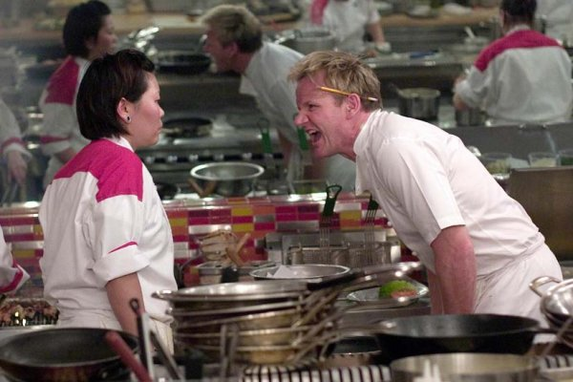
Did you seriously just ask your teacher if spelling matters?

Slide 3

Yes
I rearranged your desks after school yesterday

Slide 4
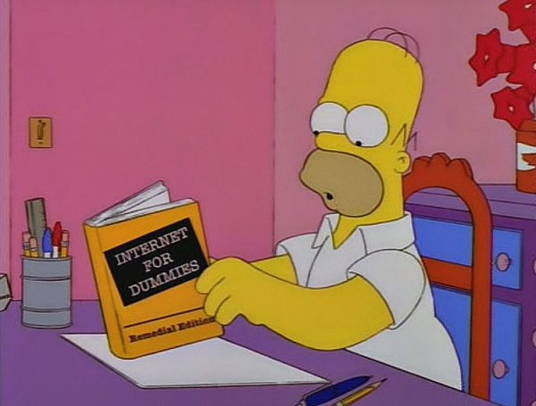
You will read for twenty minutes a day or I will tell the librarians. Got it?

Slide 5
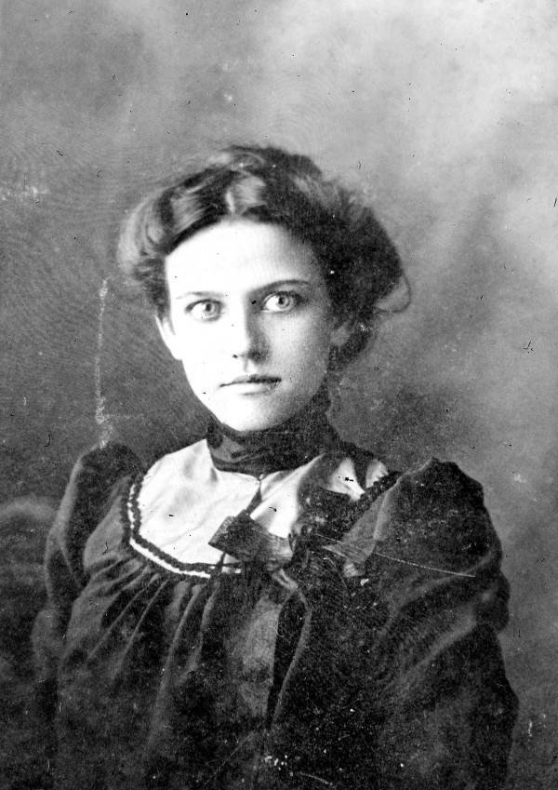
You just came in from recess and now you ask to go to the bathroom?

Slide 6
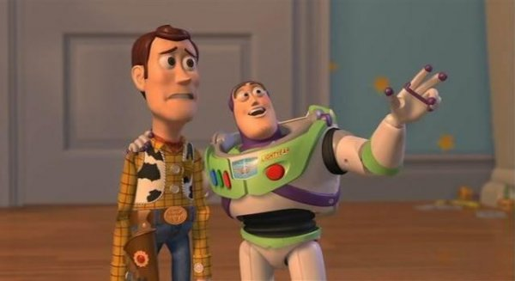
It’s going to be a lot of work
But we are in this together

Slide 7
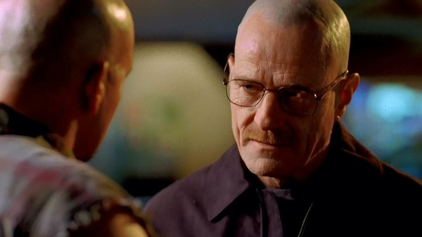
Are you bleeding or dying
No? Ok sit down

Slide 8
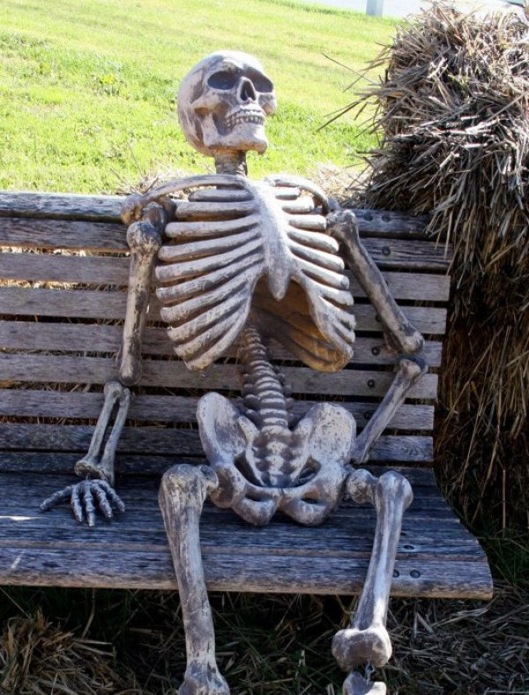
Teacher’s be like
“I’m just gonna wait until it’s quiet…”

Slide 9
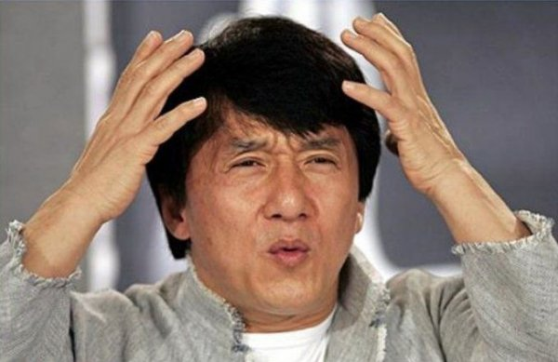
If I see one more kid flipping a bottle

Slide 10
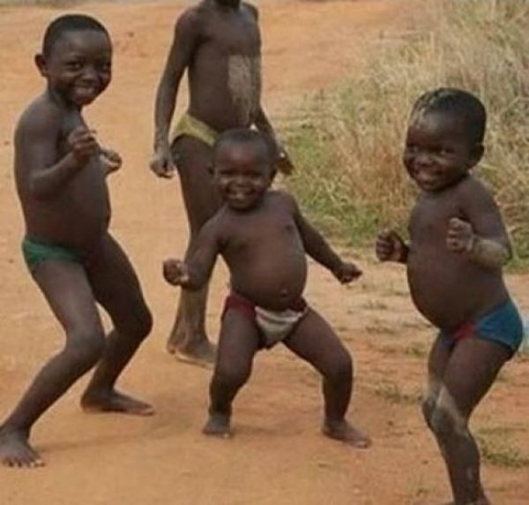
Started our final project
Just wrote the title

Slide 11
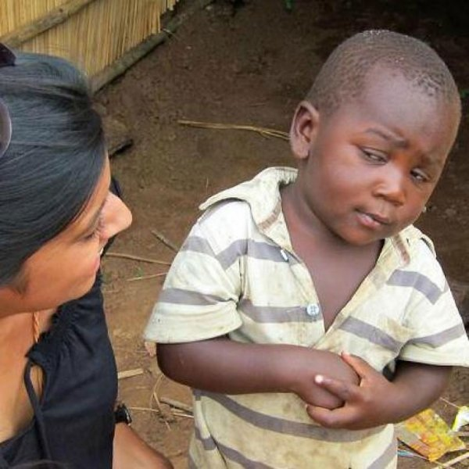
You mean to tell me the daily agenda has been written on the board all year?

Slide 12
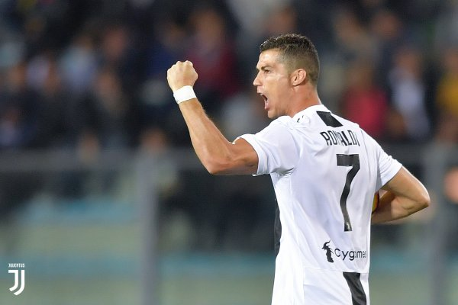
Finished my homework before the due date

Slide 13
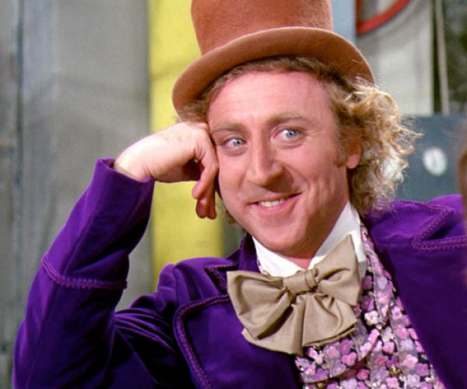
Why are you packing already.
There’s still 25 seconds left of class.

Slide 14
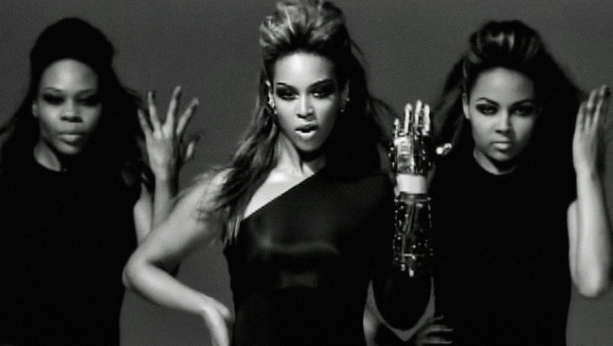
If you want a grade
You better put your name on it!

Slide 15
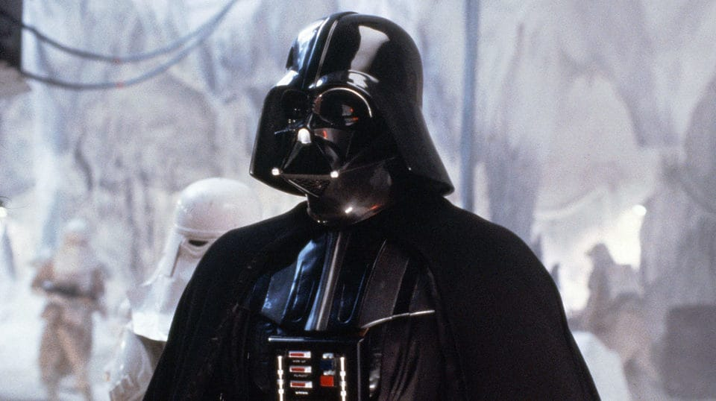
Students!
I am your teacher

Slide 16
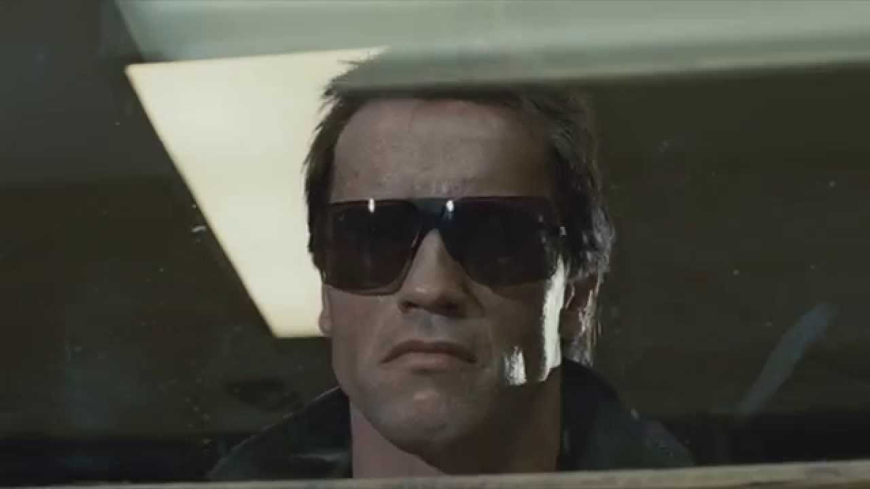
Eyes be on my back

