Slide 1
Creating and maintaining interest
Prof. Penny Ur

Slide 2
Motivation
Intrinsic
vs
Extrinsic

Slide 3
Intrinsic motivation
Dispositional
vs
Occurrent

Slide 4
Intrinsic, occurrent motivation
Depends on interest

Slide 5
What IS ‘interest’?
Very difficult to define:
By results? But even then, a combination
Interest in a task implies the following:
  attention is voluntary
  the learner is involved in doing the task
  there is enjoyment
Notes:
Note: in the context of language learning activities
My own definition

Slide 6
voluntary attention
interest
active task involvement
enjoyment
Notes:
active task involvement, no voluntary attention or enjoyment: e.g. doing grammar homework because you have to
voluntary attention, no active task involvement or enjoyment e.g. listening to an explanation
enjoyment, no active task involvement or voluntary attention – enjoying the music but not paying attention to the words
active task involvement + voluntary attention, no enjoyment: grammar exercise for homework because you want to
voluntary attention + enjoyment, no active task involvement: enjoying pictures, music, entertainment.

Slide 7
Vocabulary

Slide 8
Vocabulary (1)
afraid of touch competition
muscles dolphin
wind snow international
disabled twice
swim freezing therapy
connection lie down
Notes:
Aim: to practice these words in context of at least a sentence, to see how they combing with other words to convey meanings acceptably.

Slide 9
Give a grade of 0-5 (5= very interesting, 0= very boring)
1. Sentence with a word
2. Sentence with two words
3. False sentence
4. True sentence about me
5. Story

Slide 10
Ideas
Make a sentence from a word
Make a sentence from two words
Make a true sentence from a word
Make an obviously false sentence
Make up a story including them all

Slide 11
Why the rise in interest?
Challenge through using higher-order thinking skills:
convergent (logical, critical)
divergent (creative, ‘lateral’)

Slide 12
Convergent (critical) thinking
Examples:
connecting
prioritizing
classifying
identifying causality / lack of causality
evaluating truth/falsehood
identifying inclusion / exclusion
detecting contradictions or tautologies
identifying logical necessity

Slide 13
Divergent thinking
Creative thinking
associations
solutions to a problem
answers to a question
questions to an answer
Lateral thinking
thinking of unusual or original solutions to problems
looking at things from an unconventional angle
‘breaking rules’

Slide 14
Vocabulary (2)

Slide 15
Match
a. sure about something | 1. angry
b. scared that something bad is going to happen | 2. sad
c. not happy | 3. afraid
d. having a strong feeling against someone / something | 4. pleased
e. happy | 5. certain
Notes:
Do it.

Slide 16
Complete any three
I was angry because…
I was sad, but …
I was certain that …
I was afraid when …
I was pleased because …
Notes:
Read through, then choose three things you’ve felt recently, and complete the sentences. share in groups

Slide 17
Ideas
Match words with their definitions
Complete sentences about yourself …
Ur, 2012(b): 135-154

Slide 18

Why the rise in interest?
Higher-order thinking skills: logical relations (cause, result, time…)
Personalization
Specific and concrete rather than general and abstract
Open-ended
(Deeper thinking about the target items, and more ‘quantity’ of engagement with them)

Slide 19
Grammar

Slide 20
Have/has
Insert have / has
I ________ a dog.
Tamar ________ a new dress.
My mother ________ long hair.
We ________ six kids in this class.
He ________ a sister.

Slide 21
Detectives
Do you have the money?
No, I don’t have the money. He/she/ [name] has it.

Slide 22
Why the rise in interest?
Game-like
Meaningful, not just ‘correct’
Purposeful

Slide 23
Grammar (1): Present perfect
Make sentences using the present perfect
Lina can’t find her key. (lose)
Peter weighed 80 kilos before, now he weighs 60. (be on a diet)
Mark and Dana are delighted. (pass the test)
Becky won’t be playing today. (break her leg)
Sam will be late. (have an accident)
We aren’t going on holiday after all. (change plans)
Notes:
do scoring out of 5 before and after
Boredom because of low participation: IRF

Slide 24
Grammar (1) adaptation
What has happened?
Lina can’t find her key.
Peter weighed 80 kilos before, now he weighs 60.
Mark and Dana are delighted.
Becky won’t be playing today.
Sam will be late.
We aren’t going on holiday after all.
Notes:
Still IRF: but lower amount of teacher participation, higher student

Slide 25
Why the rise in interest?
Open-ended:
- creativity
- originality
- humour
More participation
More focus on real situations
Higher-order thinking skills: causality, justification

Slide 26
Oral fluency:
Make sentences about the picture

Slide 27
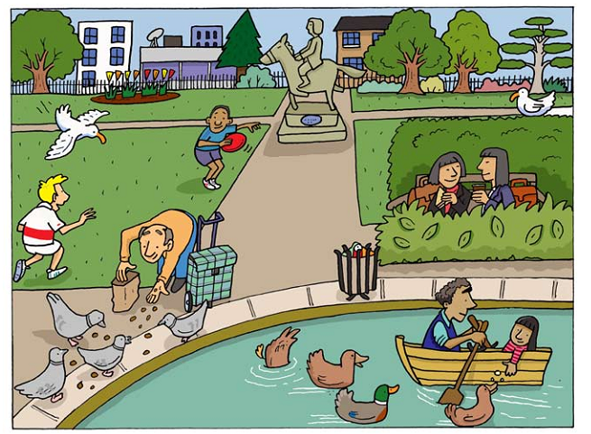
Notes:
First time: say some sentences with ‘there is’ or ‘there are’
Second picture: get up to 10 sentences
Back to this picture – you have one minute to say as many as you can.

Slide 28
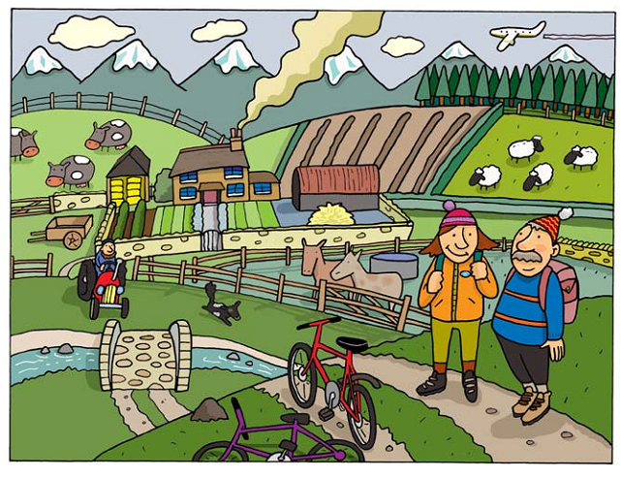

Slide 29
Ideas
Say sentences about the picture using the target feature
Achieve a set number of sentences (20? 30?)
Say as many sentences as you can in limited time (one minute/ two minutes)
Ur, P. (2009)
Notes:
Interest goes up each time: clear task

Slide 30
Why the rise in interest?
Task (clearly defined,achievable goal - outcome)
Game-like challenge
  task involving clear, achievable goal with tangible result
  constraints (rules)
Open-ended
Full participation
Success-orientation
Notes:
no particular

Slide 31
To summarize
Interest in doing a classroom activity can be identified in terms of its outcomes:
  voluntary attention
  enjoyment
  active involvement in doing the activity

Slide 32
Features that are conducive to interest 1: Activation
Activate students in some kind of (even minimal) production rather than just reception
Activate most class members simultaneously
Notes:
.. as far as possible

Slide 33
Features that are conducive to interest
2. Open-endedness
Invite a large number of ‘right’ responses
Encourage original, unusual responses
Be willing to mutilate the textbook

Slide 34
Features that are conducive to interest
3. Tasks
Provide for a clear outcome as the task goal
Make sure this goal is obviously easily achievable
Have a feedback stage at the end
Notes:
2. ‘success-orientation’

Slide 35
Features that are conducive to interest
4. HOTS
Minimalize LOTS (simple ‘recall-based’) exercises: closed-ended matching, gapfills, multiple choice
Use tasks that get learners to use HOTS: think critically or creatively
  Ask them to connect, contrast, classify, criticize, prioritize, identify causes / results, invent, problem-solve, create…
Notes:
see handout for a longer list

Slide 36
Features that are conducive to interest
5. Personal relevance
Get students to apply the target items to themselves …
…or to the real world as they know it (experiences, true / false statements, cultural differences…)

Slide 37
Features that are conducive to interest
6. Success-orientation
Make sure that the students are likely to succeed (with an effort!) in doing the task
If it’s difficult, provide answers and explanations quickly: minimize frustration time.

Slide 38
Features that are conducive to interest
7. Game-like features
Transform into a game by adding an artificial constraint to a task (time limit, not allowed to look, competition, guessing)

Slide 39
References and further reading
Ur, P. (2009). Grammar practice activities. Cambridge: Cambridge University Press.
Ur, P. (2012a). A course in English language teaching. Cambridge: Cambridge University Press.
Ur, P. (2012b). Vocabulary activities. Cambridge: Cambridge University Press.
Wu, X. (2003). Intrinsic motivation and young language learners: the impact of the classroom environment. System, 31 (4), 501-7.

