Slide 1

Effective teaching in the heterogeneous classroom using the UDL framework
Notes:
NOTE:
To change the image on this slide, select the picture and delete it. Then click the Pictures icon in the placeholder to insert your own image.

Slide 2

What are your challenges?

Slide 3

How do you deal with these challenges?

Slide 4
The UDL Framework
Developed by the Center for Applied Special Technologies (CAST) in the late 1980s
The UDL framework “emphasizes a need for a flexible curriculum that recognizes the diversity of students and strives to be accessible to all learners.” (Hartman, 2015)

Slide 5
The UDL framework assists teachers in the development and implementation of curricula more suited to a heterogeneous class.
The guidelines were developed to reduce barriers and maximize learning opportunities for all learners.
Students participate in the lessons using different modes of
- representation,
action and expression
engagement (Ralabate, 2011)

Slide 6
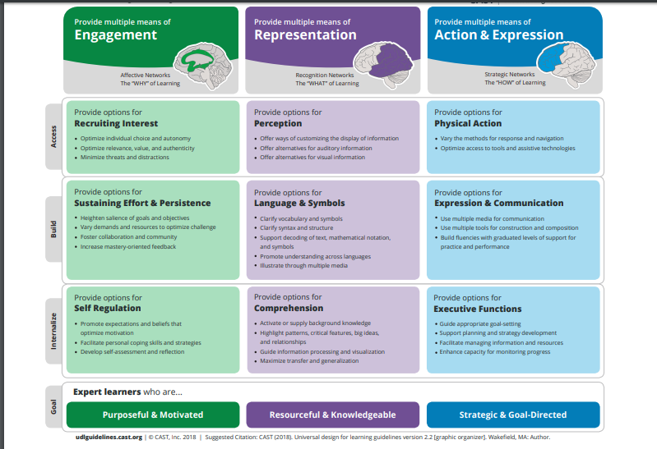

Slide 7
Stages
1. Know the students.
2. Decide on a single aim.
3. Consider the students’ barriers.
4. Refer to the guidelines and decide which ones to use to overcome the students’ barriers.
5. Prepare the lesson accordingly.

Slide 8

An Example…
Reading Comprehension

Slide 9
Around the World Magazine
March, 2018
Hi, my name is Gita. I'm eleven years old. I don't live in a city or a village like many other children. I live on a boat in the sea near India.
I don't walk or ride a bike to school because my school is on a boat too. My friends and I swim to school every morning. At school we build boats together with our teacher. We also learn how to catch fish.
Every afternoon I help my parents catch fish. I'm a very good swimmer and can swim under water for a long time. Sometimes I swim in very deep* water to catch big fish.
Tomorrow I'm going with my family to the city for the first time. I want to help my parents sell fish in the market. I'm excited to see the houses and shops there.
I hope we sell all the fish we have!

Slide 10
Barriers
Reading
Vocabulary
Understanding the questions
Writing the answers

Slide 11

Writing

Slide 12
