Slide 1
Workshop:
The Secrets of Reading in EFL
Janina Kahn-Horwitz (PhD)
Oranim College of Education

Slide 2
Outline
Components of a reading lesson.
Focus on phonemic awareness, orthographic (letter) patterns and vocabulary.
Planning across elementary school (implications for older students).
Novel sounds and letters.
Teaching a reading lesson.

Slide 3
Essential Ingredients for Successful Reading
Phonemic Awareness
Phonics
Fluency
Vocabulary
Reading Comprehension
National Reading Panel, 1997
August & Shanahan, 2006, NRP ELL

Slide 4
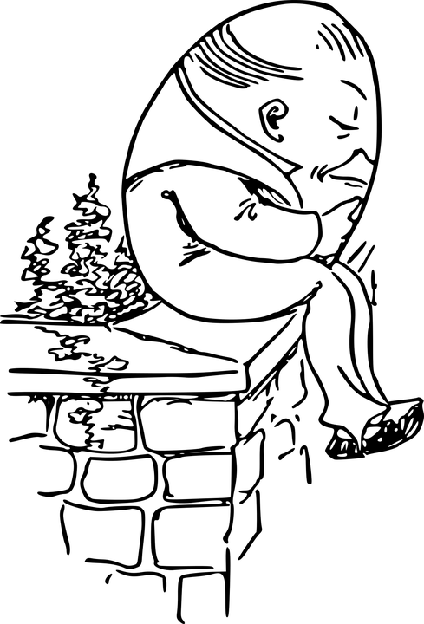
Phonological Awareness
phonemes
onset-rimes
syllables

Slide 5
The English writing system takes time to acquire so we need to teach systematically and explicitly
26 letters
44 sounds

Slide 6
Band 1 vocabulary:
Basics + Foundation Level
~950 lexical items
~160 conversational phrases and collocations

Slide 7
In order to read and write English you need to know:
consonant le 2%
ar, or, er, ir, ur, 12%
5 long vowel sounds 10%
5 short vowel sounds 43%
sounds of the
letters of
the ‘abc’
split digraph 9%
vowel teams 21%

Slide 8
In order to read and write English you need to know:
consonant sounds ‘abc’
+ ‘ch’, ‘sh’, ‘th’, ‘ph’:
1. fun, lunch
2. six, think
3. class, chat
4. slept
5. stop, shop
6. animal
Some are more frequent: s, r, t, b, d, p
Some have more than one sound: c in ‘cat’ versus ‘pencil’, ‘nice’, ‘bicycle’; g in ‘bag’
versus ‘magic’
‘page’.

Slide 9
In order to read and write English you need to know:
5 short vowel sounds:
1. man, fantastic
2. red, seven
3. sit, swimming
4. hot, laptop
5. sun, hundred
Very useful to teach:
43% of the syllables in the frequent words we want children to know by the end of elementary school.

Slide 10
In order to read and write English you need to know:
vowel teams:
1. sleep, green
2. food, book
3. rain, email
4. say, day
5. eat, teach
6. out, house
21% of the syllables in the frequent words we want children to know by the end of elementary school.

Slide 11
In order to read and write English you need to know:
vowel ‘r’:
1. car, start
2. her, sister
3. first, birthday
4. sport, story
5. church, turn
12% of the syllables in the frequent words we want children to know by the end of elementary school.

Slide 12
In order to read and write English you need to know:
5 long vowel sounds:
1. paper
2. he
3. I
4. no
5. music
10% of the syllables in the frequent words we want children to know by the end of elementary school.

Slide 13
In order to read and write English you need to know:
silent or magic ‘e’:
1. game, save
2. here, evening
3. smile, time
4. home, note
5. Druze, June
9% of the syllables in the frequent words we want children to know by the end of elementary school.

Slide 14
In order to read and write English you need to know:
consonant le:
1. table
2. little, bottle
3. example
4. people
5. bicycle
2% of the syllables in the frequent words we want children to know by the end of elementary school.

Slide 15
Goal: Our children need to be reading and writing by fifth grade
6th grade:
24 * 4 = 96 lessons
5th grade:
32 * 4 = 128 lessons
3rd grade:
32 * 2 = 64 lessons
4th grade:
32 * 4 = 128 lessons

Slide 16
A feasible plan for reading and writing acquisition
About 3-7 new vocabulary items or conversational items per week (depending on the memory capacity of the learners)
1-2 letters/letter patterns per week: ~1 per lesson

Slide 17
What about letters or sounds that don’t exist in a child’s repertoire?
Short versus long vowel sounds for Hebrew L1 speakers or the short /a/?
/p/ for Arabic L1 speakers
Voiced and voiceless <th> for Hebrew L1 and Russian L1 speakers
Vowel digraphs for all
Magic ‘e’ for all

Slide 18
Essential Ingredients for an EFL reading/writing lesson
Teach letter-sound correspondence
Teach sound-letter correspondence
Phonological awareness: Blend sounds to make words/ break words into individual sounds
Read frequent vocabulary words made up of previously learned letters.
Write frequent vocabulary words made up of previously learned letters.
Read (and write) a text made up of words.

Slide 19
Demonstration of a reading lesson - beginner level
Background:
The class has already learned the following phoneme-grapheme correspondences:
s, a, m
The class learned “I” as a sight word.
Today, I will illustrate teaching “t”

Slide 20
Review previously taught graphemes:
s
a
m
Dictate words + a sentence:
am
Sam
I am Sam.
Read words:
am
Sam

Slide 21
Brainstorm words that the class knows with “t”
Choose a key word and introduce the letter:
t
telephone
television
twenty
teacher
table
tree
ten

Slide 22
Form the grapheme “t” in a multi sensory manner
visual
auditory
kinesthetic
tactile
* trace on the table with fingers, in the air, create letter with your bodies, stickers, play dough, writing with pencils

Slide 23
Write a big “t” in personal notebooks. At the back of the “t” page, draw a picture of the key word. Label the picture.
Give out handouts with “t” printed. Pupils should practice forming the “t” correctly. Whilst writing the “t”, they should pronounce the phoneme “t”.

Slide 24
Letter matrixes with s, a, m, t
(cards)
Read words with the above letters am, at, mat, sat, Sam
Spell words with the above letters.
Read a story with the above letters.
Teach “on” as a sight word.

Slide 25
Word Reading am at mat sat
Sam

Slide 26
Story Reading: Mat (see book)
Mat.
Mat sat.
Sam.
Sam sat.
Mat sat. Sam sat.
Mat sat on Sam.
Sam sat on Mat.
Mat sat. Sam sat.
The End.
Bob Books

Slide 27
Summary
Review new letter.
What is this letter? What is your key word?
Trace the letter. Pronounce the letter.
Homework: Read words with the new letter. Read story with new letter. Fill in missing words in a “cloze” format sentence.

Slide 28
What about JHS students who do not recognize letter patterns?
Mini-lessons of 10-15 minutes integrated into your lessons.

Slide 29
Demonstration of a reading lesson – advanced level
Background:
In a 7th grade class it becomes clear that a large percentage of children do not automatically identify many of the more advanced letter patterns.
One of these is the “ou” (as in ‘out’, ‘house’)

Slide 30
Brainstorm words that the class knows with “ou”
Choose a key word and introduce the vowel team:
ou
out
mouse
house
found

Slide 31
Work on the “ou” in a multi sensory manner
visual
auditory
kinesthetic
tactile
* trace on the table with fingers, in the air, writing with pencils

Slide 32
Write “ou” in personal notebooks. At the back of the “ou” page, draw a picture of the key word. Label the picture.
Practice forming the “ou” correctly. Whilst writing the “ou”, pupils should pronounce the “ou”.

Slide 33
Letter matrixes with ou - notebook
Read words with the above letters sound, house, loud, outside, count, mouth, shout, about, round, without, our, out, thousand.
Teach hour & flour.
Spell words with the above letters. mouth, south, cloud, pound, house.
Read a story with the above letters.
Write sentences with the words (house, mouse, out etc.)

Slide 34
Story Reading: e-mail to Helen (see Entry Point 2, p. 58)
Dear Helen,
Please come and visit us in our new house. I want you to see my room. I am very proud of it. I found a red couch and a round rug at the Flea Market. I found cool posters, too.
Best of all, I can now tell my sister, “Go out and shut the door!”
I am on cloud nine!
Love,
Jane

Slide 35
Teach new words with “ou”
Eilat is in the south of Israel.
south
south
ground
דרום

Slide 36
Summary
Review ‘ou’.
What is your key word?
Trace ‘ou’. Pronounce it.
Homework: Read words and story including the ‘ou’. Write sentences with words containing ‘ou’.

Slide 37
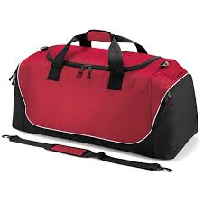
What might we include in a kit bag to facilitate EFL literacy acquisition?
Phonemic awareness (including novel sounds)
Structured and explicit instruction of the letters, letter patterns.
“Marriage” of the letter conventions (orthography) and vocabulary.
Create a “party” for novel sounds.
Facilitate learning and teaching in a measured manner. Set goals for the group/class and gradually reach them.

Slide 38

Thank you for participating!
janina_k@oranim.ac.il

