Slide 1
Teaching small groups English online
Penny Ur
2020

Slide 2
Online versus face to face learning

Slide 3
‘Hope, hype and disappointment’
The story of online teaching/ learning
Both internationally and at home
What can online teaching realistically provide?
What can it not provide?
How can we best use it?

Slide 4
All things being equal…
Online lessons are normally less effective than f2f for most students:
Less learning
Less interest

Slide 5
BUT: Assuming that we have limited/no f2f lessons and need to teach online ….
… How can we make it optimally effective?
Two issues:
Motivation and Attention
Interactivity

Slide 6
Motivation and Attention

Slide 7
Learners are less motivated to attend to online sessions
The screen does not draw attention like a real person.
The environment outside the screen is distracting.
The student is alone.

Slide 8
Hence
Higher dropout from online courses
Higher failure rate
More absentees from individual lessons
Possibility of walking out in the middle

Slide 9
Some things that can help:
Shorter sessions
More variety
Use of multi-media
More interaction
Use of motivating activities

Slide 10
Shorter sessions
So probably:
Not more than 30 minutes for school-age students.

Slide 11
Variation
Always good to vary
But even more important for online lessons:
Make sure you do at least 3 different types of activity during a lesson:
Reading/ listening/speaking/ writing
Question-answer interaction
Brainstorming
Different online and offline ‘tools’

Slide 12
Multi-media 1
Use the possibilities of ‘screen-sharing’ and ‘whiteboard’:
Exercises
Explanations
Language samples
Texts: display (parts, all, highlighted etc.)
Audio: podcasts, songs etc.
Video: movies, clips, YouTube

Slide 13
Multi-media 2
Use also conventional, non-digital, media:
Pencil and paper
The textbook

Slide 14
Interactivity

Slide 15
The best learning takes place through direct teacher/learner interaction
‘Mediation’
Learning from text or independent practice can occur, but
limited to certain types of learning
highly dependent on learner discipline and motivation

Slide 16
1. Importance of synchronous sessions
‘Asynchronous lessons’ are not lessons at all.
They are homework.

Slide 17
2. The chat box
Make sure they turn it on (AltH)
Encourage them to write in it
Keep an eye on it

Slide 18
3. Turn on microphones
To enable spontaneous and fast responses
‘Overlap’? Noise?
But worth it for the quality and quantity of the interaction

Slide 19
4. Turn on cameras
Make it compulsory for attendance!
(It is NOT illegal to require this*)
Much easier to relate if you see each other.
Use of ‘waving’ rather than ‘raise hand’ icon
*unless you are recording, when you’d need their permission

Slide 20
5. Use breakout rooms
Surprisingly easy to set up and close
For pair work:
For sharing answers to exercises or quizzes
For checking homework
For talking practice

Slide 21
5. Use polling*
For opinion surveys
But also for multiple choice or yes/no exercises
And feedback
*Not available with free version of Zoom

Slide 22
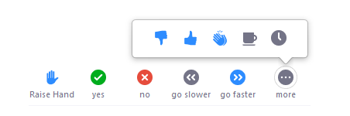
6. Use non-verbal yes/no feedback
Ask them to click on the appropriate response by their name in the ‘participants’ list (AltU)

Slide 23
Nonverbal feedback can be used to answer ‘yes/no’ questions
class management (e.g. can you hear me ok?)
language (e.g. is this right or wrong?)
comprehension (e.g. true/false comprehension questions on text)
content (e.g. agree/disagree with a statement, vote on a debate motion)
You can see who said what in your participants’ list

Slide 24
7. Enable students to write in answers online
Share screen with the exercise
Invite student(s) to respond using ‘annotate’.
‘View options’ → ‘Annotate’ →

Slide 26
Matching Exercise
B. Match
A B
I eat a ball
I read a book
I look at a chair
I sit on chocolate
I throw a picture

Slide 28
Gapfill exercise
Practise the adverbs: bravely, happily, loudly, politely, quietly, sadly
1. Well, at last we’re in England,’ she said...
2. ‘What are you doing here?’ he shouted ...
3. ‘We couldn’t get tickets for the play, unfortunately,’ sobbed the girls...
4. ‘I hurt myself, but you mustn’t worry,’ he declared ...
5. ‘Please be quiet, Jane is sleeping,’ she told us ...
6. ‘Can I help you?’ she asked

Slide 29
Practical tips 1: (Advance) Settings

Slide 30

1. Waiting room: disable
Enable only if you know there are likely to be unwelcome ‘invaders’.
Otherwise: no reason to have students waiting around:
Irritating, even humiliating, for students
Unnecessary hassle for you.

Slide 31

2.Host video, Participant video: enable
Can always turn off the camera later if necessary…
… Or ask participants to do so.
But seeing people is good!

Slide 32
3. Join before host: enable
Again: no reason why not
They don’t need to hang around

Slide 33
4. Mute participants on entry: disable
(unless a large audience)
You can always ask them to mute themselves if you need to.
In general, you want to enable them to speak.

Slide 34
5. Chat: enable
So that everyone can write in the chat box,
And everyone can see.

Slide 35
6. Polling: enable
You might not use polls every lesson, but have them available.

Slide 36
7. Who can share?
Enable all participants
Not every session, but should you want a participant to show something, need to have it possible.

Slide 37
8. Annotation
Allow host and participants to use annotation tools to add information to shared screens

Slide 38
9. Non-verbal feedback: enable
In the ‘Participants’ box

Slide 39
10. Breakout room: enable
Might not use every time, but …
You can enable host to assign participants to rooms in advance.

Slide 40
Practical Tips 2: Miscellaneous

Slide 41
1. Individual work: Leave the instructions on the screen
If you ask them to do an exercise on their own
Leave the instructions (including how much time they have) and essential texts/pics on the screen while they are working.

Slide 42
2. Have the (paper) textbook ready
Tell students to have the textbook ready.
Tell them which page(s)s we’ll be using

Slide 43
3. Pencil and paper
Tell students to have a pencil and piece of paper or notebook ready at hand.

Slide 44
Practical tips 3: Sample activities

Slide 45
1. Brainstorming into the chat box during the lesson
Any ‘open-ended’ task with short answers:
Get them to respond into the chat box.

Slide 46
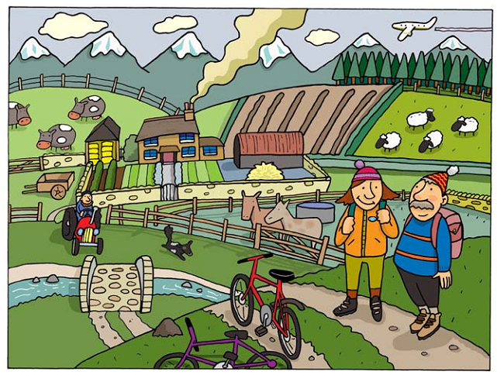
Write things about this picture

Slide 47
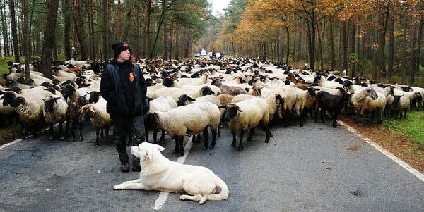
‘What’s going on’
https://www.nytimes.com/column/learning-whats-going-on-in-this-picture

Slide 48
Or:
Any brainstorming challenge e.g.
How many foods (animals, capital cities, English girls’ names…), can you think of?
What is your favorite (color, food, animal, school subject)?
What can you do with a pen (a teaspoon, a towel…)?

Slide 49
Or: Grammar, Vocabulary
What questions can you think of to which the true answer would be ‘No, I can’t.’ (Yes, I did / In the street / No, I never have)
Compare a lemon with a mango, using sentences with comparative adjectives.
How many words can you remember that we learned over the last week?
What adjectives can you think of that might describe a baby?

Slide 50
Talking practice: all together
Elementary:
Brainstorming (e.g. things you can do, things you can’t do; say things about a picture)
Guessing games (based on a hint? a fragment of a picture?)

Slide 51


Slide 52
Talking practice: all together
Elementary:
Brainstorming (e.g. things you can do, things you can’t do; say things about a picture)
Guessing games (based on a hint? a fragment of a picture?)
More advanced:
Discuss if you agree or disagree with a statement (or more than one)
Suggest what your ideas about a character based on a picture (age, name, nationality, job, interests, family…)

Slide 53


Slide 54
Talking practice: all together
Elementary:
Brainstorming (e.g. things you can do, things you can’t do; say things about a picture)
Guessing games (based on a hint? a fragment of a picture?)
More advanced:
Discuss if you agree or disagree with a statement (or more than one)
Suggest what your ideas about a character based on a picture (age, name, nationality, job, interests, family…)

Slide 55
Talking practice: in pairs in breakout rooms
Get to know each other
Find things in common
Exchange views on …
Suggest solutions to a given problem or dilemma
Discuss in what order of priority you’d put a list of items (qualities of a teacher, healthy foods, dangerous sports)

Slide 56
Put these sports in order of how dangerous they are
horse-riding
football
boxing
scuba diving
rock-climbing

Slide 57
3. On-screen reading text: first encounter
When introducing a new text.
Display the text on the screen.
Read it aloud while your students follow, using the cursor to keep them on track.

Slide 58
4. Listening
(Best if you improvise, don’t read something aloud)
Tell a story, backed up by pictures or cartoon strip
‘Bring me…’
‘Simon says’
True false statements (thumbs up/down)
Define something, they raise hands if they know what it is.

Slide 59
5. Spelling practice: Recall and share
friend because bicycle
receive business
existence necessary
parallel separate success

Slide 61
friend because bicycle
receive business
existence necessary
parallel separate success

Slide 62
Recalling
Display a set of 10-15 items on the screen.
Tell students not to write them down, but just try to remember them.
Hide them (stop sharing, or have a blank screen ready)
Tell students to write them down on a piece of paper.
After a couple of minutes …
Display them.
Ask them which items they forgot.

Slide 63
Thank you for your attention and participation!
pennyur@gmail.com

