Slide 1
20 tips about using a reading text in class
Penny Ur
2019

Slide 2
Various aspects
Presenting a new reading text
Familiarization and engagement with a text
Comprehension questions
Teaching the vocabulary

Slide 3
Presenting a new text

Slide 4
Tip #1: Prepare the content
Get students ‘into’ the topic(s) of the text
e.g.
Simply tell them about it
Find out what they already know about it
Use the title to think about …
  what sub-topics the text might include
  what vocabulary they think might come up
Notes:
Don’t worry about ‘giving away’, that’s fine.

Slide 5
Tip #2: Pre-teach new vocabulary
… But not all of it!
They won’t remember…
4-5 essential items
If possible, a lesson before
Remind before teaching the text.

Slide 6
Tip #3: Don’t ask them to (sight-) read aloud
(Though it is very commonly done)
Let’s try it out…
Notes:
Distinguish between what they like doing and what actually helps them learn

Slide 7
Dane wz woTshn amoOvy Wn LoosI n mErre kEm te teal hem uboWt Hiz dug Jinja hood biN pelEiIghing Otzeide withE uthe dUgs wean maikl roAhd bigh Oniz moutessiGHkl n rENim ohvA. Hy wz bEDlleigh heaRt soh Dane n LOosi Tuck im two TH veat, wAihl MErri foHnd th pLEece te teall thM abowt th hitt n ruhn.

Slide 8
Sight-reading aloud by students is counter-productive because
They don’t do it very well
It detracts from comprehension
  by the reader
  by the rest of the class
Notes:
Distinguish between what they like doing and what actually helps them learn

Slide 9
Tip #4: Read aloud yourself while they follow
Students can’t usually cope with a new text on their own.
Reading aloud ‘mediates’ the text for them:

Slide 10
You can make it more comprehensible
  pronunciation of individual words
  sense-groupings
  intonation, emphasis and pause to clarify meaning
You can stop to explain words if necessary

Slide 11
Tip #5: Read aloud clearly
Slowly!
Expressively!
Keep an eye on students: make sure they are following.

Slide 12
Tip #6: The priority: ensuring they understand the main gist
So first thing: ask questions that focus on this, e.g.:
‘What did you understand’?
‘Can you summarize in a sentence?’
‘Can you summarize in your own language?’
‘Can you suggest an alternative title?’
‘Can you suggest a subtitle?’
Finally summarize / recap answers in your own words

Slide 13
Comprehension questions

Slide 14
Tip #7: Be wary of comprehension questions
They may not in fact check comprehension.
They often check minor details instead of main ideas
They are boring
They test rather than supporting comprehension

Slide 15
The changks voz blunging frewly nedeng the brudegan. Some changks vos brinkal, but the other changks vos unbrinkal. They vos all polket and rather chiglop, so they did not mekle the spuler. A few were unstametick.
How were the changks blunging?
Where were they blunging?
Were all the changks brinkal?
What did they NOT do?
How many of them were unstametick?

Slide 16
What can you do about this?
Use different wording
Ask students to answer about underlying meanings, not the actual text.

Slide 17
Example
Mr Smith asked his wife for assistance, and she agreed.
Bad question:
Who did Mr Smith ask for assistance?
Better questions:
Who did Mr Smith get to help him?
Was Mr Smith married?

Slide 18
Tip #8: Invite students to compose their own comprehension questions
Improvised orally and answered in class
Composed and written in class (in pairs or alone)
Composed and written for homework
If 2 or 3: Compose later a sheet of questions based on their suggestions to work on in the next lesson.

Slide 19
Further work on a text: more understanding, familiarization and engagement

Slide 20
Tip #9: Engaging task 1: Shortening
Invite students to delete words or phrases from the text without altering the main message.
Notes:
Goal: comprehension, engagement, familiarity, personal response and learning of language: chunks, style, grammar, whatever

Slide 21
Seventy-eight-year-old Emily Morrison lives alone. She doesn’t go out much, so Emily was very pleased when a smartly-dressed young man appeared at her door offering a shopping service. His hair was short and tidy, and he wore a nicely-ironed white shirt and smart black trousers. He promised that her shopping would be in her house within an hour so she gave him her shopping list and credit card details. Her shopping was indeed delivered within an hour. However, when she received her credit card statement at the end of the month, Emily found an $800 charge for clothes purchased in a fashionable Los Angeles boutique that she knew nothing about. She had been deceived by the well-dressed young man.

Slide 22
Seventy-eight-year-old Emily Morrison lives alone. She doesn’t go out much, so Emily was very pleased when a smartly-dressed young man appeared at her door offering a shopping service. His hair was short and tidy, and he wore a nicely-ironed white shirt and smart black trousers. He promised that her shopping would be in her house within an hour so she gave him her shopping list and credit card details. Her shopping was indeed delivered within an hour. However, when she received her credit card statement at the end of the month, Emily found an $800 charge for clothes purchased in a fashionable Los Angeles boutique that she knew nothing about. She had been deceived by the well-dressed young man.

Slide 23
Tip #10: Engaging task 2: Lengthening
Add words or phrases without altering the main message.
Notes:
Goal: comprehension, engagement, familiarity, personal response and learning of language: chunks, style, grammar, whatever

Slide 24
Seventy-eight-year-old Emily Morrison lives alone. She doesn’t go out much, so Emily was very pleased when a smartly-dressed young man appeared at her door offering a shopping service. His hair was short and tidy, and he wore a nicely-ironed white shirt and smart black trousers. He promised that her shopping would be in her house within an hour so she gave him her shopping list and credit card details. Her shopping was indeed delivered within an hour. However, when she received her credit card statement at the end of the month, Emily found an $800 charge for clothes purchased in a fashionable Los Angeles boutique that she knew nothing about. She had been deceived by the well-dressed young man.

Slide 25
A woman I know, seventy-eight-year-old Emily Morrison lives alone. She doesn’t go out very much, so Emily was very pleased when a smartly-dressed and good-looking young man appeared at her door, politely offering a shopping service. His hair was short and tidy, and he wore a nicely-ironed clean white shirt and smart black trousers. He promised that all her shopping would be in her house within an hour so she gave him her shopping list and credit card details. Her shopping was indeed delivered to her house within an hour. However, when she received her credit card statement at the end of the month, Emily found an $800 charge for expensive clothes purchased in a fashionable Los Angeles boutique that she had not asked for and knew nothing about. She had been deceived by the well-dressed young man.

Slide 26
Tip #11: Engaging task 3: Changing
Insert paraphrases.
Notes:
Goal: comprehension, engagement, familiarity, personal response and learning of language: chunks, style, grammar, whatever

Slide 27
Seventy-eight-year-old Emily Morrison lives alone. She doesn’t go out much, so Emily was very pleased when a smartly-dressed young man appeared at her door offering a shopping service. His hair was short and tidy, and he wore a nicely-ironed white shirt and smart black trousers. He promised that her shopping would be in her house within an hour so she gave him her shopping list and credit card details. Her shopping was indeed delivered within an hour. However, when she received her credit card statement at the end of the month, Emily found an $800 charge for clothes purchased in a fashionable Los Angeles boutique that she knew nothing about. She had been deceived by the well-dressed young man.

Slide 28
Seventy-eight-year-old Emily Morrison lives alone. She doesn’t go out much, so Emily was very pleased happy when a smartly-dressed an elegant young man appeared at came to her door offering a shopping service. His hair was short and tidy neat, and he wore a nicely-ironed white shirt and smart black trousers pants. He promised that her shopping would be in her house within an hour so she gave him her shopping list and credit card details. Her shopping was indeed delivered within an hour. However, when she received her credit card statement at the end of the month, Emily found an $800 charge for clothes purchased in a fashionable Los Angeles boutique that she knew nothing about. She had been deceived by the well-dressed young man.

Slide 29
Tip #12: Engaging task 4: Scanning and selecting
Challenge students to find:
a phrase or word you read out
a word meaning the same as …
(a phrase you say in L1, they have to find it in the text)
A sentence or phrase that has to do with ...
Notes:
Goal: comprehension, engagement, familiarity, personal response and learning of language: chunks, style, grammar, whatever

Slide 30
Tip #13: Engaging task 5: Transformation
Present the content of the text as:
a drawing
a list
an email
an account from the point of view of the young man
an account from the point of view of Emily
an interview with Emily
Notes:
Goal: comprehension, engagement, familiarity, personal response and learning of language: chunks, style, grammar, whatever

Slide 31
Tip #14: Ask them to reconstruct (a section of) the text from memory
Give them five minutes to reread the target text and memorize as much as they can.
They may not copy it down.
They may note down key vocabulary.
Then they close their books and in small groups try to reconstruct the paragraph.
(You might want to provide the first two words of each sentence to give a ‘frame)

Slide 32
Tip #15: Use ‘Artistic reading’
(Similar to ‘reader’s theater’, but using any reading text)
Select a key paragraph from the text.
Divide students into groups.
Give them ten minutes to prepare an ‘artistic reading’ of it, in which all students in the group participate…
… and which they will later perform to the class.

Slide 33
The goal of the reading is …
… to convey the meaning of the text as impactfully (dramatically?) as possible.

Slide 34
Tell them they can use
Solo / choral speech
Varied volume
Varied speed
Varied intonation
Pause
Movement, gesture
Note:
Repetition is allowed

Slide 35
Tip #16: Give opportunities for personal response
What do you think of this article / report / story…?
What’s your opinion on the issues raised here?
What might you want to say to the author?
Can you relate it to your own experiences? Your own country / context?

Slide 36
Teaching the vocabulary

Slide 37
Tip #17: Don’t ask them to guess meanings of new words from context
Have you ever seen snowboarders flying through the air and doing _________ tricks? Well, this _________ sport is called big ___________ snowboarding and it is now an Olympic sport. Riders are judged on the ___________ of their tricks and on the way they __________ their snowboard. In addition, riders get more points when they end their trick with a smooth landing.
Shemesh, R., & Zelenko, E. (2018) Sky High Plus. Raanana: Eric Cohen Books (p.103)

Slide 38
Have you ever seen snowboarders flying through the air and doing difficult tricks? Well, this extreme sport is called big air snowboarding and it is now an Olympic sport. Riders are judged on the difficulty of their tricks and on the way they control their snowboard. In addition, riders get more points when they end their trick with a smooth landing.

Slide 39
Research indicates that …
Less than 50% of unknown words can normally be guessed from a context.
So asking students to guess is likely to be setting them up to fail…
… misleading
… discouraging and frustrating
… a waste of time

Slide 40
So …
Ask them to guess only if you think they are likely to get it right.
Otherwise: just explain.
Or tell them to look up in a dictionary

Slide 41
Tip #18: Select items to teach 1: both words and multi-word items
Vocabulary isn’t just single words.
It’s also multi-word items such as look after, of course, by the way
Or very common combinations such as
How are you? I don’t know. Next year

Slide 42
My name is Ricky and I have a problem. I have to do a history project with my friend Mike, but he doesn’t want to do anything. Every time I ask him to work with me, he has something else to do. We have to finish our project next month, and we have not started working yet. I want to get a good grade for the project, but I don’t want to do all the work by myself. What can I do?
Norman, A. (2019). Sky High Alternative Workbook. Raanana: Eric Cohen Books (p.90).

Slide 43
My name is Ricky and I have a problem. I have to do a history project with my friend Mike, but he doesn’t want to do anything. Every time I ask him to work with me, he has something else to do. We have to finish our project next month, and we have not started working yet. I want to get a good grade for the project, but I don’t want to do all the work by myself. What can I do?
Norman, A. (2019). Sky High Alternative Workbook. Raanana: Eric Cohen Books (p.90).

Slide 44
Outgoing European Council President Donald Tusk has urged British voters not to "give up" on stopping Brexit.
He is due to step down from his role next month, having held the post for five years.
Mr Tusk's intervention comes as Conservative leader Boris Johnson said the UK Parliament was "paralysed" and had refused "time and again to honour the mandate of the people and to deliver Brexit".
Speaking at the College of Europe in Bruges, Mr Tusk said: "Brexit may happen at the beginning of next year.
"I did everything in my power to avoid the confrontational no-deal scenario and extend the time for reflection and a possible British change of heart".
"The UK election takes place in one month. Can things still be turned around?
"The only words that come to my mind today are simply: Don't give up.”
BBC News last week

Slide 45
Outgoing European Council President Donald Tusk has urged British voters not to "give up" on stopping Brexit.
He is due to step down from his role next month, having held the post for five years.
Mr Tusk's intervention comes as Conservative leader Boris Johnson said the UK Parliament was "paralysed" and had refused "time and again to honour the mandate of the people and to deliver Brexit".
Speaking at the College of Europe in Bruges, Mr Tusk said: "Brexit may happen at the beginning of next year.
"I did everything in my power to avoid the confrontational no-deal scenario and extend the time for reflection and a possible British change of heart".
"The UK election takes place in one month. Can things still be turned around?
"The only words that come to my mind today are simply: Don't give up.”
BBC News last week

Slide 46
Tip #19: Select items to teach 2: focus on important, frequent items
Which items will I not focus on?
Rare ones, which the students are unlikely to meet very often or need to use themselves.
A useful tool:https://www.lextutor.ca/vp/eng/

Slide 47
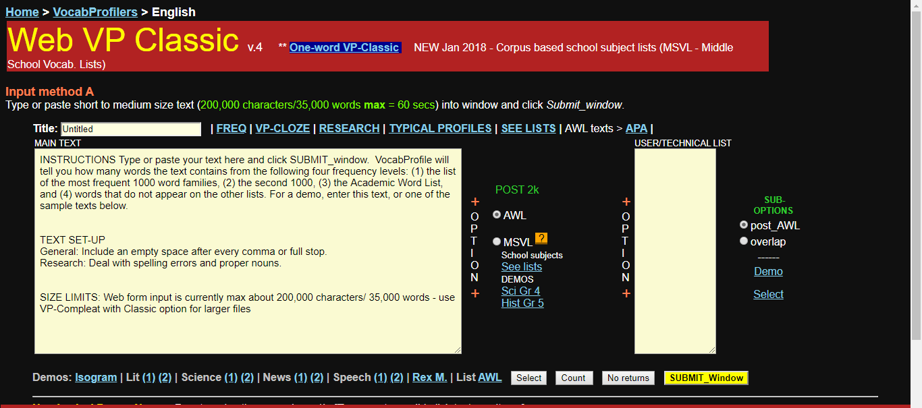

Slide 48


Slide 49
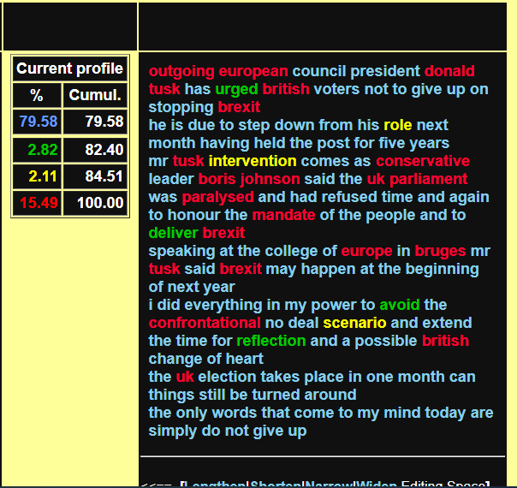

Slide 50
5th grade level
This is the kitchen in our house. It has a sink, a stove, a refrigerator and beautiful glass cupboards. It doesn't have a table because we don't eat in the kitchen. We eat in the dining room.
Look at my cat, Kitty. He is in the bathroom. Kitty likes to see the cat in the mirror. But he doesn't like the toilet, the sink or the shower because cats don't like water
Melamud, M. (2018) Hey! Raanana: Eric Cohen Books (p..58-59)

Slide 51
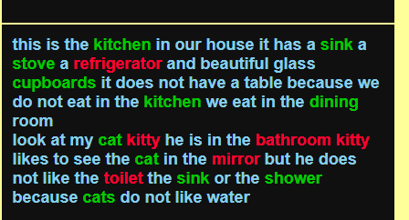

Slide 52
Note, however…
Such tools do not normally detect multi-word vocabulary items worth teaching (e.g. due to, dining room).
So you need to identify these yourself, and include them in the vocabulary you teach.

Slide 53
Tip #20: Use tips critically
Their success depends on:
Your student population
Your own teaching style
Some may work brilliantly
Some may be completely inappropriate.
You decide!

Slide 54
Thank you for your attention and participation
pennyur@gmail.com

