Slide 1

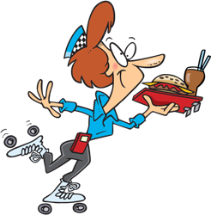
fast
food
by HERBER

Slide 2
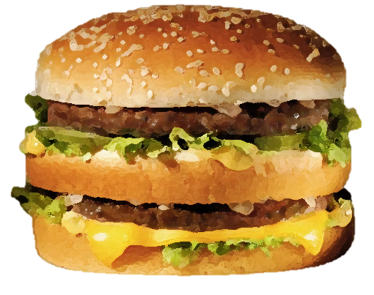
hamburger

Slide 3
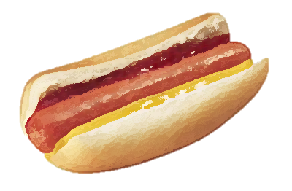
hot dog

Slide 4
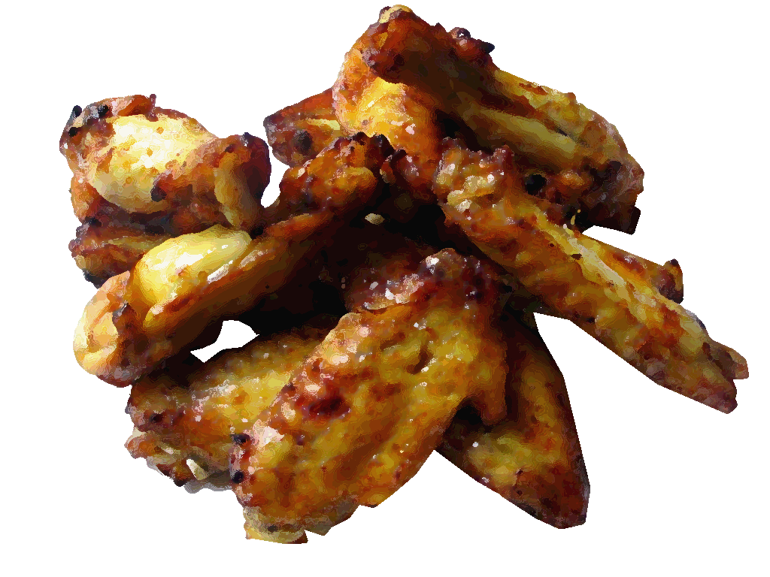
chicken wings

Slide 5
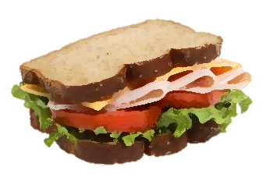
sandwich

Slide 6
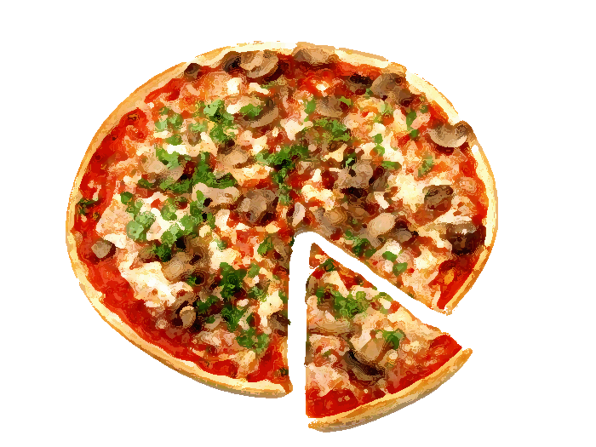
pizza

Slide 7
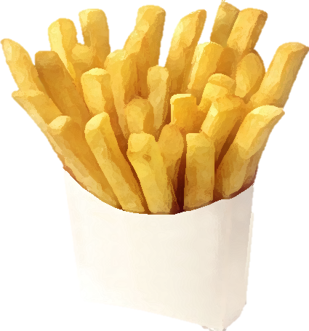
chips

Slide 8
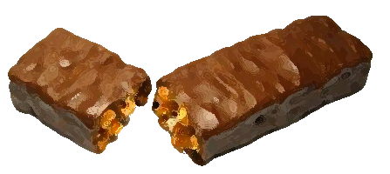
candy bar

Slide 9

ice cream

Slide 10



doughnut

Slide 11

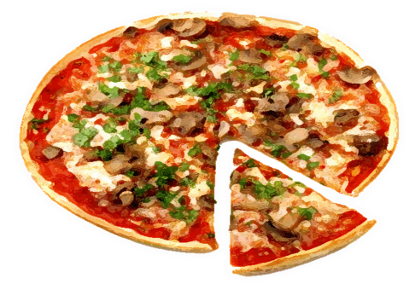
Try this …
pissa
piza
pizza

Slide 12

Try these …
cheese
chips
chicks

Slide 13
Try this …
doughnut
donut
dougnut

Slide 14
Try this …
hutdog
hot dog
hotdough

Slide 15
Try this …
hanburger
hamburger
hamburguer

Slide 16
Try this …
sanwich
sadwitch
sandwich

Slide 17
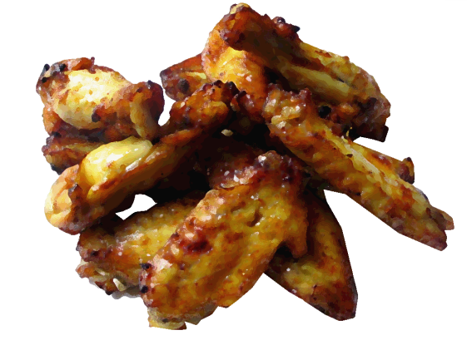
Try these …
chicken wings
chicken winds
chicken wins

Slide 18

Try this …
icecrem
ice cream
ice crim

Slide 19
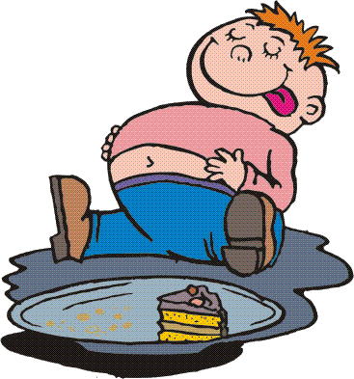
DELCIOUS!!

