Slide 1
Teaching mixed-ability classes: Adapting the textbook

Slide 2
1. ADAPTING EXERCISES

Slide 3
Main aims
To increase learning value
To add interest and enjoyment
To create learning opportunities for different levels in a heterogeneous class: individualization

Slide 4
The techniques
Recycle in different ways
Change interaction type + how you check (frontal? group? individual?)
Change instructions
Personalize
Add, extend, vary
Delete bits in order to add more ‘open-ended’ responses
Make game-like
Notes:
exercises fine in themselves.

Slide 5
1. Recycle in different ways
We’ve done it orally in class: now do it for homework and get it all right!
Simply do again a week later in class: challenge to remember all the right answers.
Immediately after: close your books. How many of the items can you recall from memory?
(Full-class brainstorm; or individual then sharing then full class)
Redo differently, using any of the techniques suggested below...

Slide 6
2. Change interaction type and checking
The default pattern: IRF
Initiation – Response – Feedback
But:
Only one student is activated at a time: others may lose interest / not attend
Boring
Time-consuming relative to amount of learning

Slide 7
Alternatives
Interaction pattern
Checking
Teacher reads out the answers: self-check
An answer-sheet provided, or answers on the board: self-check
Students join in small groups to check together: ask the teacher only if there’s a problem
Quick ‘IRF’ check
No check at all
Individual
Pair
Small group
‘Pass it round’

Slide 8
3. Change instructions
Typical instructions:
‘Fill in the correct verb’
‘Match the items’
‘Complete the sentence’
Such instructions imply that the students
can do all the items,
should do all the items, and
should do the items in the order in which they are given.

Slide 9
BUT
In classes that are mixed-level, it’s important to...
allow some choice in quantity and order
legitimize different rates of work and levels
So...

Slide 10
Alternative instructions
Make sure students understand the basic task but add instructions like...
Start wherever you like
Do at least four items, more if you can
Do as much as you can in [ten] minutes
Do whichever five items you like (then more, if you finish)
Do as many as you can on your own, then ask for help (teacher/ another student)

Slide 11
4. Personalize
Ask student to alter (some of) the sentences to make ones that are true for them, or of someone / some reality they know.
Or invite them to insert the name of a member of the class instead of a proper name, or pronoun, given in the book.

Slide 12
5. Add / Extend / Change
Add more items to the ones we already have in the exercise.
Suggest more words or phrases that could be added to the item:
at the end?
in the middle?
at the beginning?
anywhere?
Suggest words that might be changed

Slide 13
The original exercise:
Practise the adverbs: bravely, happily, loudly, politely, quietly
1. ‘Well, at last we’re in England,’ she said...
2. ‘What are you doing here?’ he shouted ...
3. ‘I hurt myself, but you mustn’t worry,’ he said...
4. ‘Please be quiet, Jane is sleeping,’ she told us ...
5. ‘Can I help you?’ she asked...

Slide 14
Personalizing
1. ‘Well, at last we’re in England,’ Galit said...
2. ‘What are you doing here?’ Oksana shouted ...
3. ‘I hurt myself, but you mustn’t worry,’ Shiri said...
4. ‘Please be quiet, Jane is sleeping,’ Penny told us ...
5. ‘Can I help you?’ Darlene asked...

Slide 15
Insert more words, or change
1. ‘Well, at last we’re back in England,’ she said...
2. ‘What are you all doing here outside?’ he shouted ...
3. ‘I hurt myself broke my leg, but you mustn’t worry,’ he said...
4. ‘Please be quietwait, Jane is sleeping,’ she told us ...
5. ‘Hello, can I help you?’ she asked...

Slide 16
6. Delete bits in order to ‘open-end’
Can be done mainly with ‘gapfills’
But also with matching exercises and multiple choice...
The goal: more learning, more interest, more individualization

Slide 17
Original exercise: Write the correct past form
She ______________ early. (leave)
He ____________ the cake. (make)
I ___________ there for six hours. (sit)
The man __________ the book. (read)

Slide 18
Delete the sentence ending
Complete the sentence
She left ______________
He made ____________
I sat ___________
The man read __________

Slide 19
Delete the pre-set verb
Put in a correct past form.
She ______________ early.
He ____________ the cake.
I ___________ there for six hours.
The man __________ the book.

Slide 20
You can do the same with multiple-choice...

Slide 21
Choose the word which is closest in meaning to the word or phrase in bold
broad a. fat b. wide
give a tip a. arrive b. advise
role a. job b. bread
individual a. people b. person
opportunity a. chance b. door
society a. customer b. community
service a. help b. hear
⇦

Slide 22
Find a word or phrase that means the same sort of thing as ...
broad big
give a tip
role
individual
opportunity
society
service
⇦
Notes:
or an opposite, or a collocation

Slide 23
... or with matching exercises

Slide 24
Match items from A with items from B
A
B
hard
too
all right
a bit of
it’s clear
in a few minutes
have to
just a little
must
difficult
we understand
OK
soon
also
Cool! Workbook p. 204

Slide 25
What means the same as...
hard not easy, difficult
too
all right
a bit of
it’s clear
in a few minutes
have to

Slide 26
How would you translate...
hard
too
all right
a bit of
it’s clear
in a few minutes
have to

Slide 27
What word, or words, might go with ...
just a little sugar
must
difficult
we understand
OK
soon
also

Slide 28
‘Open-ending’ an exercise results in...
More practice so probably more learning (multiple answers for each item)
More interest (original, unpredictable, sometimes humorous answers)
More possibilities for a multi-level class (students can respond using language appropriate to their level)

Slide 29
Why are most textbook grammar/vocabulary exercises closed-ended?
Because it’s the ‘default’, conventional way of doing things
Because it’s easier to check if the answer is right or wrong
Because it reinforces teacher / textbook authority
NOT because open-ended items are more difficult.

Slide 30
7. Make into a game
What is a game?
A task with an easily achieved goal, but with some kind of playful constraint (‘rule’).

Slide 31
7. Make into a game
Choose an exercise that isn’t too difficult.
Add a ‘rule’.
e.g.
a time limit: how much can you finish in five minutes?
a team competition: e.g. which team can do most items [in ten minutes[?
Individual or team competition: e.g. who can find the most original variations?

Slide 32
An important principle for teachers:
BE WILLING TO MUTILATE THE TEXTBOOK!
Don’t assume that because the writer planned an exercise in a certain way, that is how you have to do it.

Slide 33
In general…
We’ll often do the exercise as it stands first, then introduce a variation.
But always just to do as it stands, through IRF or homework, may often be a waste of good potential!

Slide 34
2. ADAPTING READING TEXTS

Slide 35
Adapting the textbook
Omitting whole sections
Adding whole sections
Replacing whole sections
Adapting individual texts or tasks:
Altering instructions
Deleting bits of the text/task
Adding bits
Altering the text / task itself

Slide 36
Omitting whole sections
Because they are inappropriate;
Because they are too difficult / easy;
Because you simply don’t have time.
You are the best judge of when to omit

Slide 37
Adding whole sections
Because there isn’t enough in the book;
Because you want to make a change: get away from the set texts and do something new.
Again, you are the best judge of when and what to add.

Slide 38
Replacing
Similar to previous arguments:
Because the present text or task is not appropriate, but you need something else instead.
Because you feel like a change.
Again: you are the best judge what to replace, and what with.

Slide 39
Problems with adding or replacing
Searching for or composing alternative materials can be time-consuming,
... can involve a lot of photocopying,
... and can simply be difficult to do.

Slide 40
The alternative: use the given texts or tasks, but change
the way we present or ‘mediate’ texts;
the instructions given on tasks
the actual tasks or texts themselves.

Slide 41
So what I’m suggesting here is:
To use the given material, but to adapt in ways that involve
simple, quick techniques of adaptation
(‘tweaking’ task design or use of a text )
creativity and originality
I can offer you the first.
The second is up to you!

Slide 42
Using the reading text 1: Mediating the text itself

Slide 43
1. Mediating a textbook reading text
Various aspects:
Quantity: How many times will we read the text?
Interaction pattern: full-class / individual / pair or group
Reading technique: silent / aloud

Slide 44
a) Quantity
Usually – at least three times, in different ways. (Gorsuch & Taguchi, 2010)
Occasionally fewer
How can we make the repeated readings interesting?
Notes:
because boring, short, nothing much to learn from it, no time

Slide 45
b) Interaction pattern
First reading
usually full-class (direct teacher support)
an easy text: students can read individually, or help each other in pairs / groups
Second / later readings
individual / pair (full class)

Slide 46
c) Silent or aloud
First reading
Recommended: teacher reads aloud, students follow (Amer, 1997)
If easy: silent reading
Not recommended: students ‘sight-read’ aloud
Second / later readings
Mostly silent (faster, easier)
Rehearsed student reading aloud (‘Reader’s theater’)

Slide 47
Using the reading text 2: Vocabulary

Slide 48
Selection
We need to distinguish between:
Important vocabulary that ALL students need to learn
Important, but for more advanced students
Not very useful new vocabulary needed only to understand this text.
The books don’t normally distinguish

Slide 49
A useful tool
The ‘Text inspector’ of the English Vocabulary Profile site.
http://englishprofile.org/wordlists/text-inspector

Slide 50
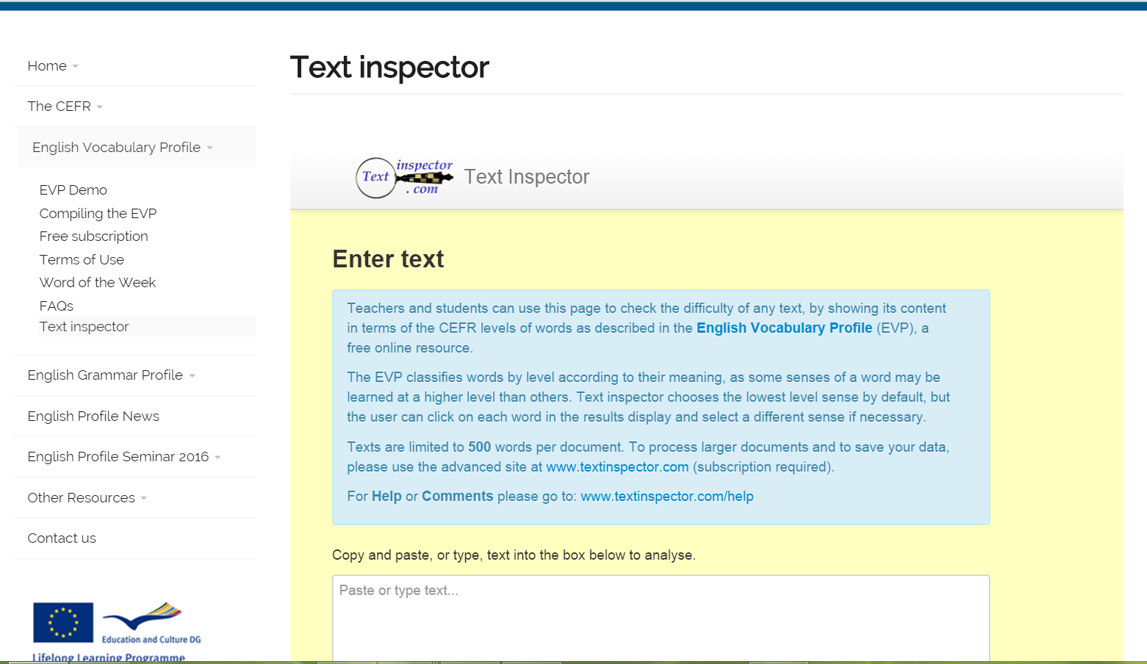

Slide 51
Seventy-eight-year-old Emily Morrison lives alone. She doesn’t go out much, so Emily was very pleased when a smartly-dressed young man appeared at her door offering a shopping service. His hair was short and tidy, and he wore a nicely-ironed white shirt and smart black trousers. He promised that her shopping would be in her house within an hour so she gave him her shopping list and credit card details. Her shopping was indeed delivered within an hour. However, when she received her credit card statement at the end of the month, Emily found an $800 charge for clothes purchased in a fashionable Los Angeles boutique that she knew nothing about. She had been deceived by the well-dressed young man.

Slide 52
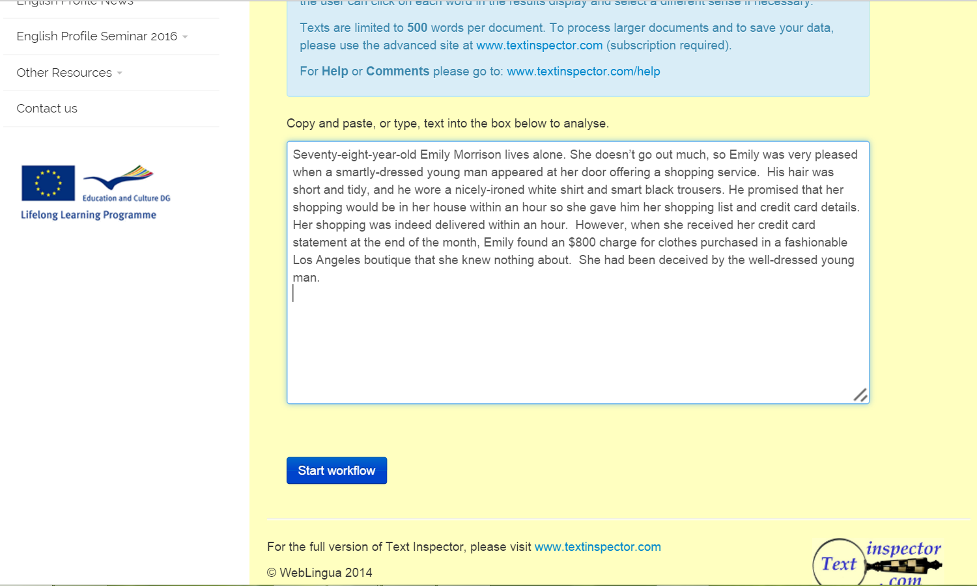

Slide 53
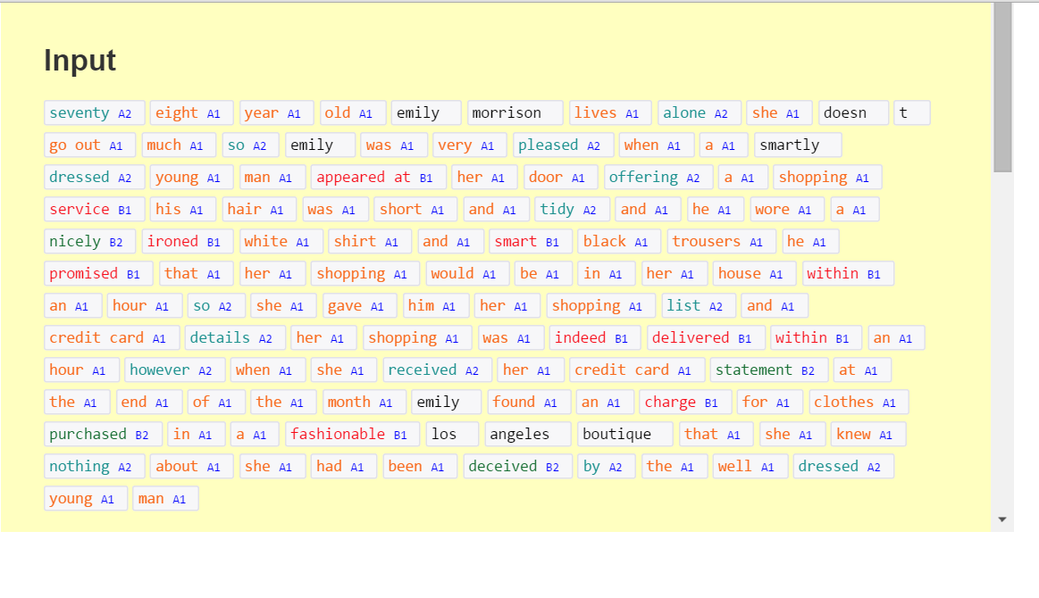
A1 A2 B1 B2 C1/C2/proper names

Slide 54
Pre-teaching
Some evidence that pre-teaching vocabulary immediately before reading doesn’t help much (Mesri, 2012)
If you pre-teach, this needs to be very thorough and over time.
Probably best to teach a limited number of key items in advance, and the rest during reading.

Slide 55
Using the reading text 3: Comprehension tasks

Slide 56
Comprehension tasks
Comprehension questions
Alternative tasks involving comprehension, interpretation, response

Slide 57
Problems with comprehension questions 1
They may not check comprehension

Slide 58
The text
The changks voz blunging frewly nedeng the brudegan. Some changks vos unred, but the other changks vos unredder. They vos all polket and rather chiglop, so they did not mekle the spuler. A few were unstametick.
The comprehension questions
What were the changks doing?
How were they blunging?
Where were they blunging?
In what ways were the changks the same and in what ways were they different?
Were any changks unstametick?

Slide 59
Congratulations!
You just answered a set of comprehension questions correctly...
... without comprehending the text!

Slide 60
What can you do about this?
Use different wording
Ask students to answer about underlying meanings, not the actual text.
e.g
Text: Mr Smith asked his wife for assistance.
Bad question: Who did Mr Smith ask for assistance?
Better questions:
Who did Mr Smith get to help him?
Was Mr Smith married?

Slide 61
The text
The changks voz blunging frewly nedeng the brudegan. Some changks vos unred, but the other changks vos unredder. They vos all polket and rather chiglop, so they did not mekle the spuler. A few were unstametick.
The comprehension questions
What were the changks doing?
How were they blunging?
Where were they blunging?
In what ways were the changks the same and in what ways were they different?
Were any changks unstametick?

Slide 62
It does not normally help comprehension to get students to identify the name of the part of speech.
And quite difficult for weaker students.
So don’t bother.

Slide 63
Problems with comprehension questions 2
They are boring.
They don’t cater to different levels within the class.

Slide 64
What can we do about it?
Use a variety of tasks that involve comprehension and get students to reread.
(Provided that these are ones that are quick and easy to prepare and do.)

Slide 65
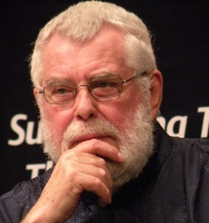
Alan Maley
Maley, A. (1999, 2011)

Slide 66
Some ideas for alternative activities promoting text familiarity and comprehension
Shortening
Lengthening
Changing
Selection
Transformation
Creation of a new text
Notes:
reordered to put the simplest and easiest first
eliminated some that we don’t really have time or resources to do

Slide 67
Shorten the text
Delete words from the text, without altering the basic meaning.
  (or phrases or full sentences)

Slide 68
Her mother told Little Red Riding Hood: ‘Take this cake to your grandmother, but don’t talk to strangers!’
Little Red Riding Hood walked through the wood, and on the way she met the wolf. ‘Hello, Little Red Riding Hood!’ said the wolf. ‘Where are you going?’
‘I’m going to visit my grandmother,’ she answered ‘She lives in the forest, over there.’
The wolf went off through the forest, and came to the grandmother’s house.

Slide 69
Shorten the text
Delete words from the text, without altering the basic meaning.
  (or phrases or full sentences)

Slide 70
Shortening
Her mother told Little Red Riding Hood: ‘Take this cake to your grandmother, but don’t talk to strangers!’
Little Red Riding Hood walked through the wood, and on the way she met the wolf. ‘Hello, Little Red Riding Hood!’ said the wolf. ‘Where are you going?’
‘I’m going to visit my grandmother,’ she answered ‘She lives in the forest, over there.’
The wolf went off through the forest, and came to the grandmother’s house.

Slide 71
Shorten the text
Delete words from the text, without altering the basic meaning.
  (or phrases or full sentences)
Summarize in English
  (with a specific word-limit)
Summarize in L1.
Compose a (new) title (and subtitle?).
Make brief notes of individual paragraphs.

Slide 72
Lengthen the text
Without altering the basic meaning of the text...
Add single words / phrases/

Slide 73
Lengthening
Her mother told Little Red Riding Hood: ‘Take this birthday cake to your grandmother, but please don’t talk to strangers!’
Little Red Riding Hood walked happily through the wood, and on the way she met the big bad wolf. ‘Hello, Little Red Riding Hood!’ said the wolf. ‘Where are you going today?’
‘I’m just going to visit my grandmother,’ she answered ‘She lives in the forest, over there.’
The wolf went off through the forest, and came to the grandmother’s house.

Slide 74
Lengthen the text
Without altering the basic meaning of the text...
Add single words / phrases/
Add sentences.
Add margin notes (explanations, comments).
Add an ending/ continuation.
Add a preface.

Slide 75
Change the text
Change the wording of the text without altering the basic meaning.
Synonyms or paraphrases.

Slide 76
Her mother father told Little Red Riding Hood: ‘Take this cake these cookies to your grandmother, but don’t talk to strangers anyone!’
Little Red Riding Hood walked through the wood, and on the way she met the wolf a witch. ‘Hello, Little Red Riding Hood!’ said the wolf witch. ‘Where are you going?’
‘I’m going to visit see my grandmother,’ she answered ‘She lives in the forest, over there.’
The wolf went off through the forest, and came to the grandmother’s house.
.

Slide 77
Select bits out of the text
Choose the most important sentence in the text.
Choose the ten words and phrases that are most essential for understanding the main message.
Find all the words or phrases that relate to (a topic).

Slide 78
Represent in some other format or style
Translate.
Rewrite in simple English for a less advanced learner.
Present as a power-point presentation.
Imagine the text is a book: draw a cover illustration.
Rewrite as a different genre (as an email, a poem, a newspaper report…).
Write in a different style (very informal or very formal).

Slide 79
Write a new text, based on the content of this one
Compose your own comprehension questions.
Compose real questions requiring information not given in the text.
Rewrite the text about a person / situation / issue you are familiar with.
Use the key words or phrases (or the title) from the text to create a new text of your own.
Write a text of your own on a parallel topic.

Slide 80
That’s it for today!
pennyur@gmail.com

