Slide 1
Reading Engagement Strategies Emphasizing Digital Aspects
HannyFuks

Slide 2
Reading Engagement Strategies - Emphasizing Digital Aspects - Hanny Fuks, M.A.
Learn Pre, While and Post-Reading while creating interactive digital activities, Talent Show and Mentoring Reading Club materials such as treasure hunt, and creative book reports as well as interactive video reading lessons. By the end of the seminar, you will be able to create your own interactive YouTube activity book, online activities for vocabulary acquisition, use video and audio tools for reading, and share activities on Padlet.
Notes:
Reading Engagement Strategies - Emphasizing Digital Aspects - Hanny Fuks, M.A.
Learn Pre, While and Post-Reading while creating interactive digital activities, Talent Show and Mentoring Reading Club materials such as treasure hunt, and creative book reports as well as interactive video reading lessons. By the end of the seminar, you will be able to create your own interactive YouTube activity book, online activities for vocabulary acquisition, use video and audio tools for reading, and share activities on Padlet.

Slide 3

Definition of Reading
Two of the most widely cited definitions of reading:
1. Reading is the process of constructing meaning from written texts.
2. Constructing meaning through:
The reader's existing knowledge
The information suggested by the text being read
The context of the reading situation
(Anderson et al., 1985)
(Wixson, Peters, Weber, & Roeber, 1987, citing the new definition of reading for Michigan).
Notes:
Reading is the process of constructing meaning from written texts. It is a complex skill requiring the coordination of a number of interrelated sources of information (Anderson et al., 1985).
2.Reading is the process of constructing meaning through the dynamic interaction among: (1) the reader's existing knowledge; (2) the information suggested by the text being read; and (3) the context of the reading situation (Wixson, Peters, Weber, & Roeber, 1987, citing the new definition of reading for Michigan).

Slide 4
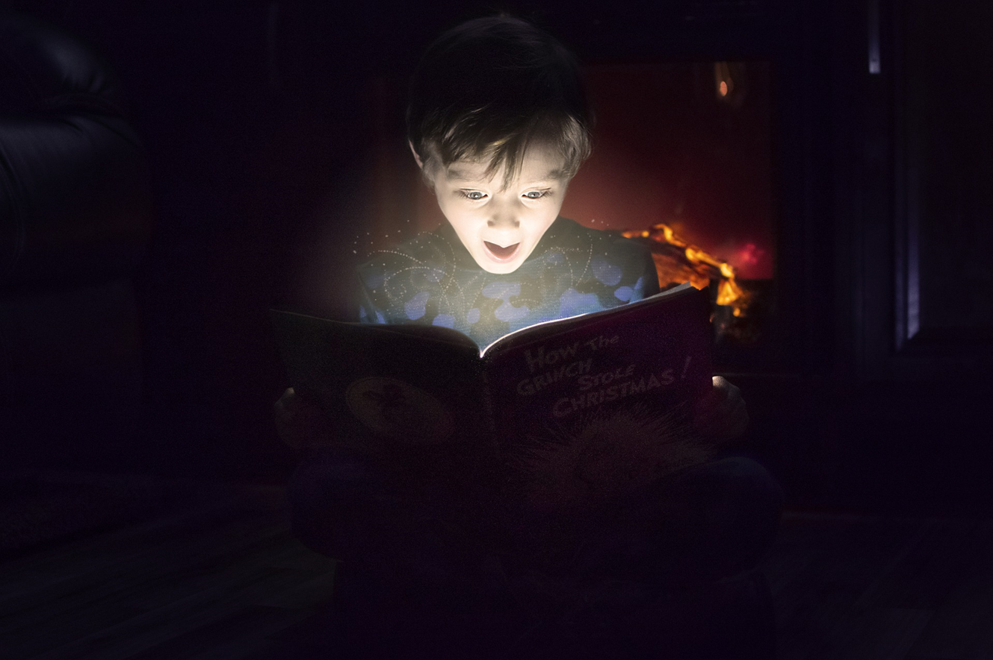
EXTENSIVE AND INTENSIVE READING
Notes:
EXTENSIVE AND INTENSIVE READING. ... The first difference is that Extensive Reading covers large area, while Intensive Reading covers narrower area. According to Graham Stanley, Extensive Reading involves students reading long texts or large quantities for general understanding, with the intention of enjoying the texts.

Slide 5

Announcing Reading in Class
Notes:
If telling my students "And now we're going to practise listening," elicits looks of dread and fear, announcing reading practice can often elicit yawns, heads descending to desks, or eyes ascending heavenwards.
And these reactions are from my adult students. My young learners' reactions may be even more extreme. "I can read at home, I come to lessons to speak!" more than one of my students has told me. Many students do seem to regard reading as a waste of class time but how many of these students will read outside class without encouragement inside? The aim of this article is to consider a few approaches to making classroom reading more communicative, by which I mean integrating it with other skills work, so that students can see its value.

Slide 6

Announcing Listening in Class
Notes:
If telling my students "And now we're going to practise listening," elicits looks of dread and fear, announcing reading practice can often elicit yawns, heads descending to desks, or eyes ascending heavenwards.
And these reactions are from my adult students. My young learners' reactions may be even more extreme. "I can read at home, I come to lessons to speak!" more than one of my students has told me. Many students do seem to regard reading as a waste of class time but how many of these students will read outside class without encouragement inside? The aim of this WORKSHOP is to consider a few approaches to making classroom reading more communicative, by which I mean integrating it with other skills work, so that students can see its value.

Slide 7
Can reading be communicative?
Strategies used for communicative reading
Pre-reading tasks
While-reading tasks
While-reading tasks leading into post-reading tasks
Post-reading tasks
Conclusion
Notes:
Can reading be communicative?
Communication suggests interaction of some sort, perhaps in many students' minds between speaker and listener. Is reading, therefore, since it is often a solitary activity, a non-communicative activity? Surely not since the reader is interacting with the writer, albeit in a less direct way than speaker and listener. Reading is, of course, just as communicative as any other form of language use and as teachers our aim is to bring out that communicative element. For example by establishing direct communication between reader and writer by exploiting students' written work for reading practice (see below for ideas). Another feature of real reading is that while we may read alone we communicate what we read to others constantly. Talking about what we have read is a rich source of classroom possibilities.

Slide 8
Reading Engagement Strategies
Interactive digital activities - Vocabulary
Talent Show
Mentoring Reading Club
Treasure hunt
Creative book reports – Digital and Non-digital
Interactive video reading lessons
Activities on Padlet
Notes:
Learn Pre, While and Post-Reading while creating interactive digital activities, Talent Show and Mentoring Reading Club materials such as treasure hunt, and creative book reports as well as interactive video reading lessons. By the end of the seminar, you will be able to create your own interactive YouTube activity book, online activities for vocabulary acquisition, use video and audio tools for reading, and share activities on Padlet.
Strategies I use for communicative reading
One of the things to bear in mind when lesson planning is that classroom reading is not the same as real reading. Classroom reading aims at helping students develop the skills they need to read more effectively in a variety of ways (the same variety of ways as they can employ in their own languages, of course). To enable this we plan 'pre-reading', 'while-reading', and 'post-reading' stages. These stages can help us make reading more communicative

Slide 9
Pre-reading tasks
Tell your partner what you know about the topic
Do a quiz in pairs to find out what you know about the topic
Look at some pictures related to the topic
Skimming the first paragraph for gist and then predicting.
Notes:
Pre-reading tasks
Pre-reading tasks often aim to raise the readers' knowledge of what they are about to read (their schematic knowledge) as this knowledge will help them to understand the text. In our L1 we use this knowledge subconsciously and as a result need to raise it consciously in an L2. This raising of awareness is most effectively done collaboratively. Approaches I use include:
Tell your partner what you know about the topic
Do a quiz in pairs to find out what you know about the topic
Look at some pictures related to the topic
Skimming the first paragraph for gist and then predicting.
When reading in our L1 we are constantly using our schematic and linguistic knowledge to predict content (both related to the topic and the language itself). In class, predictions can be communicated to colleagues, of course. Some examples of what predictions can be based upon include:
A title
Visuals
Knowledge of the author
A skim of the first paragraph
A set of keywords from the text
Reading the end, predicting the beginning.
Reading the middle, predicting the beginning and the end.

Slide 10
Schematic and Linguistic knowledge
Some examples of what predictions can be based upon include:
A title
Visuals
Knowledge of the author
A skim of the first paragraph
A set of keywords from the text
Reading the end, predicting the beginning.
Reading the middle, predicting the beginning and the end.

Slide 11
Video Lessons
https://en.islcollective.com/video-lessons/disneys-aladdin-2019-trailer

Slide 12
Video quiz questions (printable)
1) What does he say?
Put the words in order: Do me? trust you
2) What does he say?
Fill the gap: I can ________________________ you the world.
3) What does he say?
Fill the gap: Tell me, ________________________ Now when did you last let your heart decide.
4) What does he say?
Fill the gap: I can ________________________ your eyes, take you wonder by wonder. Over, sideways, and under on a magic carpet ride.
5) What doe he say?
Fill the gap: No one to tell us no, or ________________________ to go, or say we're only dreaming.
6) What does she say?
Fill the gap: A whole new world! A dazzling place I never knew. But when I'm way up here it's crystal clear that ________________________ I'm in a whole new world with you.
7) What does she say?
Fill the gap: Unbelievable sights. Indescribable feeling. Soaring, tumbling, freewheeling through an endless ________________________ sky.
8) What do they say?
Fill the gap: I'm like a shooting star. I've come so far. I can't go ________________________ to where I used to be.
9) What do they say?
Fill the gap: I'll chase them anywhere, there's time to spare. Let me ________________________ this whole new world with you.
10) What do they say?
Fill the gap: A thrilling chase. A wondrous ________________________ For you and me.

Slide 13
While-reading tasks
Collaborative Reading
Running and reading
Finding the Text
Answering Questions
Jigsaw
Notes:
While-reading tasks
Although reading is often a solitary activity and the idea of 'reading in pairs' seems odd, reading can be collaborative. Approaches I use include:
Running and reading: this approach especially lends itself to scanning as the idea is to encourage the students to read as quickly as possible in a race.
Divide the class into student A and student B pairs. Student A sits at one end of the classroom.
Stick the text to be read on the wall at the other end of the room.
Give student A a list of questions.
Student A reads the first question to student B who has to run down the classroom to find the answer in the text, and then run back to dictate the answer to student A, who then tells B question 2 and so on.
The first pair to answer all the questions wins. (I ask the students to swap roles halfway through so everyone gets a chance to scan).
Slashed / Cut up texts: This is a genuinely collaborative reading approach.
Photocopy a suitable text and cut it diagonally into four.
Seat students in fours. Give a piece of the text to each student. They mustn't show their piece to the others.
Give each group a set of questions.
The group have to work collaboratively to answer the questions since no one has the whole of the text.
Groups can compare answers when they have finished.
Using websites: if you have a computer room available this is a very effective way of promoting communication as students can work on a reading task in pairs reading from the same screen.
While-reading tasks leading into post-reading tasks
Jigsaw reading is an old favourite but perennially effective.
Divide a text into two parts or find two (or three) separate texts on the same topic.
Students A get one text and a related task, students B get the other text and task.
Students A complete their tasks in a group. Students B likewise. Compare answers in A & B groups.
Students get into A & B pairs and tell each other about their tasks.
Creating a class text bank: I encourage students to bring in interesting texts that they have found (perhaps as a homework task using the Internet) which can be submitted to the class text bank. For weekend homework each student selects a text to take away which they then discuss with the student who originally submitted it. This is, of course, what readers do in real life.
Exploiting graded readers: this is a good way to help with detailed reading since this implies reading for pleasure. I have used two approaches:
Using a class set of the same reader so that everyone reads the same book. This leads into class discussions of what everyone has read.
Students read different books and then recommend their book (e.g. by writing reviews) to their colleagues.
Exploiting students' written work: I often put students written work up on the walls for the others to read. Tasks can include guessing who the author is, voting on which is the most interesting, selecting some for a class magazine.

Slide 14
Interactive Digital Activities
Exploiting graded readers: this is a good way to help with detailed reading since this implies reading for pleasure. We have Aladdin and Secret Garden
Two approaches:
Using a class set of the same reader so that everyone reads the same book. This leads into class discussions of what everyone has read.
Students read different books and then recommend their book (e.g. by writing reviews) to their friends.
Notes:
Exploiting students' written work: I often put students written work up on the walls for the others to read. Tasks can include guessing who the author is, voting on which is the most interesting, selecting some for a class magazine

Slide 15
Interactive Digital Activities

Slide 16
PADLET https://padlet.com/

Slide 17
Post-reading tasks
Discussions about the text
Summarising texts
Reviewing texts
Using a 'follow-up' speaking task related to the topic
Looking at the language of the text (e.g. collocations).
Notes:
Post-reading tasks
As mentioned above, telling someone about what we have read is a very natural reaction to a text. I have already mentioned a few in connection to 'while-reading' (e.g. recommending readers to the class) but other ideas I have used include:
Discussions about the text
Summarising texts
Reviewing texts
Using a 'follow-up' speaking task related to the topic
Looking at the language of the text (e.g. collocations).

Slide 18

Interactive Digital Activities
Visia:https://vizia.co/

Slide 19


Slide 22
Story setup: Pre-reading strategies for comprehension
https://youtu.be/sVlcr_ORpQk
Teach Children to Read : How to Teach Reading & Writing to EFL
https://youtu.be/lzh69ajU4hQ
Teach Children to Read : How to Write in Response to Reading
https://youtu.be/RbomcxDUEYE

Slide 23
Short Stories
Five Important Elements

Slide 24
Short Stories
The 5 key elements that make up a short story are:
Characters
Setting
Conflict
Theme
Plot

Slide 25
Character
A character is a person, or sometimes an animal, who takes part in the action of a short story or other literary work.
Characters and how we get to know them:
  Through the author’s physical description of them
  Through their actions
  Through their words (dialogue)
  Through their inner thoughts
  Through what other characters say and think about them

Slide 26
Setting
Setting is the time and place that a story occurs.
Authors often use descriptions of landscape, scenery, buildings, seasons or weather to provide a strong sense of setting.

Slide 27
Theme
Theme is the meaning behind events and characters’ actions in a story.
The theme is the central idea, message, or purpose in a short story.
A theme can be expressed as a general statement about people or life.
It is NOT plot summary.
It can be either directly or indirectly stated by the author. Most likely indirectly.

Slide 28
Conflict
Conflict is any of the problems that a character encounters in a story.
The conflict is a struggle between two people or things in a short story.
The main character is on one side of the main conflict.
Conflicts can be:
  1. External – conflict with others and with nature
  2. Internal – conflict within themselves
The main character may struggle:
  against another important character
  against the forces of nature
  against society
  against something inside himself or herself (feelings, emotions, illness).

Slide 29
Plot
Plot is a pattern of events that develop from the interactions between characters.
A plot is a series of events and character actions that relate to the central conflict.
There are 5 elements of plot:
  Exposition
  Rising Action
  Climax
  Falling Action
  Conclusion

Slide 30
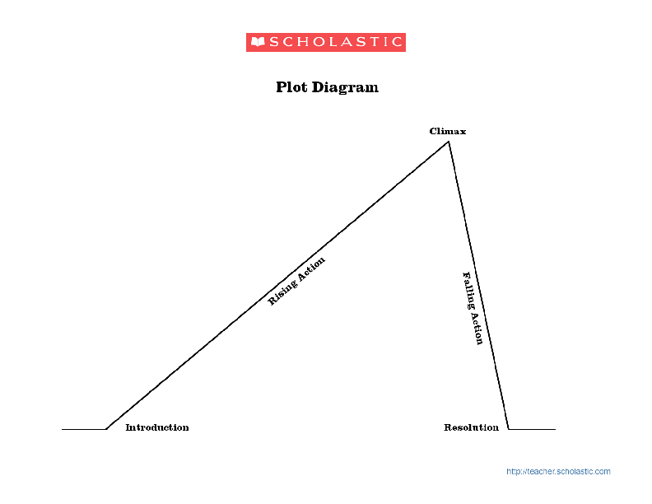
Plot Diagram
5 Elements of Plot

Slide 31
Exposition
The start or introduction of the story.
The background information that the reader must have in order to understand the story.
This is where characters and setting are introduced.

Slide 32
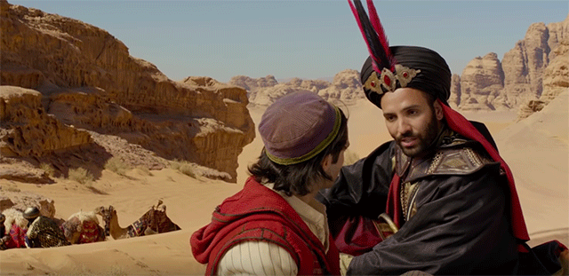
Rising Action
All of the events that take place leading up to the climax.
This is where the reader is introduced to the conflict.
Notes:
Definition of Rising Action. Rising action in a plot is a series of relevant incidents that create suspense, interest, and tension in a narrative. In literary works, a rising action includes all decisions, characters' flaws, and background circumstances that together create turns and twists leading to a climax.
The rising action is everything from the inciting moment to the turning point which just precedes the climax. So in “Aladdin” a few events in the rising action would be Aladdin arriving at the palace as a prince, The Oscar winning “A Whole New World” carpet ride scene, and Jafar attempting to kill Aladdin

Slide 33
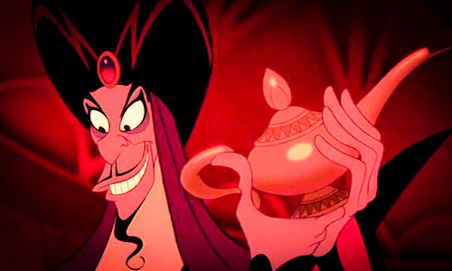
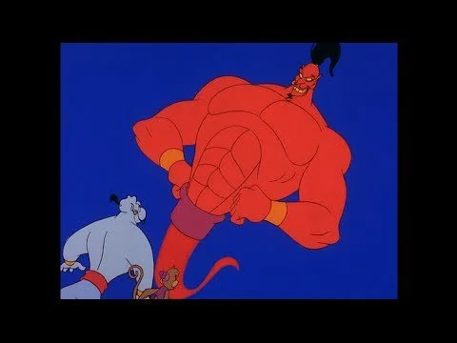
Climax
The most exciting part of the story.
The turning point in the story.
Here the story is turned in a different direction, toward the conclusion.
Notes:
What is the climax of Aladdin?
In “Aladdin” this is when Jafar gains possession of the lamp and with it the Genie. The following scene of Jafar in power and Aladdin fighting him off is the climax of the film. The falling action is everything between the climax and the denouement.Sep 30, 2011
Climax: Aladdin escapes death at the ends of the Earth and flies back on the magic carpet to get the lamp back from Jafar. Despite their best efforts, Jafar is merely amused, transforms into a giant snake, and starts to crush Aladdin (though Aladdin gets a good hit or two in with a sword).

Slide 34
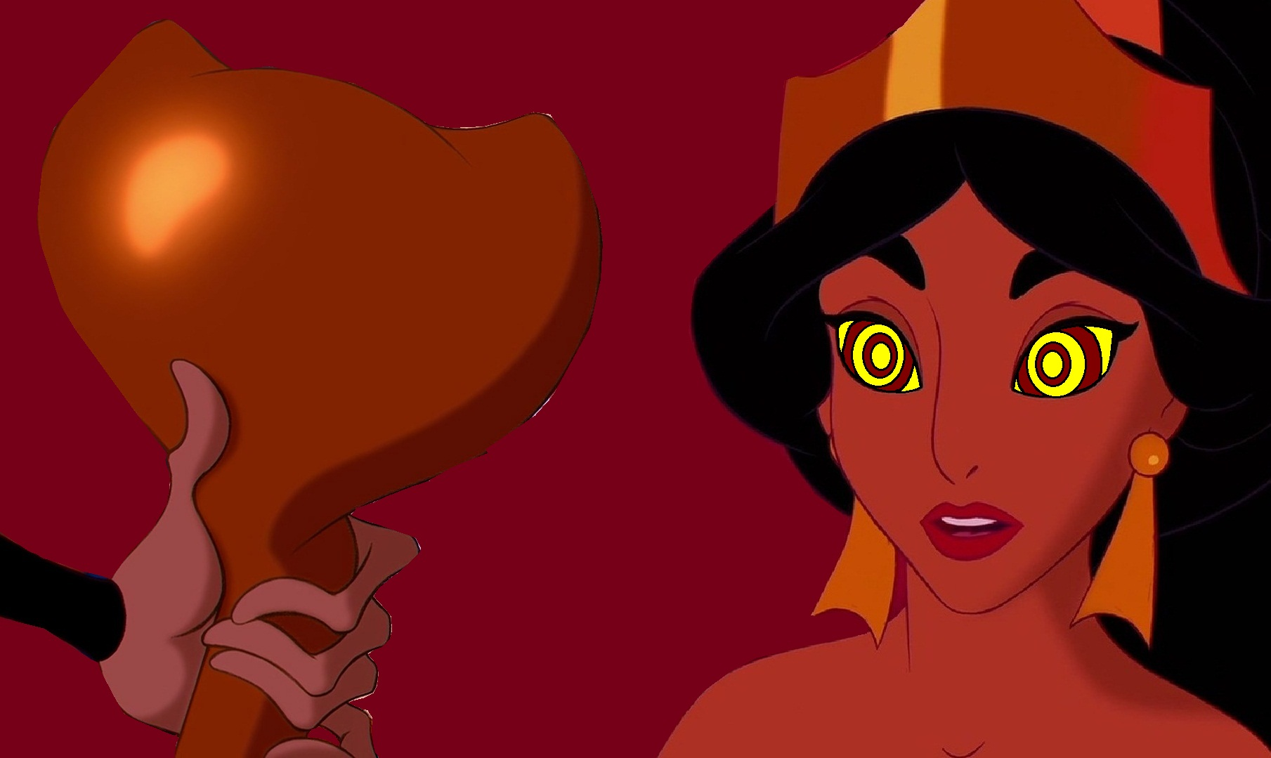
Falling Action
The immediate reaction to the climax.
All the actions that occur after the climax and before the conclusion of the story.
Notes:
Jafar and Aladdin battled it out. Jafar had shape-shifting abilities which gave him an advantage on Aladdin. Aladdin won the fight! Jasmine's hypnosis spell vanished and the two lived happily together forever.

Slide 35
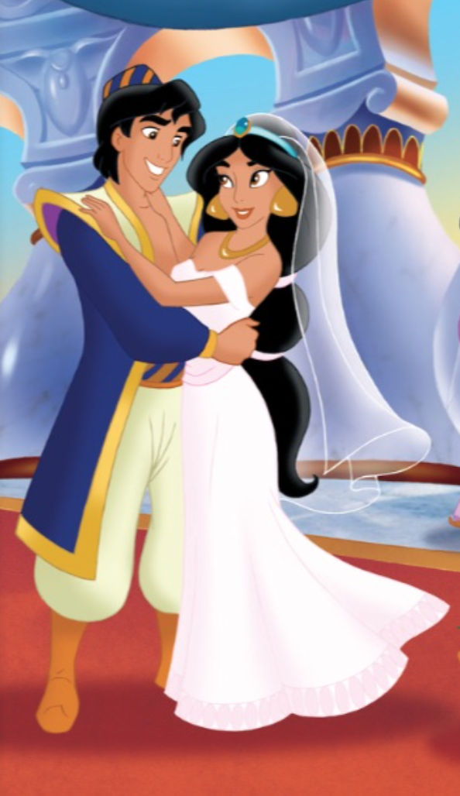
Resolution
The conclusion of the plot.
Loose ends are tied up.
There might not be a clear resolution. This is called a cliffhanger ending.
Notes:
There are several resolutions in Aladdin.
1. Jasmine and Aladdin are finally allowed to be married, despite the previous laws of princesses only being allowed to marry princes.
2. Genie is set free by Aladdin's third wish.

Slide 36


