Slide 1
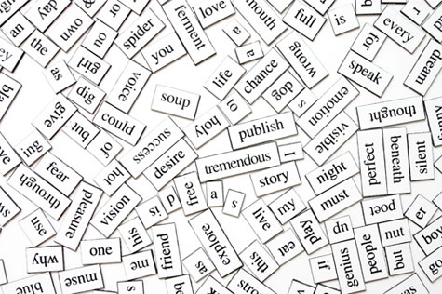
Words, Words, Word
Working with Words
Edited by
Shiri Rosenberg

Slide 2
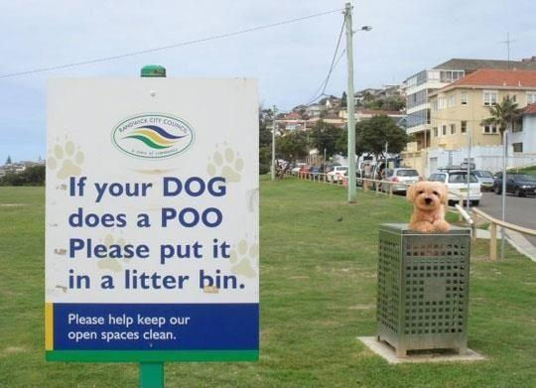

Slide 3
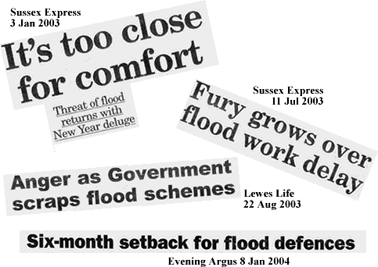
Grammar or Vocabulary?

Slide 4
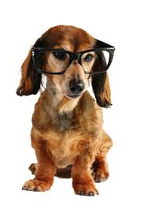
Very Important Quote
Without grammar very little can be conveyed, without vocabulary nothing can be conveyed
Wilkins, 1972

Slide 5
How Many Words?
Blub blib is a system of communication in which arm, hand and finger klods are substituted for groy, used especially by the himp. Most countries have their own blub blib, for example, American Blub Blib is used in the United States. Many splinch people may choose to learn blub blib - sometimes to talk to himp people, sometimes because they have a himp friend or a himp person in their family, or just because they find blub blib very interesting. Himp people may also understand groy by lip-reading if they are around splinch people who do not use blub blib.

Slide 6
What was that all about?
Blub blib is a system of communication in which arm, hand and finger klods are substituted for groy, used especially by the himp. Most countries have their own blub blib, for example, American Blub Blib is used in the United States. Many splinch people may choose to learn blub blib - sometimes to talk to himp people, sometimes because they have a himp friend or a himp person in their family, or just because they find blub blib very interesting. Himp people may also understand groy by lip-reading if they are around splinch people who do not use blub blib.
Sign language is a system of communication in which arm, hand and finger gestures are substituted for speech, used especially by the deaf. Most countries have their own sign language, for example, American Sign Language is used in the United States. Many hearing people may choose to learn sign language - sometimes to talk to deaf people, sometimes because they have a deaf friend or a deaf person in their family, or just because they find sign language very interesting. Deaf people may also understand speech by lip-reading if they are around hearing people who do not use sign language.
Adapted from http://simple.wikipedia.org/wiki/Sign_language

Slide 7
Teaching Vocabulary
High frequency words
  bombilate -
  digamy -
  gambrinous -
Chunks / collocations
  Let’s call it a ________
  Once upon a _______
  To wage _________
Recycling – how many times?
to loudly hum or buzz continually
a 2nd marriage after the death or divorce of a spouse
Full of beer
Notes:
Bombilate – to loudly hum or buzz continually
Digamy – a 2nd marriage after the death or divorce of a spouse
Gambrinous – full of beer

Slide 8
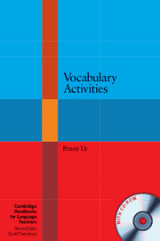
Vocabulary
Activities
Penny Ur
With apologies for the adaptations/ corruptions etc!

Slide 9
20
Activities

Slide 10


Activity 1
Listing from memory p107
Pupils write down as many words as they can remember from the previous lesson.
Check spelling and understanding.
Competition?

Slide 11
Activity 2
Bingo! p119
Use the words from activity 1.
Take all the words, ask pupils to copy down four of the words.
Teacher says words (in Hebrew or English depending on level of difficulty).
Pupils cross off the words as they are said.
First to cross off all four is the winner.

Slide 12
Activity 3
Recall and Share! p108
Use the words from activity 1.
Write all the words on board / paper where pupils can see them.
Tell pupils to “photograph” the words.
Teacher hides the words.
Pupils write as many words as they can remember, they can help each other if you want.
Show words again to check spelling. If pupil forgot a word, they copy it down now.
Check pupils understand words.

Slide 13
Activity 4
Which did I erase? p150
Write a scattered selection of words on the board, possibly from Activity 1
Tell pupils to “photograph” the words
Pupils close their eyes
Erase one word
Pupils guess which word is missing
Variation – Gradual Erase p150 : write a whole text on the board and gradually erase words. Pupils must “read” the text adding the missing words.

Slide 14
Activity 5
Tongue Twisters p248
Write a tongue twister on the board and read it
Ask the pupils to read it aloud - twice
Erase one word, and ask them to read it again
Continue erasing until all words are erased
Challenge pupils to speak faster and faster
The big fat cat sat on the rat.
Orange jelly, lemon jelly, orange jelly, lemon jelly.
Red lorry, yellow lorry, red lorry, yellow lorry.

Slide 15
Activity 6
Words without vowels! p109
Write some recently used words without vowels
e.g. f_m_ly, s_st_r
Pupils complete word
Check pupils understand words

Slide 16
Activity 7
Draw a Word p113
Tell the pupils to look through their textbook for recently learnt words
Tell the pupils to draw the word on the board
The other pupils have to guess the word
This can also be done using mime

Slide 17
Activity 8
Sort them out (1) p126
Give the pupils a list of items, tell them each one fits under a heading in the chart
Change the headings
Ask them to write sentences e.g. I like, I don’t like

Slide 18
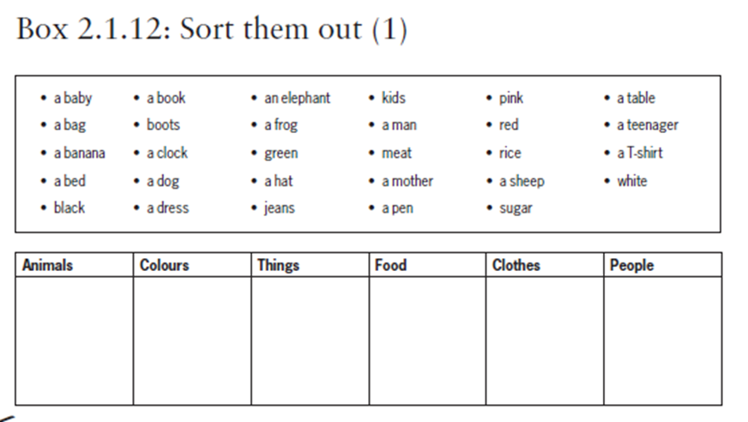
like
I don’t like
have
need
want

Slide 19
Activity 9
Sort them out (3) p128
As in activity 8, but make it more difficult, for example:
  Parts of speech
  Boring / Interesting
  Positive / Negative

Slide 20
Activity 10
Arrange along a continuum p129
Give pupils a set of words and show them how to arrange them along a continuum
e.g. tiny, small, big, huge, gigantic
Give them other lists of words they have to arrange according to the continuum
  e.g. how old?
  how energetic?
  how dangerous?
  how fast?

Slide 21
Activity 11
Items in Context p135
Choose a text the pupils have worked on recently
Call out a word or phrase from the text
Pupils have to find the word
Pupils all call out word, line number, sentence etc
Variation: pupil calls out word and you and other pupils look for it

Slide 22
Activity 12
Cognates p117
Pupils make a list of cognates – how many can they think of?
album ,algebra, ambulance, balloon, bank, comedy, concert, dragon, allergy, festival, ketchup, marathon, museum, plastic, pyjamas, sandal, shampoo, sport, tank, toast, toffee, tractor, vitamin

Slide 23
Activity 13
Connect Two p138
Write a scattered selection of words on the board
Ask the pupils to make a sentence using any two of the words
Draw a line connecting the two words
Continue until all the words are connected
If the pupils start to link 3 or more words – that’s fine too!

Slide 24
Activity 14
True or false p140
Write a scattered selection of words on the board
Pupils choose one item and write 2 sentences in which they relate to the word – one true and one false
One pupil reads / writes their sentences
The other pupils guess which is true and which is false

Slide 25
Activity 15
Finish the sentences p144
Write a set of unfinished sentences, each containing a word to be reviewed
Ask the pupils to complete the sentence
Compare sentences : which is the longest/funniest/most interesting/original?

Slide 26
Activity 16
Words from letters p229
Write 12 letters on the board (at least 3 vowels)- scattered
Pupils make as many words as they can from these letters in a given time
Letters may not be used more than once
Points can be given

Slide 27
Activity 17
Short words from a longer word p231
Write a long word (known or unknown) on the board
Pupils make as many words as they can from these letters in a given time
Letters may be used more than once if they are repeated in the word
Points can be given

Slide 28
4 leters or more!
gambrinous
bombilate
burn
born
barn
grin
boring
baring
sour
brain
rain
grain
gain
mourn
morn
soaring
bomb
late
bile
bail
mail
blame
lame
bleat
table
able
mile
male
meal
team
meat
mate
lime

Slide 29
Activity 18
Beetle hangmanp233
Regular hangman – but draw a beetle instead!

Slide 30
Activity 19
Words beginning with p245
Write a letter on the board
Set a target number
Pupils have to think of words that start with this letter to reach target
“Easy” letters are L, T and N.

Slide 31
Activity 20
Word of the day p23
At the beginning of every lesson teach a new chunk / phrase
Write the chunk and say it, translate it if necessary
Make sure all the pupils understand it
Use it during the lesson and again at the end
http://www.englishspeaking.org/common-collocations/
http://www.englishclub.com/vocabulary/collocations-lists.htm

Slide 32
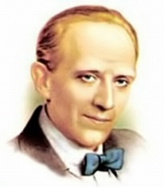
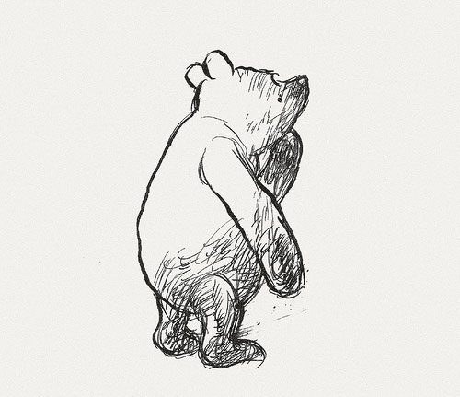
“It is more fun to talk with someone who doesn't use long, difficult words but rather short, easy words like 'What about lunch?'”
A.A. Milne

Slide 33
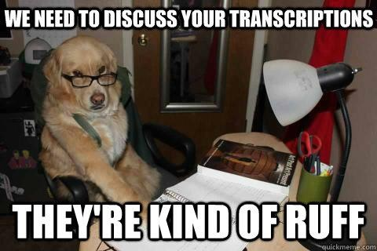

Slide 34


