Slide 1
VR & Virtual Field Trips
Tours of Understanding
tinyurl.com/ett-virtualtours17
Tom Daccord
@thomasdaccord
tom@edtechteacher.org

Slide 2
Web Tools & Apps

Slide 3
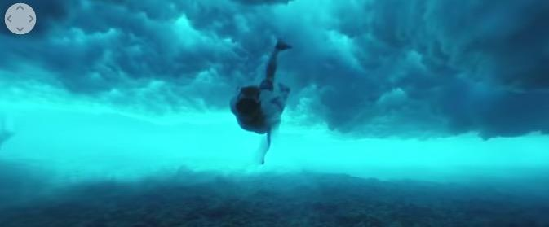
YouTube -- 360 or GoPro VR
videos that allow you to pan 360° around a video while playing
work best on an iPad or other mobile device with YouTube app
Search “360” or “GoPro VR” youtube.com

Slide 4
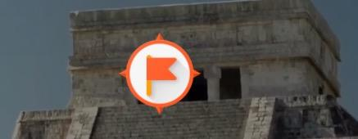
Google Expeditions (VR)
iOS (and Android) app
Teacher can guide students through VR tour
Video tutorial: https://www.youtube.com/watch?v=8yPjqgFZWJ4

Slide 5

Discovery VR
New VR offering by Discovery; create VR
Also VR lessons, but $$
http://www.discoveryvr.com/
https://itunes.apple.com/us/app/discovery-vr/id1030815031?ls=1&mt=8

Slide 6
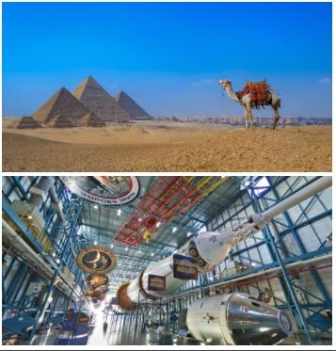
Google Map Treks
Two-dozen tours of cultural and historical sites around the world
https://www.google.com/maps/about/treks/#/grid

Slide 7
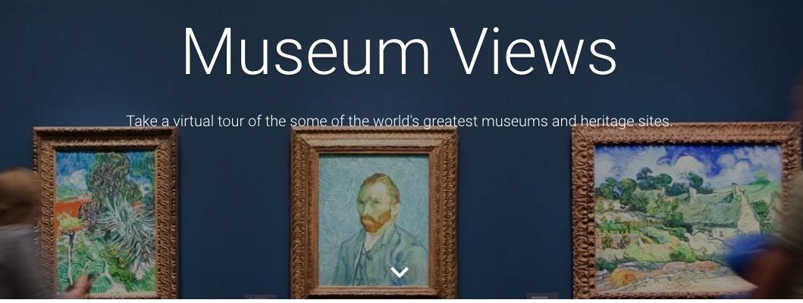
Google Street View - Museums
can take you inside of many museums and historical sites
can be accessed through Google Earth on the iPad
https://www.google.com/culturalinstitute/beta/project/streetviews

Slide 8
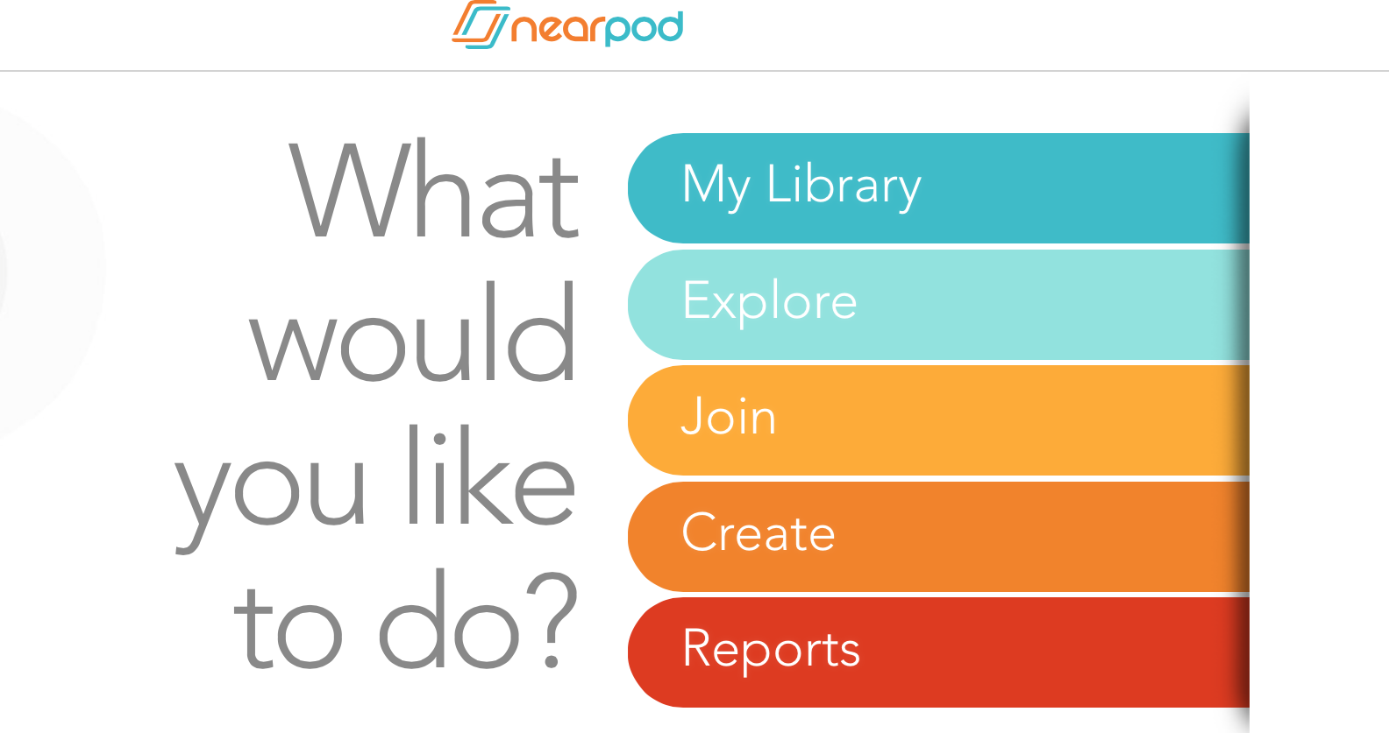
https://www.youtube.com/watch?v=4VliWohdvAg (tutorial)

Slide 9
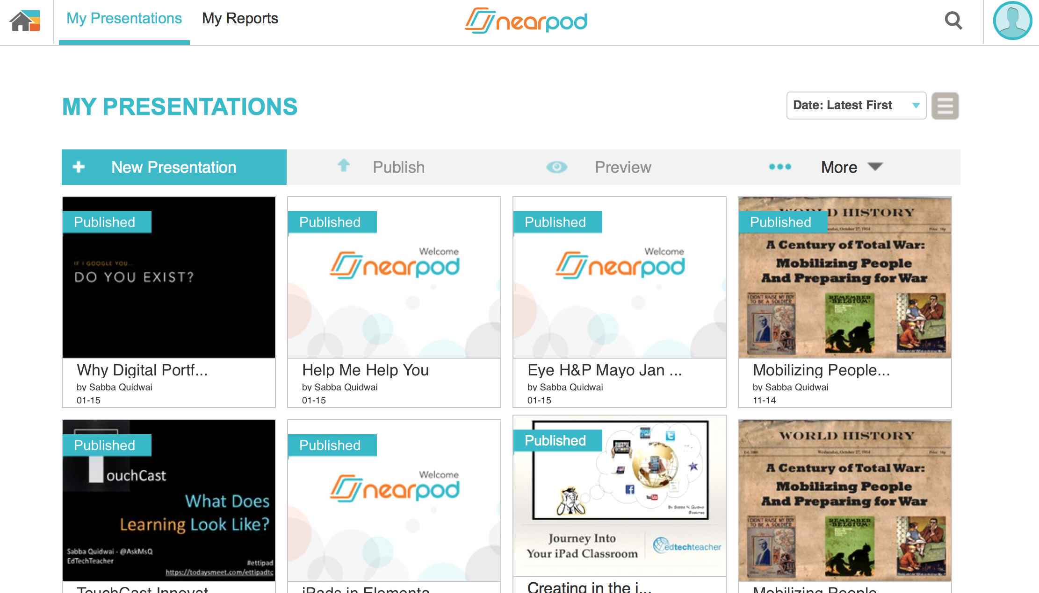
Process:
Create
Add Content
Field Trip
Add Questions, etc
** Nearpod offering free VR headsets with subscription

Slide 10
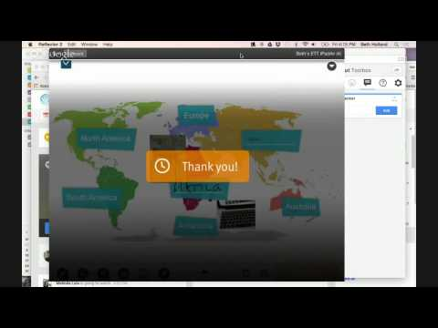
Nearpod Webinar

Slide 11
Virtual Trips (non VR)

Slide 12
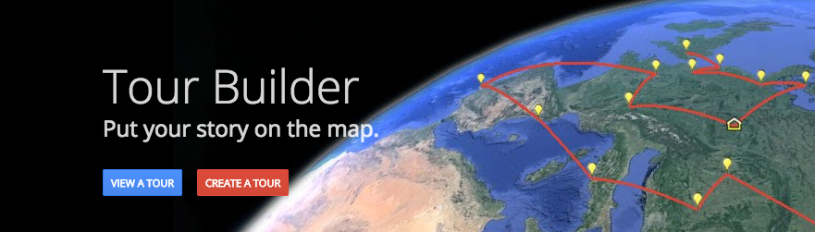
Google Tour Builder (beta)
show people places you've visited using Google Earth
add in photos, text, and video, and then share
https://tourbuilder.withgoogle.com/

Slide 13
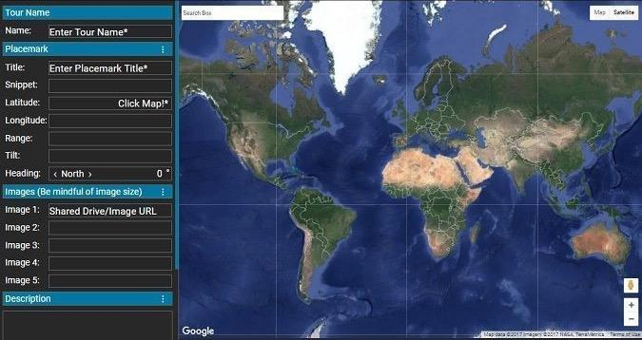
Tour Maker for New Google Earth
Create placemarks that open up in the new sidebar
KML tours, but buggy in Google Earth Classic
GE Teach Tutorial

Slide 14

Google Lit Trips
mark journeys of characters from famous literature on Google Earth
placemarks contain resources including media, discussion starters, and links
http://www.googlelittrips.org/

Slide 15
Special Projects

Slide 16

Google - Project Night Walk
Special immersive “Night Walk” tour of Marseille district
Includes 360 panoramas
https://nightwalk.withgoogle.com/en/home

Slide 17

The VR Mars Bus
LockHeed Martin offering
http://lockheedmartin.com/generationbeyond/mars-experience

Slide 18
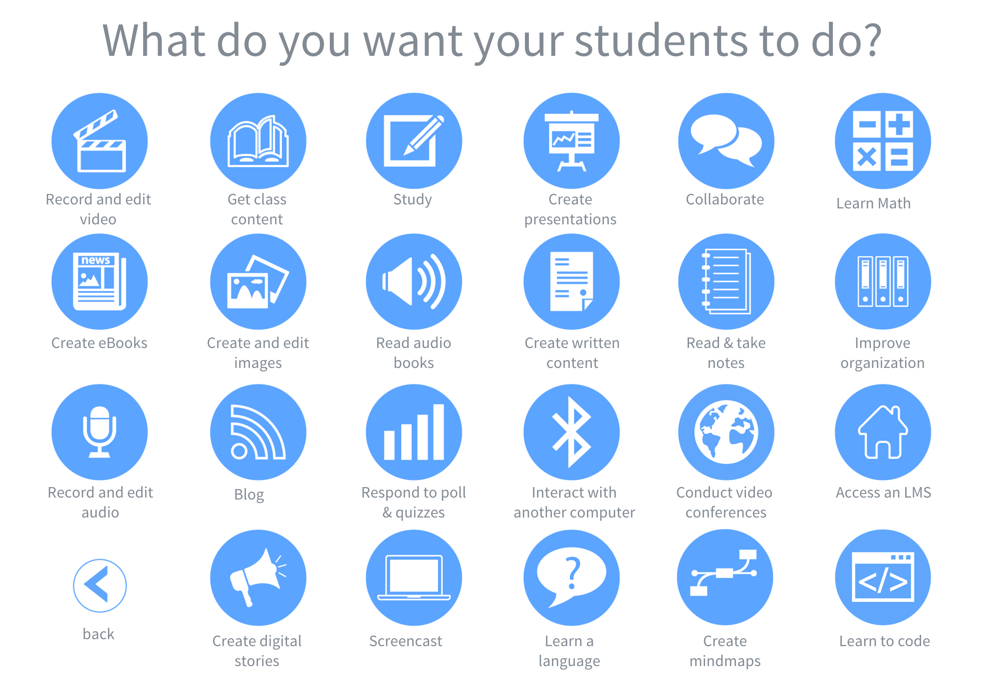
http://edtechteacher.org/apps/

Slide 19
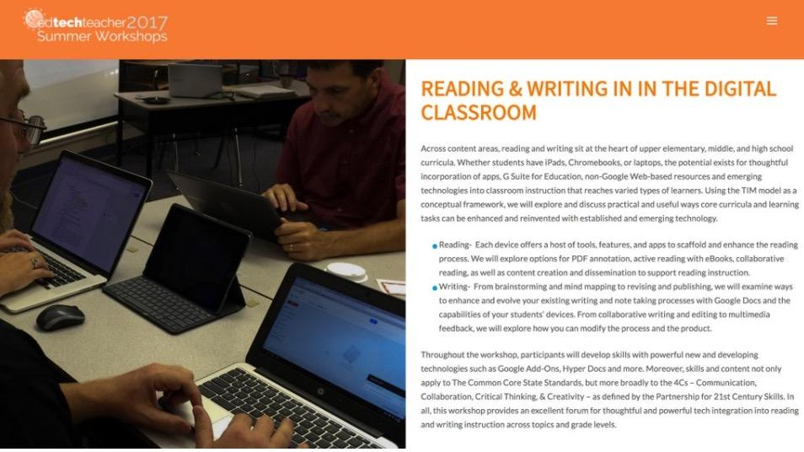
June 8-9 Orlando - ettsummer.org

