Slide 1
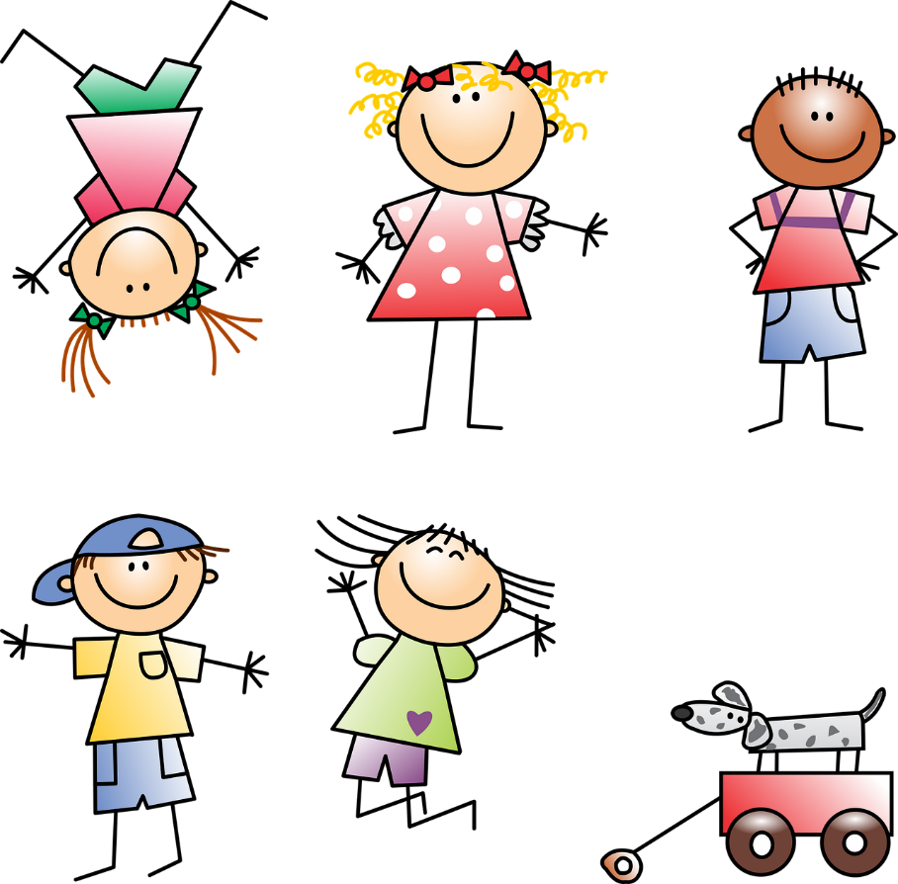

verbs
Adapted from Vered Carmel Ziss by Hanny Fuks

Slide 2
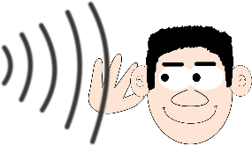
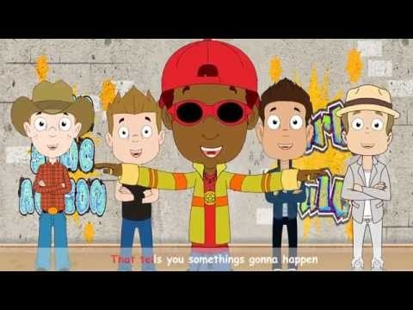
Listen
https://youtu.be/GDb5LboBieY

Slide 3


Verbs
Stand
Look at the picture…
Eat
Play
What do you see?
The kids…
Jump

Slide 4
Verbs
Stand
Look at the picture…
Eat
Play
Jump

Slide 5


Listen and Say

Slide 6





Actions
Listen and Say

Slide 7
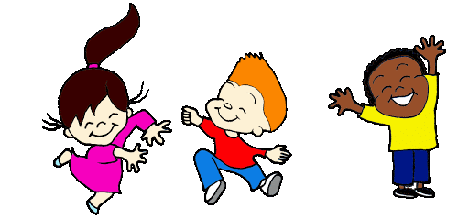
Actions
Listen and Say

Slide 8

Actions
Listen and Say

Slide 9
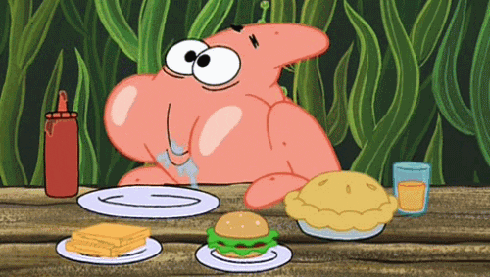
Actions

Slide 10
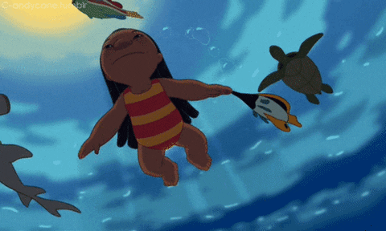
Actions
Listen and Say

Slide 11

Actions
Listen and Say

Slide 12
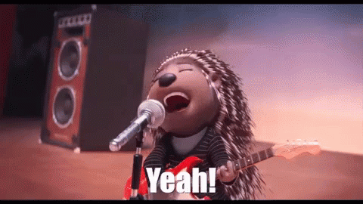
Actions
Listen and Say

Slide 13
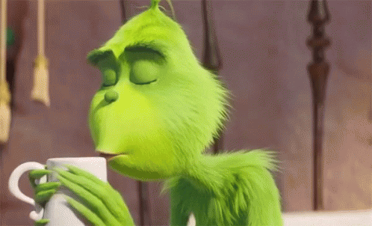
Actions
Listen and Say

Slide 14

Actions
Listen and Say

Slide 15
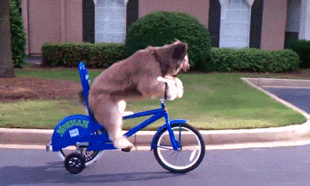
Actions
Listen and Say

Slide 16

Actions
Listen and Say
T

Slide 17
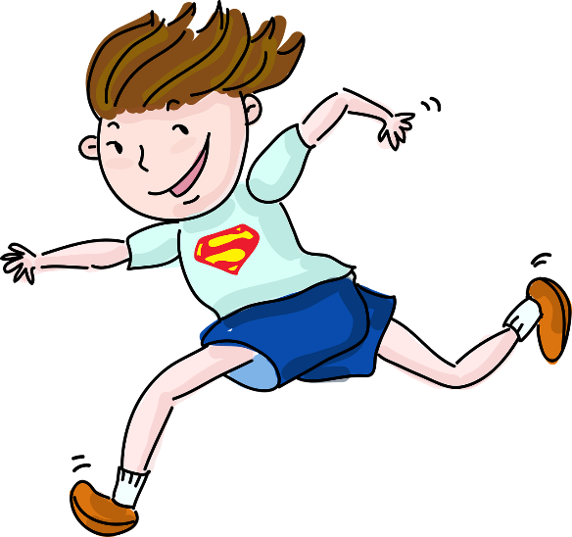
Actions
Listen and Say

Slide 18

Actions
Listen and Say

Slide 19
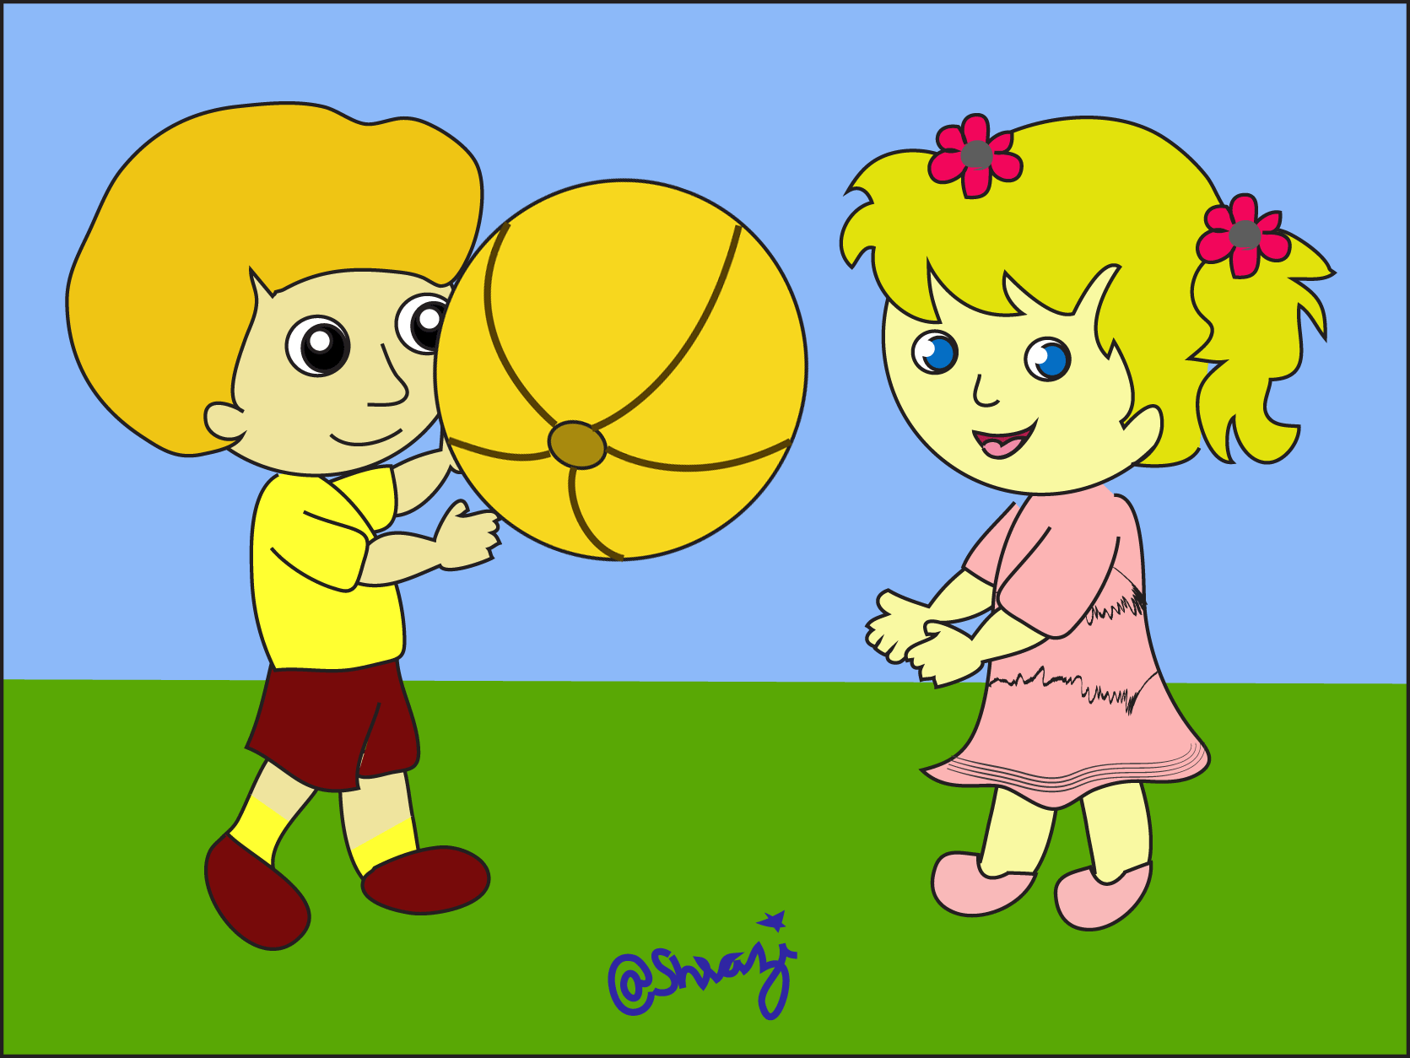
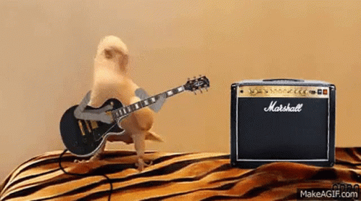
Actions
Listen and Say

Slide 20
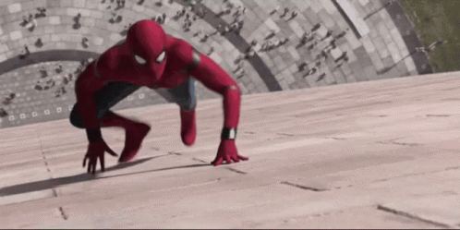
Actions
Listen and Say

Slide 21







Play
4
5
1
2
3
9
10
6
7
8
11
I say the word you say the number.
I say the number you say the word.
I mimic and you guess.
I say the English you say the Hebrew.
https://www.liveworksheets.com/worksheets/en/English_as_a_Second_Language_(ESL)/Action_verbs/Action_verbs_-_Listening_and_reading_sl5578sc
Live Worksheet Sample

Slide 22



Instructions
Listen, Read and Say

Slide 23
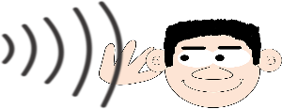

Actions
Listen, Read and Say
jump rope
What does he do?

Slide 24

Actions
Listen, Read and Say
What they do?
dance

Slide 25

Actions
Listen, Read and Say
What does it do?
read

Slide 26
Actions
Listen, Read and Say
What does it do?
eat

Slide 27
Actions
Listen, Read and Say
What does she do?
swim

Slide 28

Actions
Listen, Read and Say
What does it do?
talk
Silent L
האות אֵל אינה נשמעתTalk * במילה

Slide 29
Actions
Listen, Read and Say
What does she do?
sing

Slide 30
Actions
Listen, Read and Say
What does he do?
drink

Slide 31
Actions
Listen, Read and Say
What does he do?
do homework

Slide 32
Actions
Listen, Read and Say
What does it do?
ride

Slide 33

Actions
Listen, Read and Say
What does he do?
listen
Silent T
T
האות תִי אינה נשמעתlisten * במילה

Slide 34

Actions
Listen, Read and Say
What does he do?
run

Slide 35
Actions
Listen, Read and Say
What does he do?
watch

Slide 36
Actions
Listen, Read and Say
What do they do?
play

Slide 37
Actions
Listen, Read and Say
What does he do?
climb
Silent B
האות בִי אינה נשמעתclimb * במילה
B

Slide 38



Listen
&
Sing
Click on the picture and listen to the song

Slide 39


https://youtu.be/dUXk8Nc5qQ8

Slide 40
Listen
&
Sing
Click on the picture and listen to the song

Slide 41
Play
4
5
1
2
3
9
10
6
7
8
11
I say the word you say the number.
I say the number you say the word.
I mimic and you guess.
I say the English you say the Hebrew.
https://www.liveworksheets.com/worksheets/en/English_as_a_Second_Language_(ESL)/Action_verbs/Action_verbs_-_Listening_and_reading_sl5578sc
Live Worksheet Sample

Slide 42
Post-Zoom Activities
Open you’re your notebook: Write the date and the title
Sunday, October 25th, 2020
כתבו תאריך וכותרת- VERBS - פעלים
Copy the new words
See the following links for practice:
Quizziz
Live Worksheet
Wordwall 1
Wordwall II
Extra Fun song : https://youtu.be/GDb5LboBieY
שימו לב לסיים את כל המשימה וללחוץ על "שמור" לפני שאתם יוצאים מאתר.

Slide 43

Copy & Translate
jump: _________________
Dance: _________________
Read: _________________
eat : _________________
swim : _________________
talk : _________________
sing : _________________
drink : _________________
Do homework : _________________
ride : _________________
listen : _________________
run : _________________
watch : _________________
play : _________________
climb : _________________

Slide 44

Remember
Need- צריך/ צריכה/ צריכים/ צריכות
Can- יכול/ יכולים/ יכולות/ יכולה
Have- יש לי/ יש להם/ יש לנו
Has- יש לו או לה

Slide 45
Good Luck!
Adapted from Vered Carmel Ziss by Hanny Fuks

