Slide 1


The Visual Side
of Reading
Strategies
Ahava Steinbauer, M.Ed.
Lori Abramson, MAJE

Slide 2

MITF
Pedagogical Development Seminar
Oranim Academic College of Education
https://docs.google.com/document/d/1E1NWrBvInAh5WPFR8syFtNCTV3-Zr_Ocbzq3cJCLNaM/edit?usp=sharing

Slide 3
Target
for
Today
Topics
Accessing prior knowledge
Vocabulary and visualization
Read/think/draw strategy
Storyboarding/comics

Slide 4

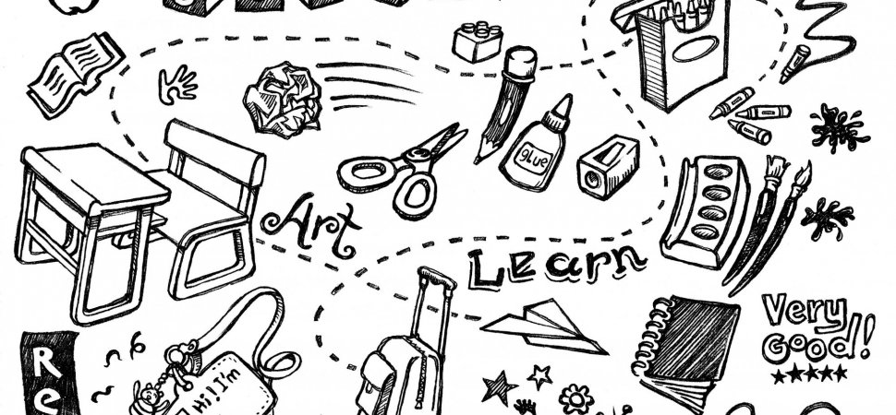
Drawing Is the Fastest, Most Effective Way to Learn, According to New Research https://www.inc.com/jessica-stillman/drawing-is-fastest-most-effective-way-to-learn-according-to-new-research.html?fbclid=IwAR15F1ivCwsFQ0WkfqaSQmDtDDVyebmtSKEX3dBwb2aFFxJSlZ5uTB5nLIM&sfns=mo

Slide 5
WHY? Drawing gives your brain so many different ways to engage with new material
you have to figure out how to draw it by imagining it in detail in your mind,
you experience the physical feeling of rendering that idea, and then,
in the end, you look at a visual representation of it.
https://www.inc.com/jessica-stillman/drawing-is-fastest-most-effective-way-to-learn-according-to-new-research.html?fbclid=IwAR15F1ivCwsFQ0WkfqaSQmDtDDVyebmtSKEX3dBwb2aFFxJSlZ5uTB5nLIM&sfns=mo

Slide 6

Aladdin

Slide 7

Access Prior Knowledge - Before reading/introducing the book
Access Prior Knowledge - Before reading/introducing the book
___________________________________________________________________________________
5 posters around the room
Label 5 posters: Aladdin (the book), Aladdin (the character), Princess Jasmine, Genie, Uncle Abanazar
Colored pencils or markers
As students enter room, ask what they already know about Aladdin. Direct them to draw pictures and write words and phrases about what they already know about each topic.
Discuss each poster before beginning the book.

Slide 8
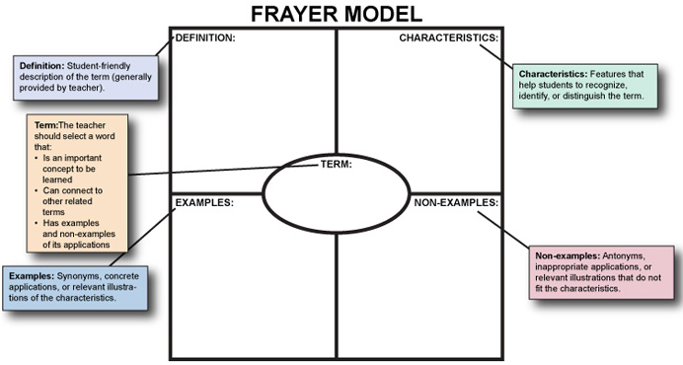
Frayer Model
Vocabulary Acquisition
Frayer Model:
Graphic organizer used for word analysis and vocabulary building
http://www.readingeducator.com/strategies/frayer.htm
https://iris.peabody.vanderbilt.edu/module/sec-rdng/cresource/q2/p07/

Slide 9
Frayer
Model
Vocabulary Acquisition
information in sections - provides visual representation
prompts students to understand words within larger context
asks students to analyze concept & synthesize information by thinking of examples and nonexamples
activates prior knowledge of topic and builds connections
Sample Lesson Plan: http://www.readingeducator.com/strategies/frayer.htm
https://wvde.us/math4life/educators/strategies-for-teaching-and-learning/frayer-model/

Slide 10
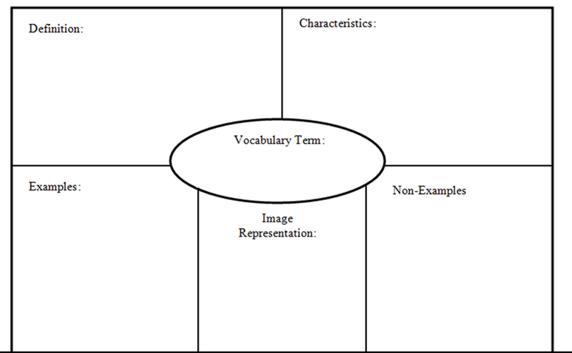
Frayer Model
Vocabulary Acquisition
https://www.google.com/imgres?imgurl=https%3A%2F%2Fi.pinimg.com%2Foriginals%2F1b%2F6c%2F45%2F1b6c452fdab4504596ad64a1c029edda.png&imgrefurl=https%3A%2F%2Fwww.pinterest.com%2Fpin%2F271482683762664960%2F&docid=SAOvcdOsbgxb0M&tbnid=ftGCFsWqT_N3nM%3A&vet=10ahUKEwi-nfbRgu3lAhUyUxUIHVBCDbUQMwhrKA4wDg..i&w=800&h=494&bih=660&biw=1406&q=frayer%20model%20definition%20with%20picture&ved=0ahUKEwi-nfbRgu3lAhUyUxUIHVBCDbUQMwhrKA4wDg&iact=mrc&uact=8

Slide 11


Try one now
surprised
Page 10 - Aladdin

Slide 12
Strategy:
Think Draw Write

Slide 13

The Secret Garden

Slide 14
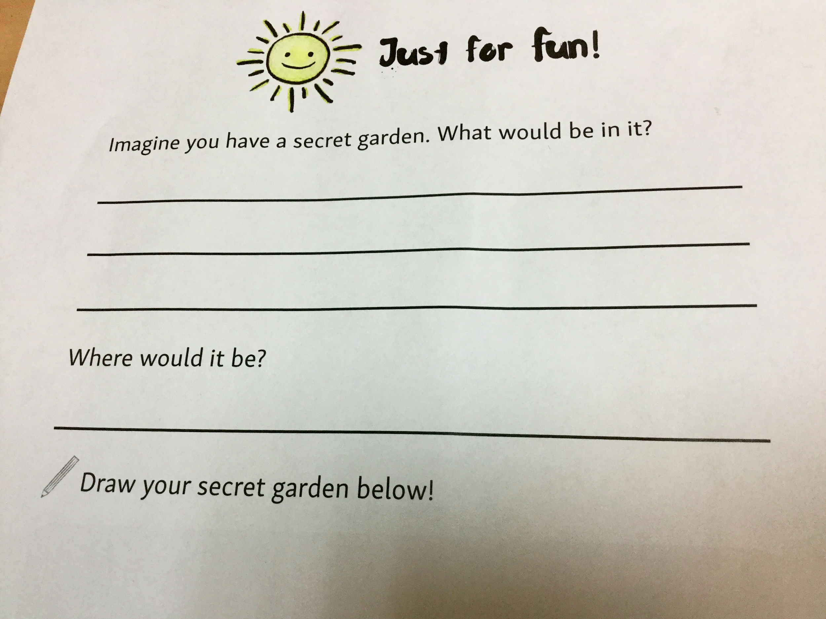
What
is
the
order? Wh
Draw?
Write?
Think?
FiOriginal Assignmentf lite

Slide 15
Strategy:
Think - Draw - Write
How is this process
different?
Think: Imagine you have a secret garden.
Draw: Draw your secret garden below.
Write: What would be in it?

Slide 16
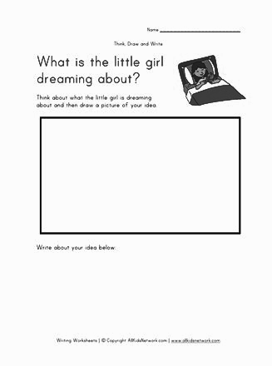
With a partner:
Choose a chapter from Aladdin.
Create a Read-Think-Draw prompt.
Sketch and post on the wall.
Read - Think - Draw
https://www.allkidsnetwork.com/writing/think-draw-write/writing-worksheet-dream.asp

Slide 17
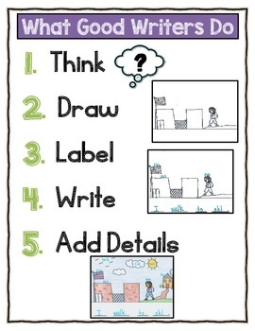
Think - Draw - Write
A Variation
Free on TeachersPayTeachers
https://www.teacherspayteachers.com/Product/Writing-Anchor-Chart-2144320

Slide 18
Differences between Comics and Storyboard
A storyboard does not tell a story. It describes how a story should be told.
https://bdmusings.wordpress.com/2014/09/05/gina-on-the-distinction-between-comics-and-storyboards/
Storyboards are visual organizers - series of illustrations displayed in sequence for the purpose of previsualizing.https://www.instructionaldesign.org/concepts/storyboarding/
Storyboards are models, showing how future interaction or narrative may flow.
Comics tell stories, presenting viewers with place, time, and purpose with which they can engage.
https://bdmusings.wordpress.com/2014/09/05/gina-on-the-distinction-between-comics-and-storyboards/

Slide 19
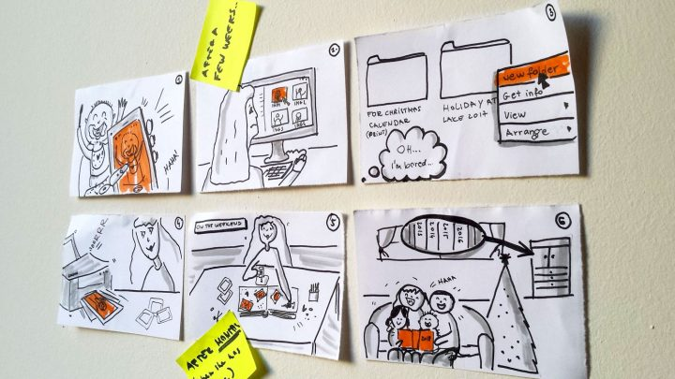
Strategy:
Storyboarding
Storyboarding/Comic Idea = Jigsaw - One scene per student
Storyboarding = pre-reading for a play or video / Comic = while and post-reading

Slide 20
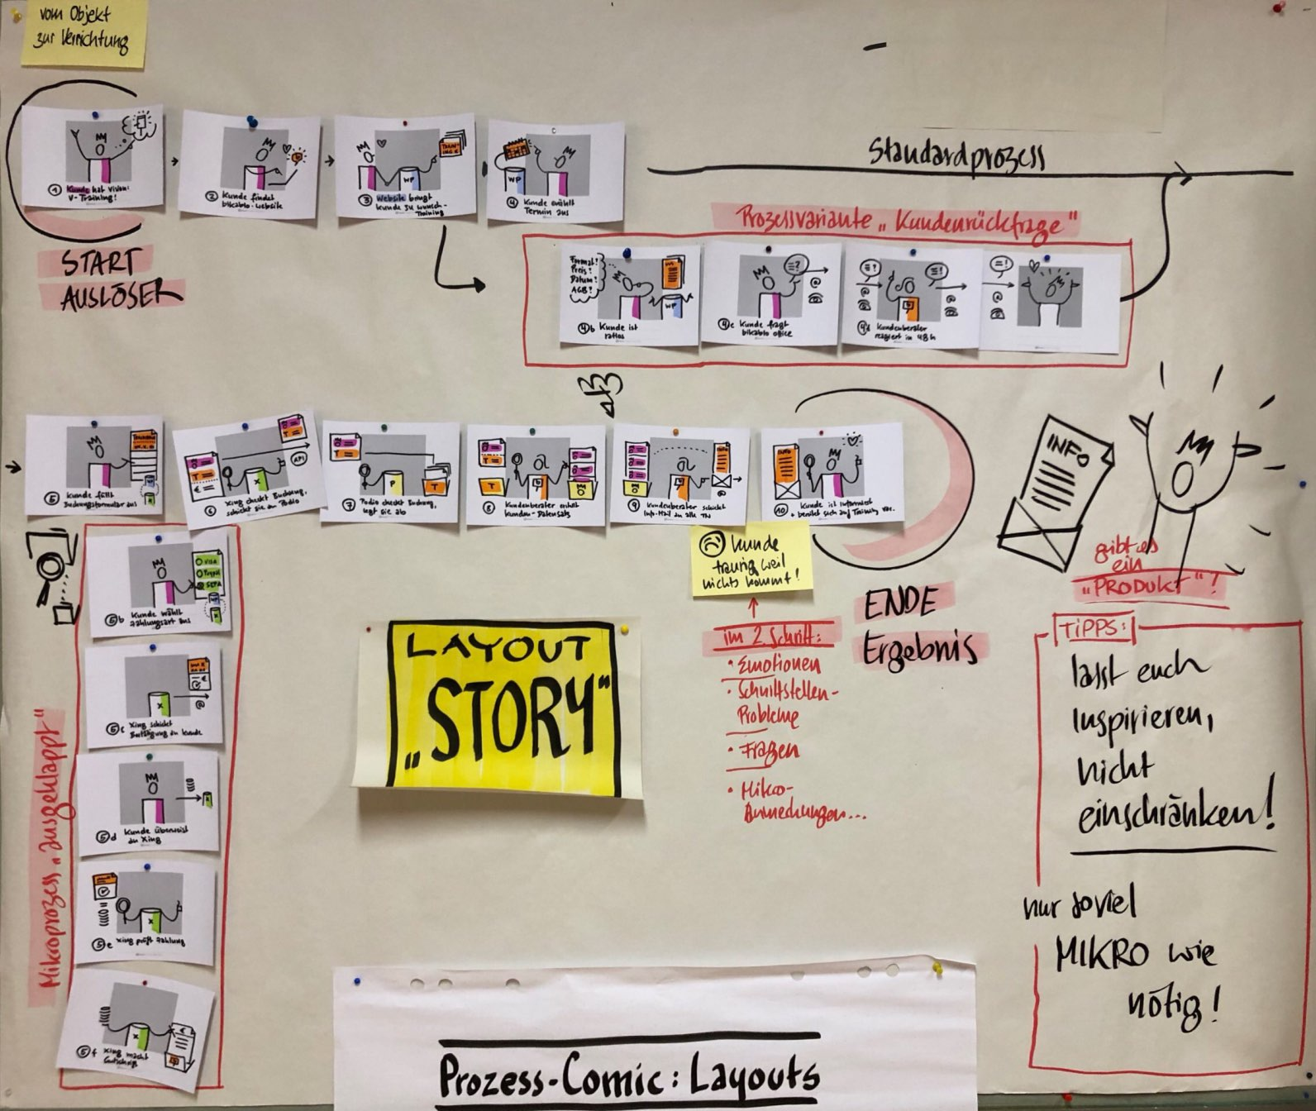
Strategy:
Storyboarding
Storyboarding - A Different Layout
https://www.google.com/search?q=%22vocabulary+and+visualization%22+technique&sxsrf=ACYBGNTryiYBNSIruhNaik6dh8emgj-FBA:1573716665808&tbm=isch&source=iu&ictx=1&fir=rxums3LbBIF-8M%253A%252CcMPyLPjTA4F4vM%252C_&vet=1&usg=AI4_-kTPKdjphh-DrjP2ORZW_rioBWtzTQ&sa=X&ved=2ahUKEwjnv962l-nlAhX5SxUIHXFCBmUQ9QEwCXoECAoQDA#imgdii=FbEQQVeqI2BwOM:&imgrc=U7OqAcJKdiNM2M:&vet=1

Slide 21

TTYPA
Turn To You Partners And…

Slide 22
Turn To You Partners And…
Try to put the 13 Aladdin graphics in order.
Think of several ways that you could use the graphics.
Write down your ideas.
Share with the whole group.
Notes:
TTYPA Activity with School Visit Forms

Slide 23

Time to Explore
Practical Teaching and Learning Tools
Time to create using what you’ve learned
Get organized and explore/print materials, online sites...Frayer Model, Read/Think/Draw, Comics
Download activities for future use
Create and customize your teaching materials

Slide 24
Free Comic Templates
From Medialoot.com - https://medialoot.com/item/printable-comic-strip-templates/
From Scholastic.com - https://www.scholastic.com/content/dam/parents/migrated-assets/printables/pdfs/jason-printable-comic-strip.pdf.pdf
Links to Ahava’s comics resources: https://drive.google.com/open?id=1yXOHBAMN1_tnpIs7GBniutJ0E0wTiXJN

Slide 25
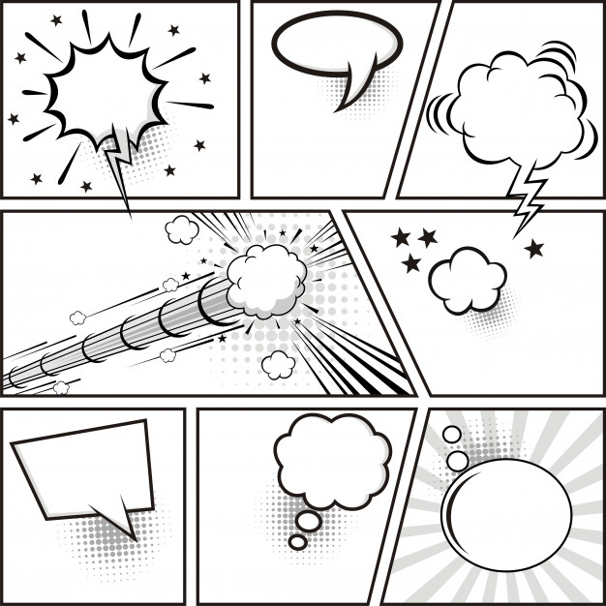
Speech and
Action Bubbles

Slide 26


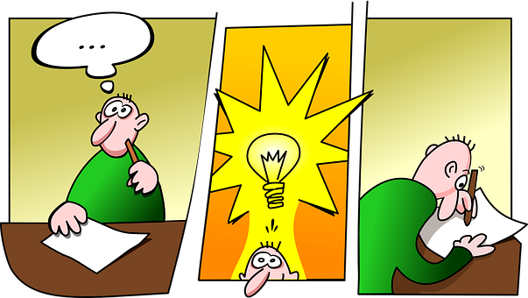
Practice with Comics
A

Slide 27
w
I

Slide 28

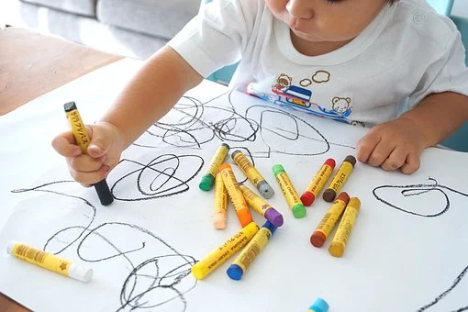
We wish you a great year!
Notes:
Good Luck and see you on September 8th!

Slide 29

Thanks!
Any questions?
You can find me at:
ahava.steinbauer@oranim.ac.il
Photos from SlidesCarnival, Unsplash,l or Pixabay

Slide 30
Hello!
I am Jayden Smith
I am here because I love to give presentations.
You can find me at @username

Slide 31
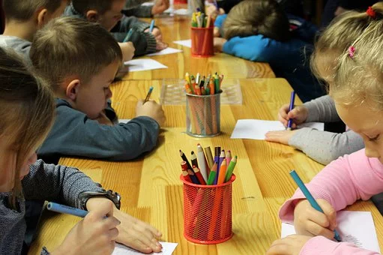
This is your presentation title

Slide 32

MITF Pedagogical Toolbox
https://mitf.masaisrael.org/
Our goal is to support YOU in using this new approach to teaching and engaging students in learning English.
Notes:
This digital platform is a “Toolbox” to help you reach your students using enjoyable activities that will make a difference in your teaching experience. It includes a variety of teaching resources.
The Toolbox is designed to provide a pedagogical foundation and support you with challenges you may encounter teaching English as a Foreign Language (EFL) in the Israeli school settings throughout the year.

Slide 33




Instructions for use
EDIT IN GOOGLE SLIDES
Click on the button under the presentation preview that says "Use as Google Slides Theme".
You will get a copy of this document on your Google Drive and will be able to edit, add or delete slides.
You have to be signed in to your Google account.
EDIT IN POWERPOINT®
Click on the button under the presentation preview that says "Download as PowerPoint template". You will get a .pptx file that you can edit in PowerPoint.
Remember to download and install the fonts used in this presentation (you’ll find the links to the font files needed in the Presentation design slide)
More info on how to use this template at www.slidescarnival.com/help-use-presentation-template
This template is free to use under Creative Commons Attribution license. You can keep the Credits slide or mention SlidesCarnival and other resources used in a slide footer.

Slide 34

Hello!
I am Jayden Smith
I am here because I love to give presentations. You can find me at @username

Slide 35
phonemic awareness
phonics,
reading fluency,
vocabulary
reading comprehension
FiFive pillars of literacy (National Reading Panel)f lite

Slide 36

This is a slide title
Here you have a list of items
And some text
But remember not to overload your slides with content
Your audience will listen to you or read the content, but won’t do both.

Slide 37
Try one now

