Slide 1


The Voice is the Vehicle
Reader’s Theater in the English Classroom
Dr. Nancy Peled
MITF Professional Development Seminar
“Engaging New Readers”
November 17, 2019

Slide 2
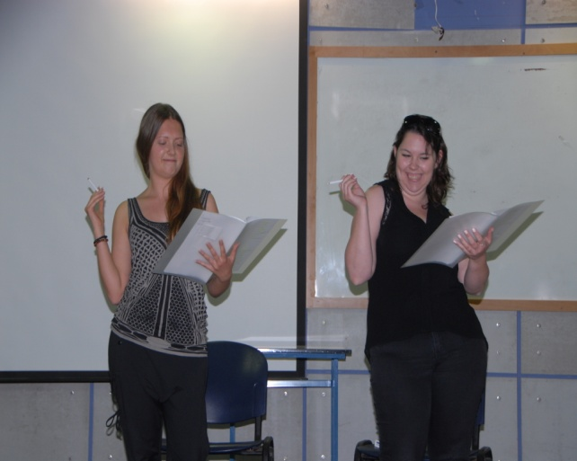
What is Reader’s Theater?
Reader’s Theater is an interpretive reading activity in which readers use their voices to bring a text to life.
Student teachers participating
in RT at Oranim
Academic College, 2015
Dr. Nancy Peled 2019

Slide 3
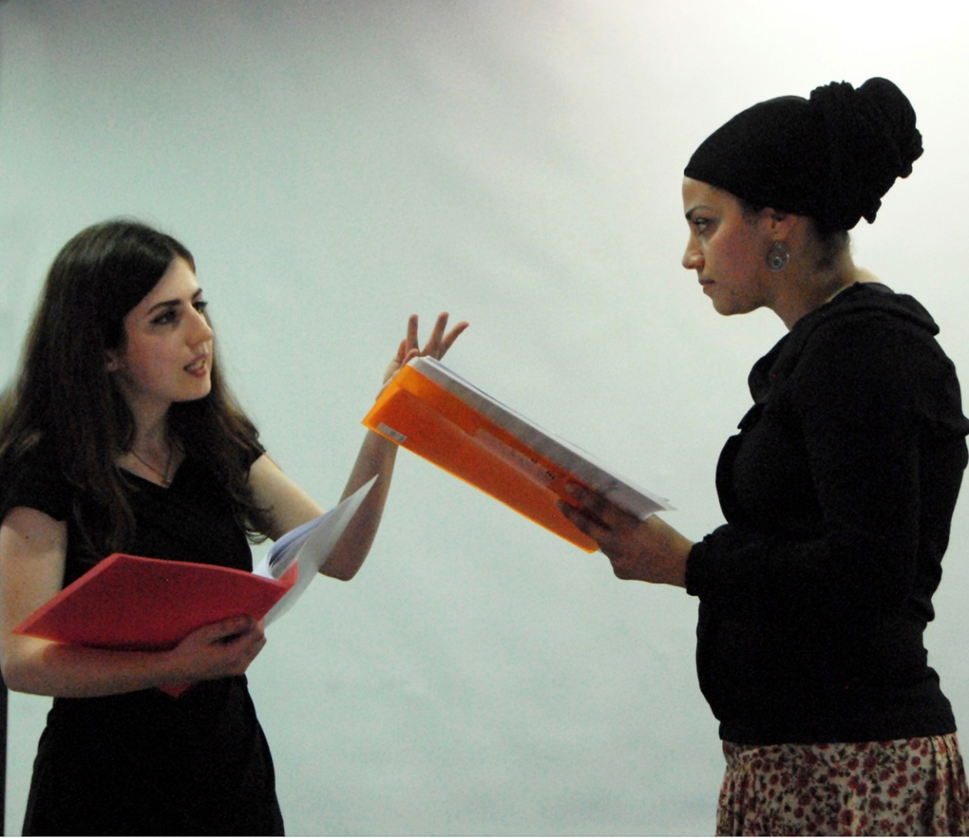
In Reader’s Theater the “performer’s” goal is to read a text aloud effectively, enabling the audience to visualize the action. Reader’s theater in the classroom is an instructional method.
Student teachers
reading from the
play Anastasia,
at Oranim Academic
College, 2015.
Dr. Nancy Peled, 2019

Slide 4
Why Use Reader’s Theater?
Reader’s Theater is an appropriate and effective method for improving reading and oral fluency.
“Fluency difficulties may be the key concern for upwards of 90% of children with significant problems in reading comprehension.”
1997 American National Reading Panel Report
Dr. Nancy Peled, 2019

Slide 5
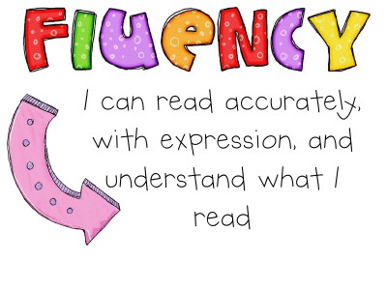
What is Fluency?
Fluency (automaticity) is performing any activity (including reading words) with no noticeable cognitive or mental effort.
Fluency ~ in any activity~ is achieved through practice. So too, in reading, fluency is achieved through practice.
Dr. Nancy Peled, 2019

Slide 6
What Is Reading Fluency?
“One teacher observed, ‘I don’t
know how to define fluency, but I know it when I
hear it.’”
Martinez, Roser & Strecker, 2002.
Fluency means reading text quickly, accurately, and with proper expression or prosody. This frees the reader’s attention to process meaning. The focus of reading instruction is for pupils to get to the meaning.
Dr. Nancy Peled, 2019

Slide 7
Research Definitions
Reading fluency is “a developmental process that refers to efficient, effective decoding skills that permit the reader to comprehend text. ... Fluency is manifested in accurate, rapid, expressive oral reading and is applied during, and makes possible, silent-reading comprehension.”
Samuels & Farstrup, 2005.
Prosody has been described as the “music” of speech and can be identified in the “enthusiasm, phrasing, emphasis, smoothness and pace” in oral reading.
Groen, Veenendaal & Verhoeven, 2018.
Dr. Nancy Peled, 2019

Slide 8
Using Voice Inflection (Prosody) to Convey Meaning
Consider the implication of each statement:
I didn't say Nancy stole my blue pen.
I didn't say Nancy stole my blue pen. I didn't say Nancy stole my blue pen.
I didn't say Nancy stole my blue pen. I didn't say Nancy stole my blue pen.
I didn't say Nancy stole my blue pen. I didn't say Nancy stole my blue pen. I didn't say Nancy stole my blue pen.
Dr. Nancy Peled, 2019

Slide 9
The Importance of Reading Fluency
“Our current thinking on reading fluency is that it is indeed an important factor when considering effective reading programs for students. Moreover, it may be even more of a concern for those students who experience difficulty in learning to read and comprehend what they read.”
Rasinski, Homan & Biggs, 2008.
To gain meaning from text, students must read fluently.
Dr. Nancy Peled, 2019

Slide 10
Reader’s Theater & Fluency
Studies repeatedly demonstrate that Reader’s Theater is an instructional practice that develops fluency.
(Garrett & O’Connor, 2010; Keehn, et al., 2008; Young & Rasinski, 2009).
Students improve comprehension using close reading techniques to fully understand vocabulary, characters, themes, and so on, before “performing” a text.
*Students enjoy participating in Reader’s Theater!*
Dr. Nancy Peled, 2019

Slide 11
Reader’s Theater & Reading Comprehension
A Case Study
involving fourth graders with comprehension skills but unable to actually read despite mediation.
After using Reader’s Theater in the classroom:
in10 weeks their reading level moved up by one year
in one year it jumped three grade levels
The teacher called the transformation in their reading fluency "totally remarkable."
https://www.scholastic.com/teachers/articles/teaching-content/power-readerx2019s-theater/
Dr. Nancy Peled, 2019

Slide 12
Reader’s Theater & Vocabulary Learning
Research has shown that:
in order to learn vocabulary, students need to hear the pronunciation and practice saying the word aloud. (Ellis & Beaton, 1993; Fay and Cutler, 1977.)
it is more effective to study words regularly over several short sessions than to study them for one or two longer sessions. (Hunt & Beglar, 1998.)
fluency building activities recycle already known words in familiar grammatical and organizational patterns. (Nation,1994.)
All of this occurs naturally while preparing Reader’s Theater!
Dr. Nancy Peled, 2019

Slide 13
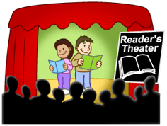
Implementing Reader’s Theater in the Classroom
Dr. Nancy Peled, 2019

Slide 14
From Text to Script
Reader’s Theatre Play Title:
Based on the Book/Story:
Setting/Where does the story take place? :
Cast of Characters
Name | Character Traits | Read by | Costumes/ Props
Dr. Nancy Peled, 2018

Slide 15
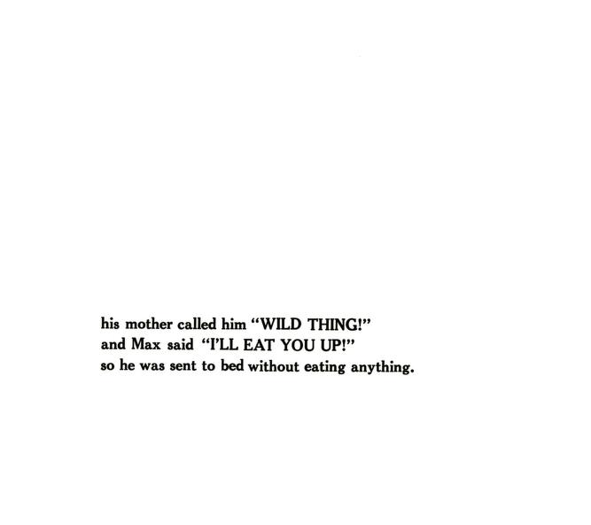
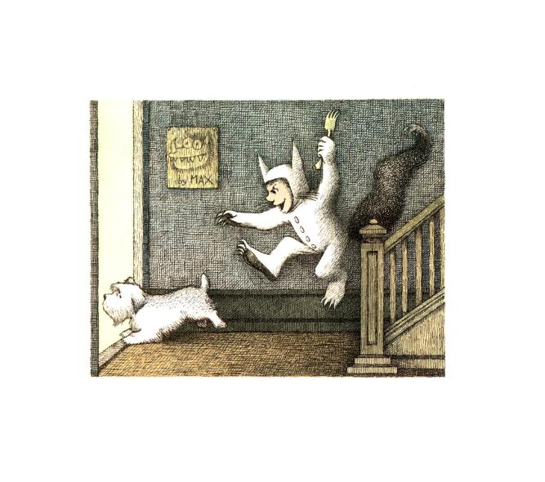
Where the Wild Things Are
Maurice Sendak
The night Max wore his wolf suit
AND made MISCHIEF of one kind
and another.
Dr. Nancy Peled, 2019

Slide 16
Where the Wild Things Are
Maurice Sendak
Characters (6): NARRATOR / CHILD 1/ CHILD 2 / CHILD 3 / CHILD 4 MAX
NARRATOR: THE NIGHT MAX WORE HIS WOLF SUIT
CHILD 1: AND MADE MISCHIEF
CHILD 2: OF ONE KIND
CHILD 3: AND ANOTHER.
NARRATOR: HIS MOTHER CALLED HIM
CHILD 4: "WILD THING!"
NARRATOR: AND MAX SAID:
MAX: "I'LL EAT YOU UP!!"
Dr. Nancy Peled, 2019

Slide 17
Assessing
Possible points for attention:
Student read the script with confidence and
expression, made appropriate gestures and good eye contact.
Student read smoothly and with correct phrasing to reflect the writer’s intended meaning.
We heard and understood all the words.
Dr. Nancy Peled, 2019

Slide 18
Advantages
Reader’s Theater promotes fluency because it demands repeated readings for a real reason- the performance.
It is an interactive activity with inherent motivation.
It increases self confidence in the readers.
It promotes overall reading growth.
Dr. Nancy Peled, 2019

Slide 19
More Advantages
Reader's Theater meets the individual needs of many types of students:
  struggling readers.
  students acquiring English.
  accelerated learners.
It promotes oral fluency.
It enhances vocabulary acquisition.
Dr. Nancy Peled, 2019

Slide 20
Even More Advantages
Reader’s theater is an activity that is suitable for any age group, even those with minimal reading ability, from very young children to adults.
Practicing for the performance –that is, repeated reading- improves the ability to read connected text rapidly, smoothly, effortlessly, and automatically.
Dr. Nancy Peled, 2019

Slide 21
The “Added Value” of Reader’s Theater in the Classroom
Provides a context for writing.
Expands vocabulary.
Promotes collaboration and attentive listening.
Offers a supportive context for peer assessment.
Can be integrated into other subjects.
Dr. Nancy Peled, 2019

Slide 22

To Conclude
Reader’s Theater
in the classroom
integrates reading, writing,
speaking and listening
in an authentic
context.
It makes
reading
come alive!
Dr. Nancy Peled, 2019

Slide 23
Selected Bibliography
Channell, J. (1988). Psycholinguistic considerations in the study of L2 vocabulary acquisition. In R. Carter & M. McCarthy (Eds.), Vocabulary and Language Teaching. London: Longman.
Clementi, L B. (2010). Readers theater: a motivating method to improve reading fluency. Phi Delta Kappan, 91 (5), 85-88.
Doherty J., Coggeshall K. (2005). Reader's theater and storyboarding: Strategies that include and improve. Voices from the Middle, 12 (4) 37-43.
Groen, M. Veenendaal, N & Verhoeven, L. (2018). The role of prosody in reading comprehension: Evidence from poor comprehenders: Prosody and Reading Comprehension. Journal of Research in Reading, 42 (3), 1-21.
Hunt, A. & Beglar, D. (1998). “Current research and practice in teaching vocabulary” The Language Teacher, http://jalt-publications.org/tlt/articles/1914-current-research-and-practice-teaching-vocabulary
Keehn,S. (2003. The effect of instruction and practice through readers theatre on young readers' oral reading fluency. Reading Research and Instruction, 42 (4), 40-61.
Loertscher D. V. ( 2009). More readers theater for middle school boys: adventures with mythical creatures. Teacher Librarian, 37 (10) 61; 84.
Martinez, M., Roser N. L., & Strecker S. (1998-1999). "I never thought I could be a star": a reader’s theatre ticket to fluency. The Reading Teacher, 52 (4), 326-334.
McKay, M. E. (2008). Readers Theatre—Take Another Look—It’s More Than Fluency Instruction LEARNing Landscape, 2 (1) 131-144.
Nation, I. S. P. (Ed.). (1994). New Ways in Teaching Vocabulary. Alexandria, Virginia: TESOL, Inc.
Ruggieri C. A. (2008). A chorus of thought: readers theater in the high school English class. English Journal; High School Edition, 97 (6), 118-119.
Young, C & Rasinski, T. (2009). Implementing readers theatre as an approach to classroom fluency instruction. The Reading Teacher, 63(1), 4–13.
Worthy, J & Prater, K. (2002). I thought about it all night: Readers theatre for reading fluency and motivation. The Reading Teacher, 56 (3), 294-297.
Dr. Nancy Peled, 2019

Slide 24
Sites with free RT scripts
Aaron Shepherd has great resources:
http://www.aaronshep.com/rt/RTE.html
Brian Smith shares ideas and scripts:
https://www.scholastic.com/teachers/blog-posts/brian-smith/increasing-reading-fluency-readers-theater/
From Dr. Chase Young:
http://www.thebestclass.org/rtscripts.html
A teacher resource site:
http://www.teachingheart.net/readerstheater.htm
Promoting Spoken English in the 7th Grade (MOE site)
https://sites.google.com/view/letstalk7/home
Dr. Nancy Peled, 2019

Slide 25
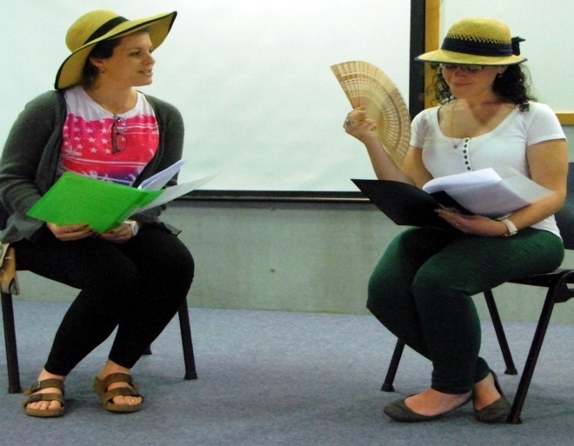
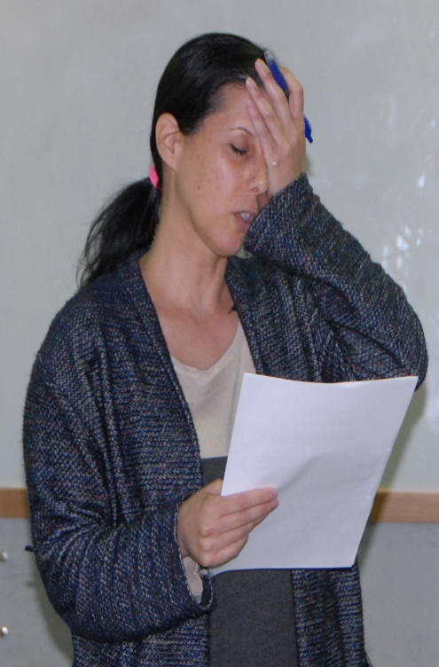
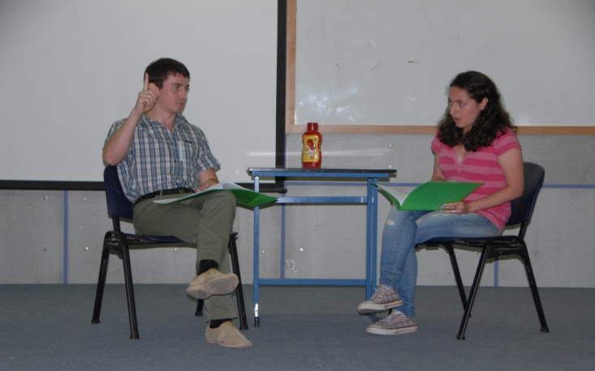
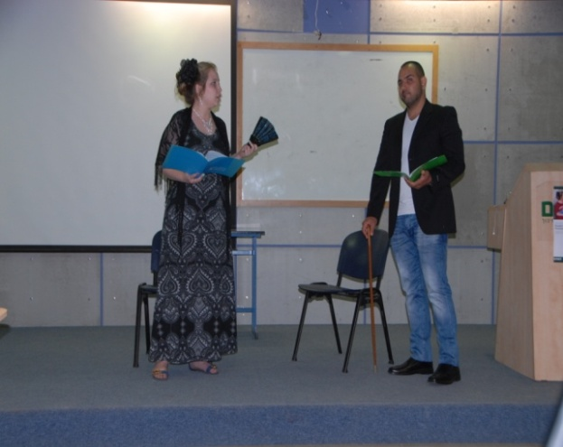
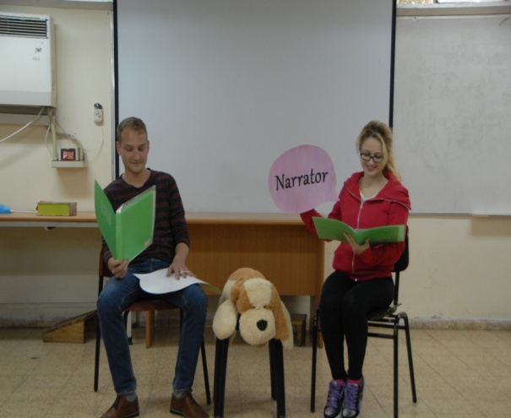
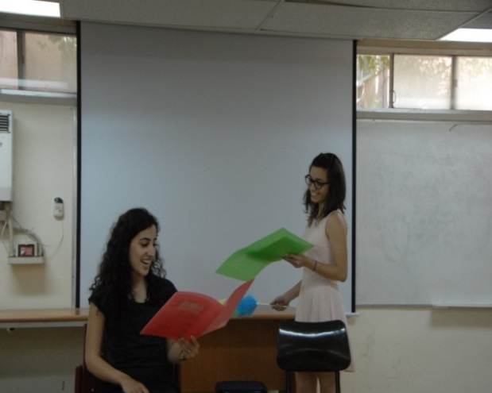
Some photos from past Oranim RT English Department Events

