Slide 1
Effective Co-Teaching Strategies & Projects
Eshkol Primary Teachers
Be’er Sheva, Israel

Slide 2
Co-Teaching Strategies
Students are assigned one teacher to:
  Ask questions during independent work.
  Submit assignments/homework.
  Positive/negative behavioural consequences.
Organized methods of instruction:
  One/Two teacher(s) facilitates brief (10-15 minutes) of whole group instruction, while the remaining teacher(s) assist students.
  Students are split into three heterogeneous groups and given small group instruction.
“Partanee” for English Skills
  1x week, 5th grade students meet with a teacher for a small-group study session.
  Groups are homogenous in regards to ability level.
  Focused on vocabulary, comprehension strategies, and sentence structure.

Slide 3
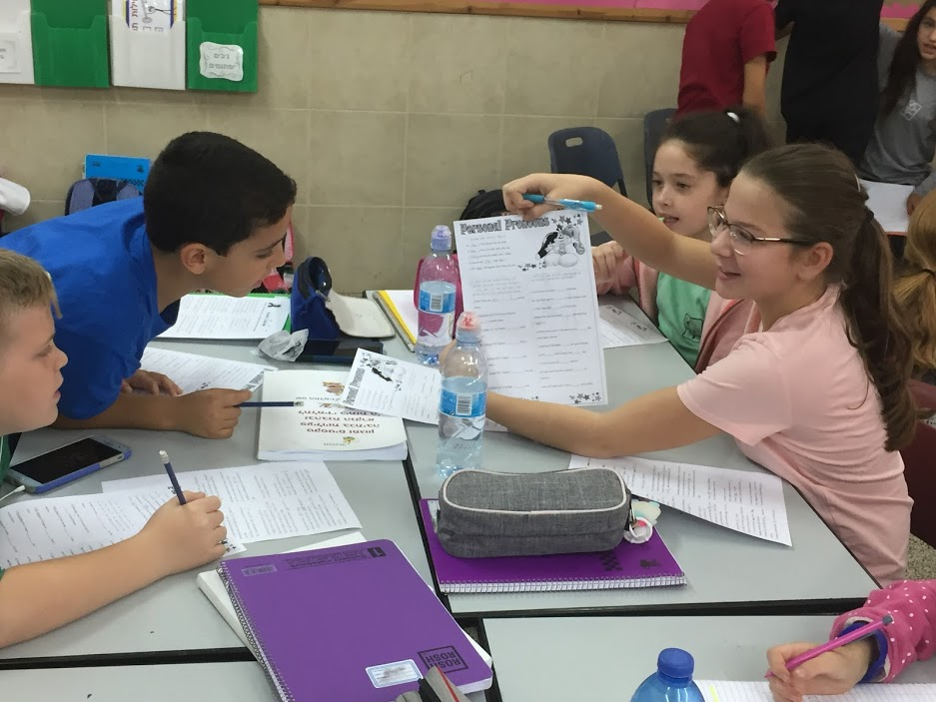
Student-Led Stations
Conducted 1-2 times a month to summarize learned skills (e.g. possessive pronouns, adjectives, etc.)
Four stations to practice foundations:
  Reading, Writing, Listening and Speaking
Student leader responsible for each group.
  Only person to ask teacher a question.
  Goes around to help classmates.
  May get answer sheet afterwards to check everyone’s work.
Rotation every 10 minutes.
Co-teachers facilitate 1-2 stations.

Slide 4
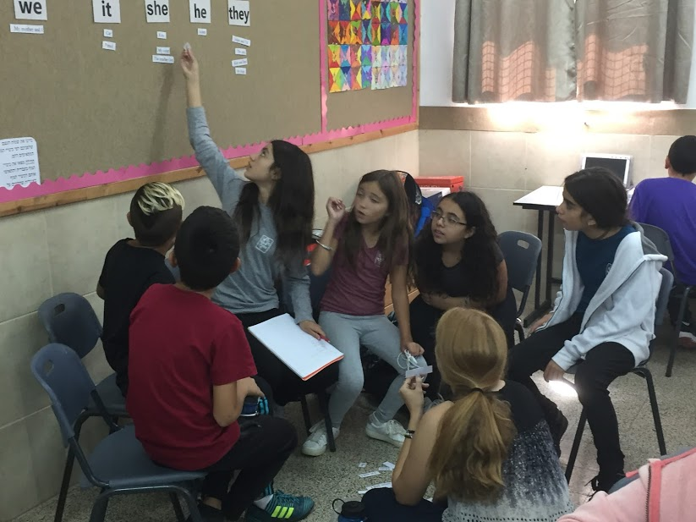
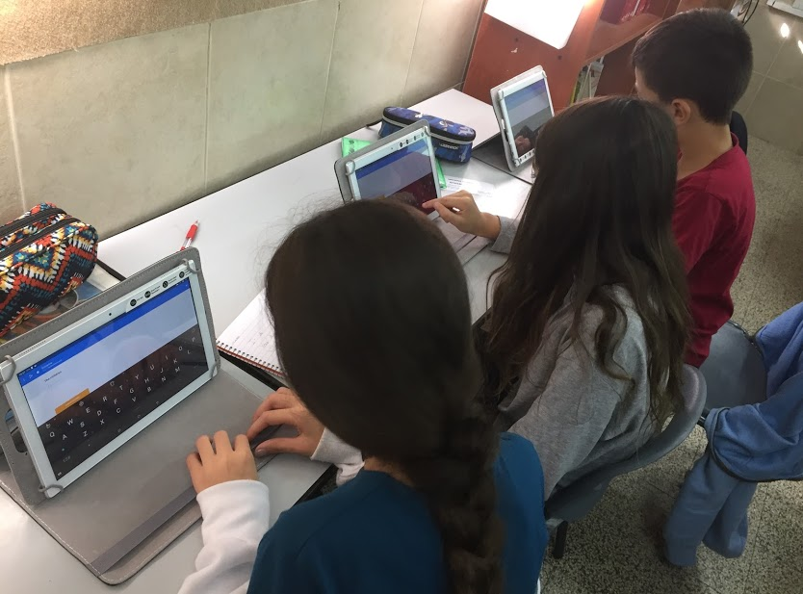
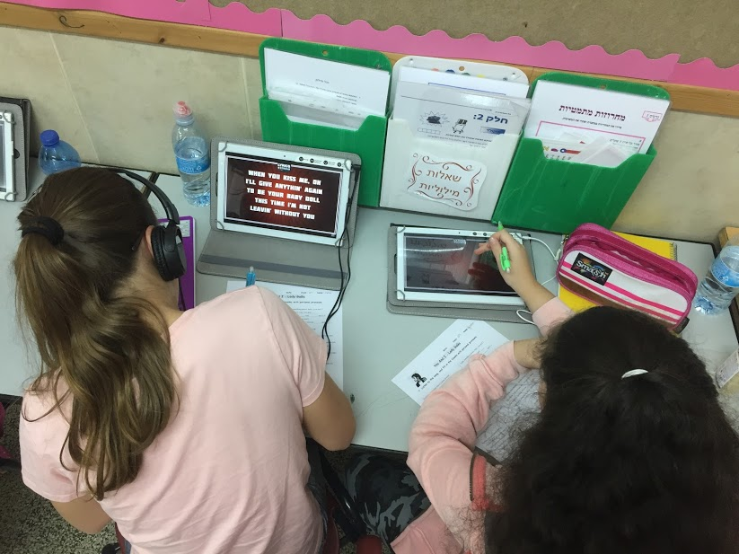
Sample Stations
Categorizing
Students worked together to put subjects under
correct pronouns.
Socrative App
Engages students to answer questions, also giving instant feedback.
Listening to Songs
Students filled in missing lyrics (taught vocabulary)
to songs.

Slide 5
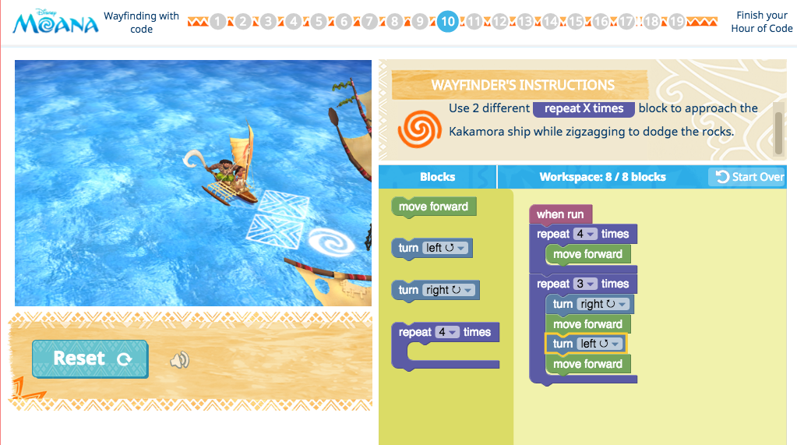
Hour of Code
During International Computer Science Week (4th-10th December), students will participate in “Hour of Code.”
‘Moana’s Wayfinding with Code’ game.
It’s a great way to integrate science in English:
  Vocabulary: forward, backwards, turn, left, right, repeat, run, dodge, strike and more!
Students get a certificate of completion afterwards.

Slide 6
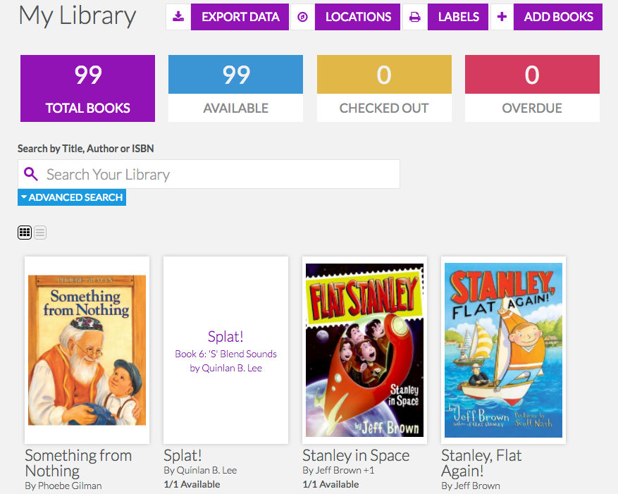
English Language Library Project
Collecting books through donations, and purchasing via Book Depository sales.
  Reaches different reading levels.
  Age appropriate
Using Book Retriever application for an easy electronic check-in/out system.
  System does take time to set up.
5th grade students are responsible!
  Checking in/out books.
  Conducting inventory every week.
  Collecting overdue books.

Slide 7

American Idol
(Extra Curricular Activity)
Available to any 5th or 6th grade student.
  Time Frame: March to May
Students will audition to sing an English song of their choice related to an overall theme.
  Students may choose to sing their song in pairs
Student-led performance.
  Judges are students
Students receive a certificate of participation at the end of the performance
Winners receive a special prize!

Slide 8


Labels Around the School
Initiative to label every room around the school in English, and add pictures to the labels.
Examples include: Principal’s office, gym, bathroom, basketball court, counselor, etc.
Students will be able to practice their English without even knowing it when they look at the labels!
Secretary
Washroom

