Slide 1


MITF
TOOLBOX
PEDAGOGICAL TOOLBOX
DIGITAL SUPPORT PLATFORM
Notes:
I would like to thank all of you for joining us on this wonderful journey.
Oranim Academic College of Education has been in charge of developing a digital tool to help you cope with teaching challenges and resources. Our goal is to support YOU in using this new approach to teaching and engaging students in learning English.

Slide 2

TOOLBOX
PROFESSIONAL DEVELOPMENT
HANNY FUKS
English Pedagogical Advisor and Digital Toolbox Manager
Notes:
My name is Hanny Fuks. I am the English Pedagogical Advisor and Digital Toolbox Manager. I would like to take this opportunity to thank the Oranim International School staff and all the Masa staff members who have worked intensively in order to launch this Digital Toolbox for you.
Toolbox
My session will be devoted to the MITF Toolbox.

Slide 3

MITF
PEDAGOGICAL DIGITAL SUPPORT PLATFORM
What does the word pedagogy means?
The function or work of a teacher; teaching. the art or science of teaching; education; instructional methods.
What is a pedagogical practice?
The learning activities that support the unit of content; the instructional approach such as active learning, constructivist model, student-to-student engagement; teaching to multiple learning styles, variety of assessments.
Notes:
I would like to thank all of you for joining us on this wonderful journey.
Oranim Academic College of Education has been in charge of developing a digital tool to help you cope with teaching challenges and resources. Our goal is to support YOU in using this new approach to teaching and engaging students in learning English.

Slide 4

MITF Survey
Notes:
MITF Survey Feedback

Slide 5
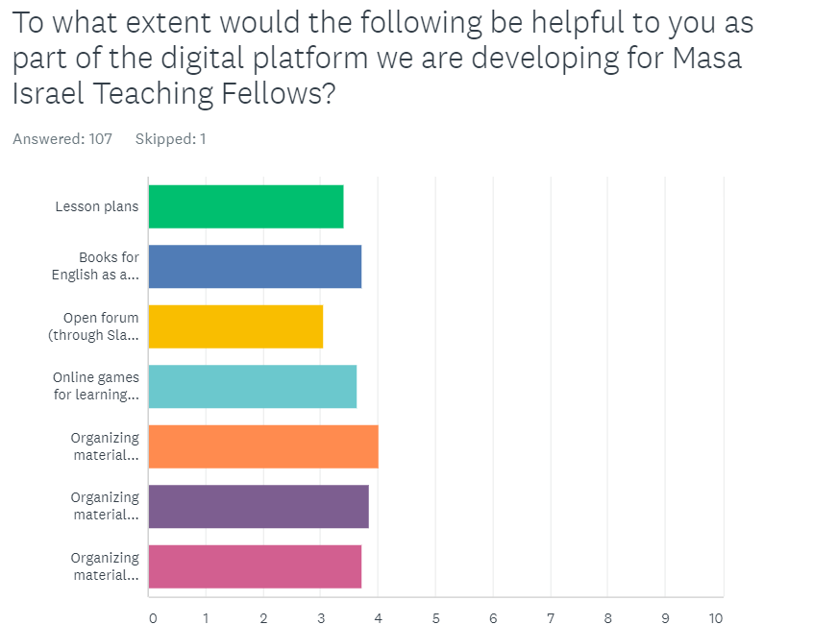


Level
Topics
Age Groups & Levels
Notes:
MITF Survey Feedback

Slide 6
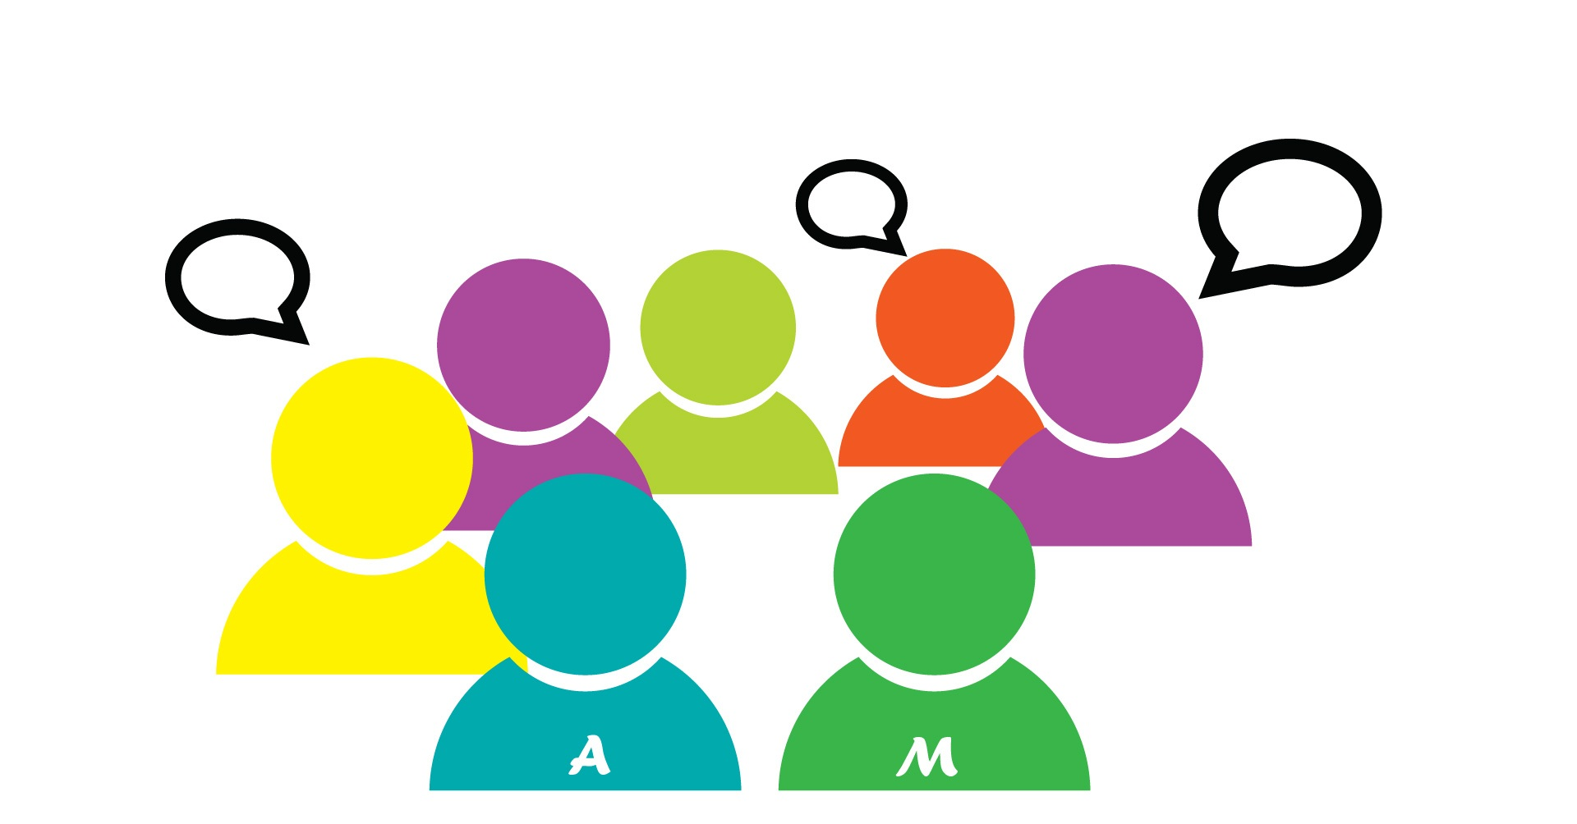
FORUM
FELLOWS COMMUNITY
Notes:
Forum Fellows Community

Slide 7

MITF Survey
Create an open forum
A catalogue of words in Hebrew which are helpful for teaching non English speakers in the classroom ie- study, listen, sit, important, stand sit etc…
Have print out worksheets available

Slide 8

MITF Survey
Make sure most activities require little props/pre planning
How to get kids to be quiet, pay attention, get other kids to go away that aren't my kids I'm teaching, interactive learning games
Links grouped by grammar topics (i.e. present progressive, a vs. an, this vs. that)

Slide 9

MITF Survey
Make sure it aligns with being able to use the workbooks since most teachers here do not like to stray from them.
Figure out how to keep out "noise".
Book Access online.

Slide 10
MITF
Pedagogical Digital Toolbox
MITF Digital Platform
Professional Pedagogical Feedback and Guidance
Sharing Ideas and Materials
Open Forums
Practical Teaching Principles
Implementation of Teaching and Learning Tools
Notes:
The main purpose of this Digital Toolbox is to serve as a repository of resources since it will allow you to download teaching aids, reach various sites that have been organized by grade levels, share ideas and materials and participate in conversation forums.

Slide 11

MITF Toolbox
https://mitf.masaisrael.org/
The goal is to support YOU in using this new approach to teaching and engaging students in learning English.
Notes:
This digital platform is a “Toolbox” to help you reach your students using enjoyable activities that will make a difference in your teaching experience. It includes a variety of teaching resources.
The Toolbox is designed to provide a pedagogical foundation and support you with challenges you may encounter teaching English as a Foreign Language (EFL) in the Israeli school settings throughout the year.

Slide 12
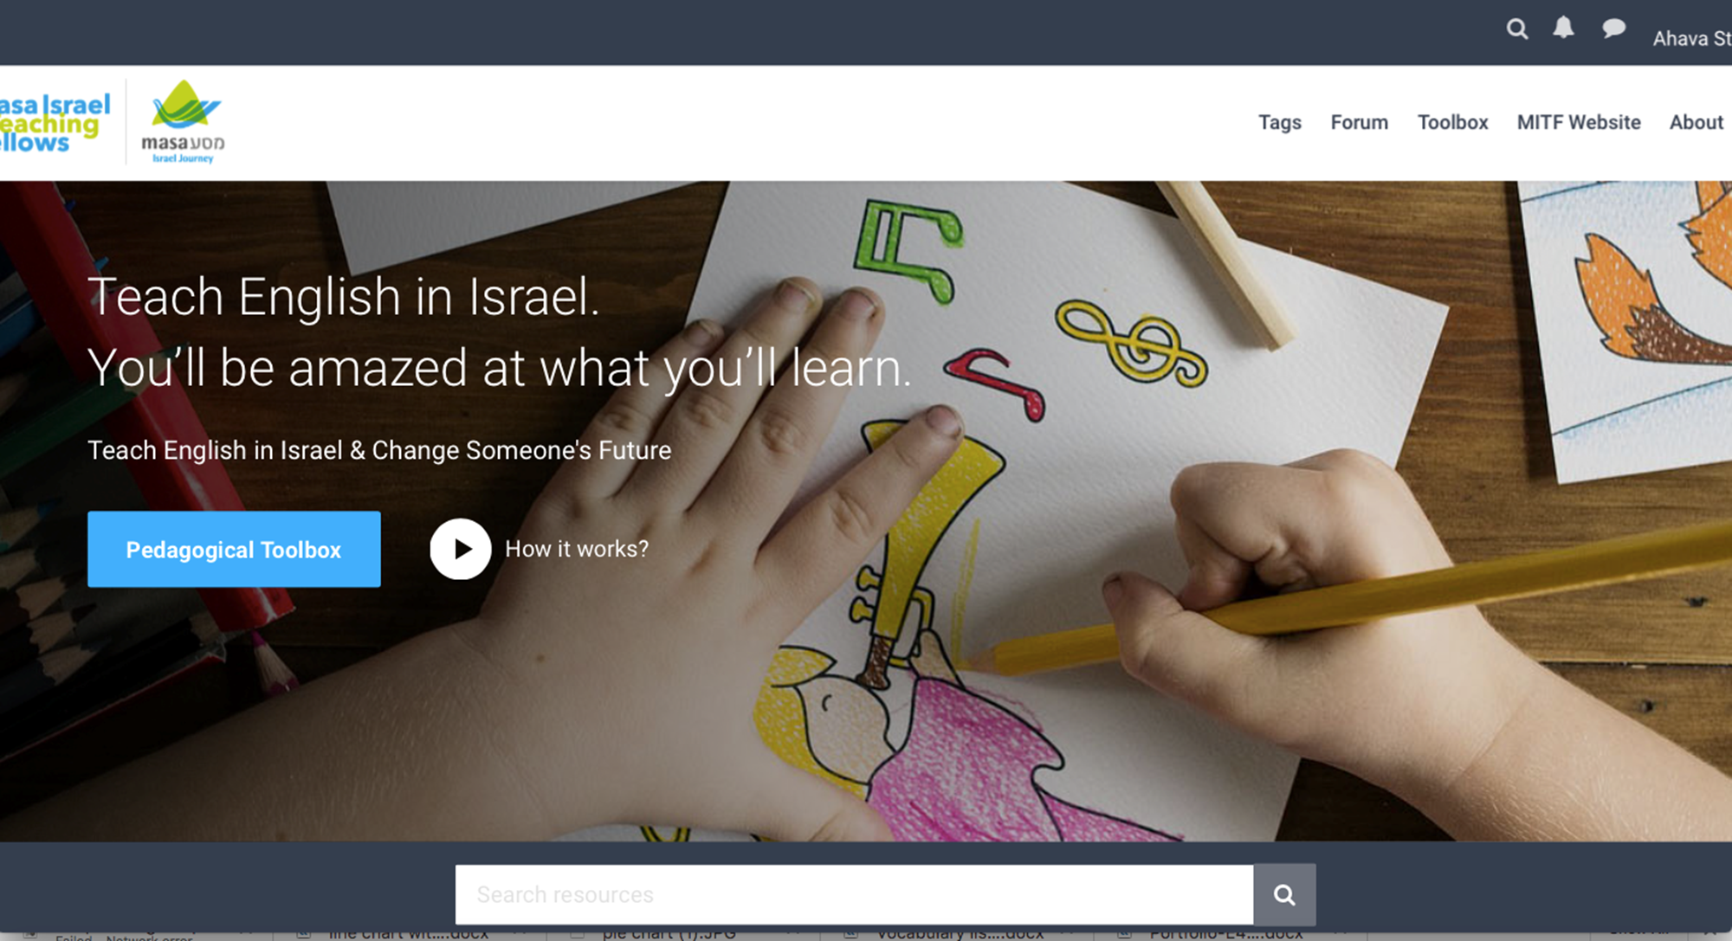
Notes:
To start on the Platform:
You can use the search engine while looking for general teaching resources.
However, in order to plan in advance and efficiently find specific activities for your students, we suggest you get acquainted with how the toolbox is organized.
Then you can download the activities in advance and have the materials with you while working with the students.

Slide 13
MITF Toolbox
Why should I use the Toolbox? (What’s in it for me?)
Take your lessons on the road! We know your time is valuable. Using the toolbox is an opportunity for you to save time and lighten your planning load.
Then you can focus on other important demands such as building relationships with your students, staff and taking care of yourself.

Slide 14
The activities in the toolbox will give you high-quality content such as lessons to correspond to the book your students are using in the classroom as well as songs, videos, and games at your fingertips you can deliver to students.
Watch and listen on the go! A digital Toolbox gives you these engaging activities and resources for a given subject which can be downloaded to have in front of you while working with your students.
Using these well-designed digital teaching tools, you can present content straight from your device.
You will also use the Forum to support you if challenges arise while teaching English as a Foreign Language. You can share ideas, ask questions, and receive feedback to assist you.
It is clear that digital tools support pedagogy and promote learning. The fun and varied activities in the Toolbox enrich student learning. You can use the Toolbox to find what works for you and your students and learning in the classroom will be transformed as a result.

Slide 15
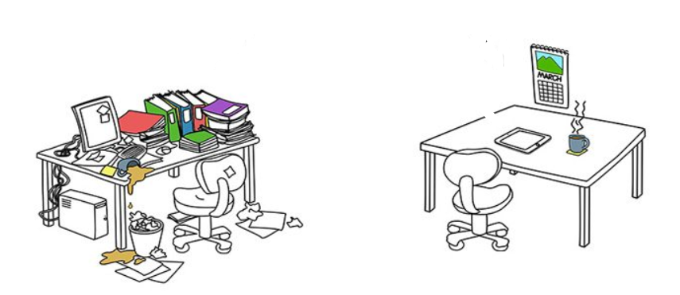
More benefits for digital planning…
Notes:
Benefits of Digital Planning - Why should I use the Toolbox?
Take your lessons on the road! We know your time is valuable. Using the toolbox is an opportunity for you to save time and lighten your planning load.
Then you can focus on other important demands such as building relationships with your students, staff and taking care of yourself.
The activities in the toolbox will give you high-quality content such as lessons to correspond to the book your students are using in the classroom as well as songs, videos, and games at your fingertips you can deliver to students.
Watch and listen on the go! A digital Toolbox gives you these engaging activities and resources for a given subject which can be downloaded to have in front of you while working with your students.
Using these well-designed digital teaching tools, you can present content straight from your device.
You will also use the Forum to support you if challenges arise while teaching English as a Foreign Language. You can share ideas, ask questions, and receive feedback to assist you.
It is clear that digital tools support pedagogy and promote learning. The fun and varied activities in the Toolbox enrich student learning. You can use the Toolbox to find what works for you and your students and learning in the classroom will be transformed as a result.

Slide 16

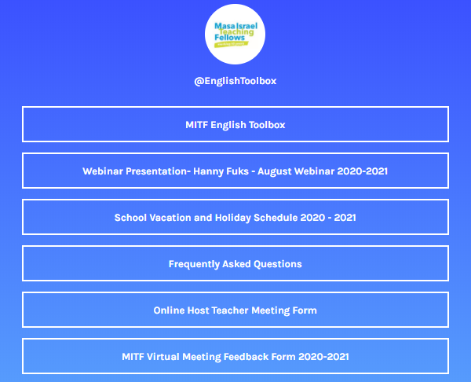

Slide 17
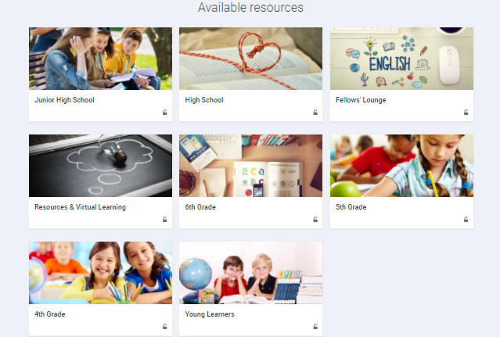
Digital Toolbox
There are two main sections in addition to the grade levels.
Fellow’s Lounge
Resources & Virtual Learning
Notes:
Besides the grade sections there are three additional sections:
The Forum will attempt to offer Pedagogical guidance via this digital tool by a professional team who will be attentive to your needs and feedback. Here you can open a question on the Forum and share your ideas, ask questions, and help your fellows. (Slide 20)
“English Day” is a seminar where you will learn more unique and exciting methods to support teaching English.
“Resources and Activities” includes eleven different subsections:

Slide 18

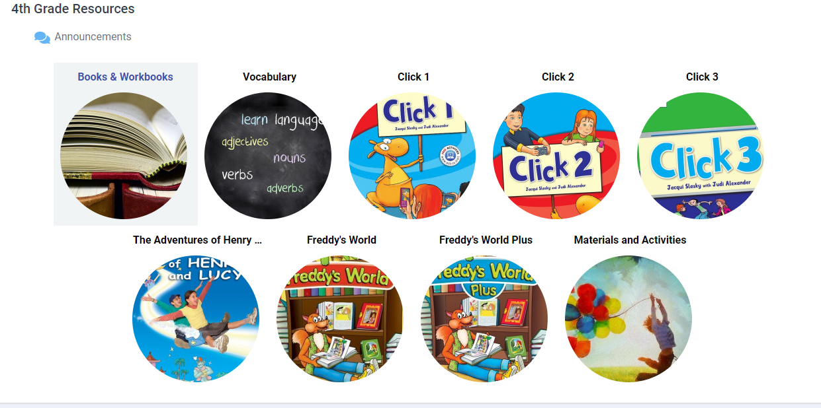
Notes:
Within each grade level you will find:
1) the relevant Schoolbooks used in Israel with activities to enrich each unit.
2) materials and activities for specific grade levels including songs, speaking activities, reading and writing tasks, games and more
3) You will also find vocabulary and grammar support activities

Slide 19
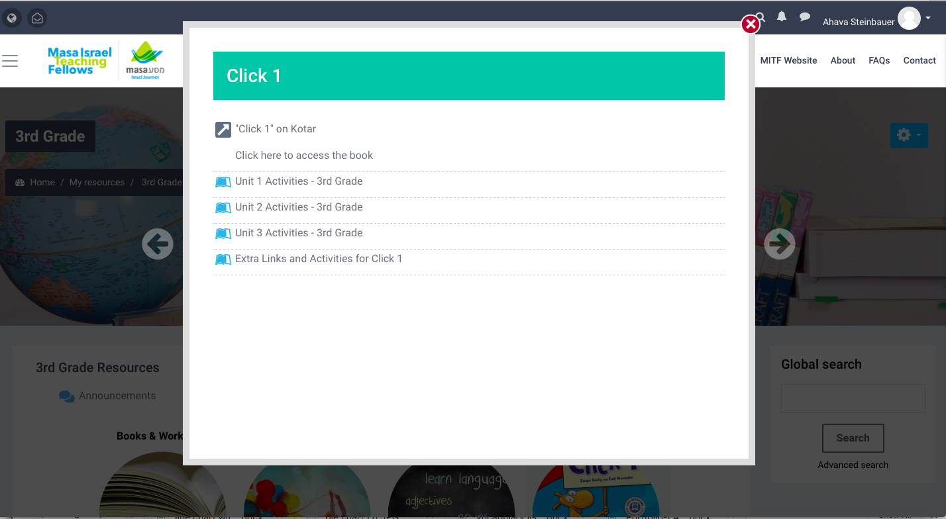
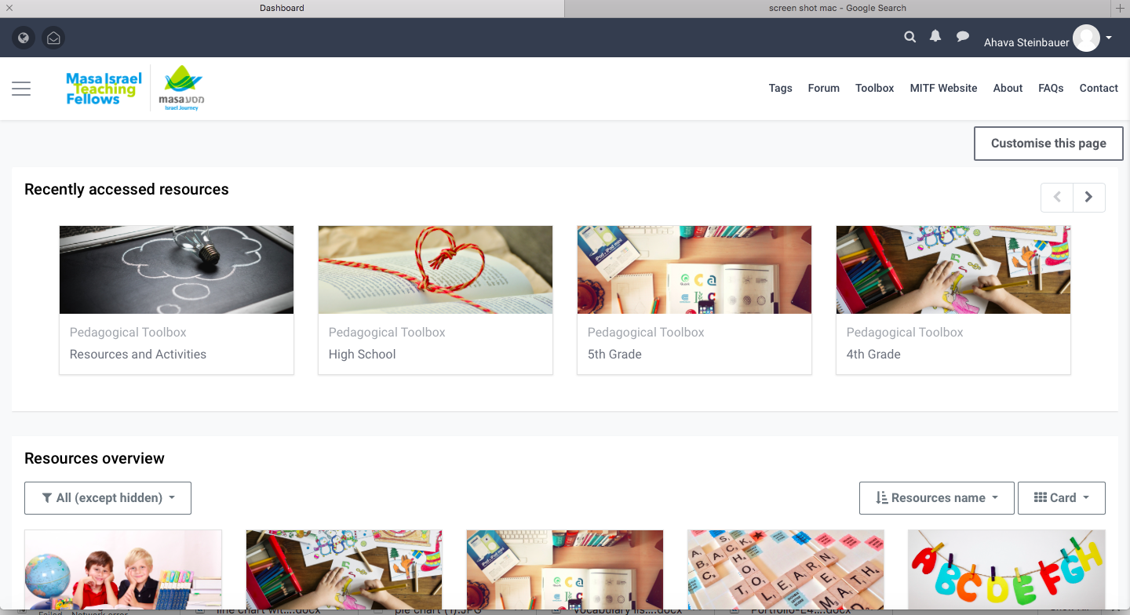
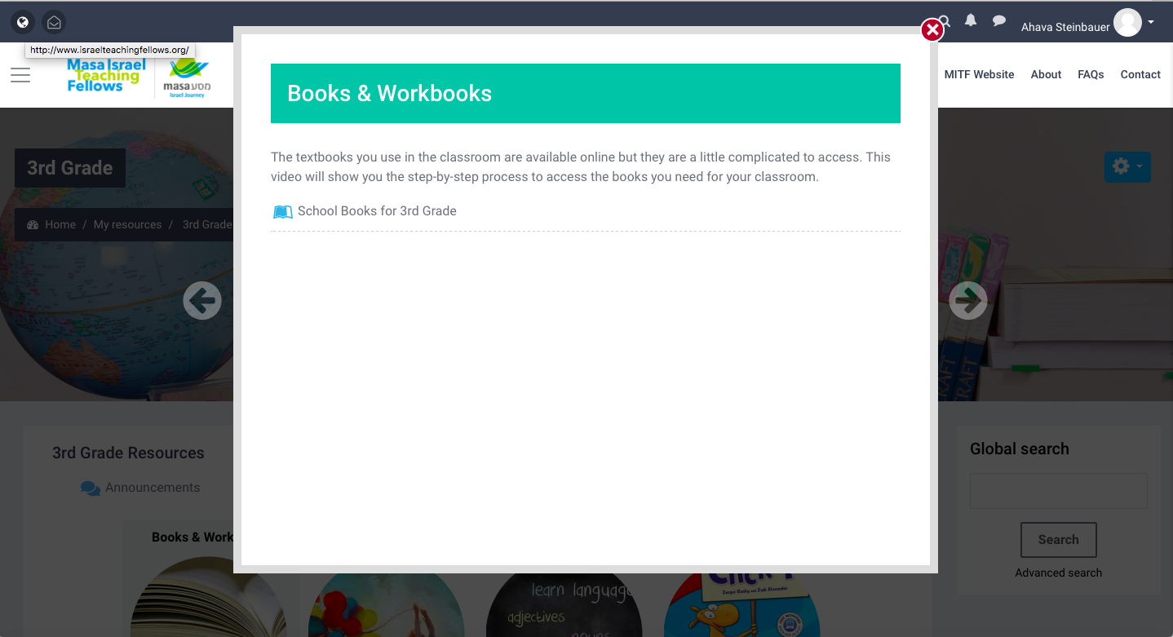
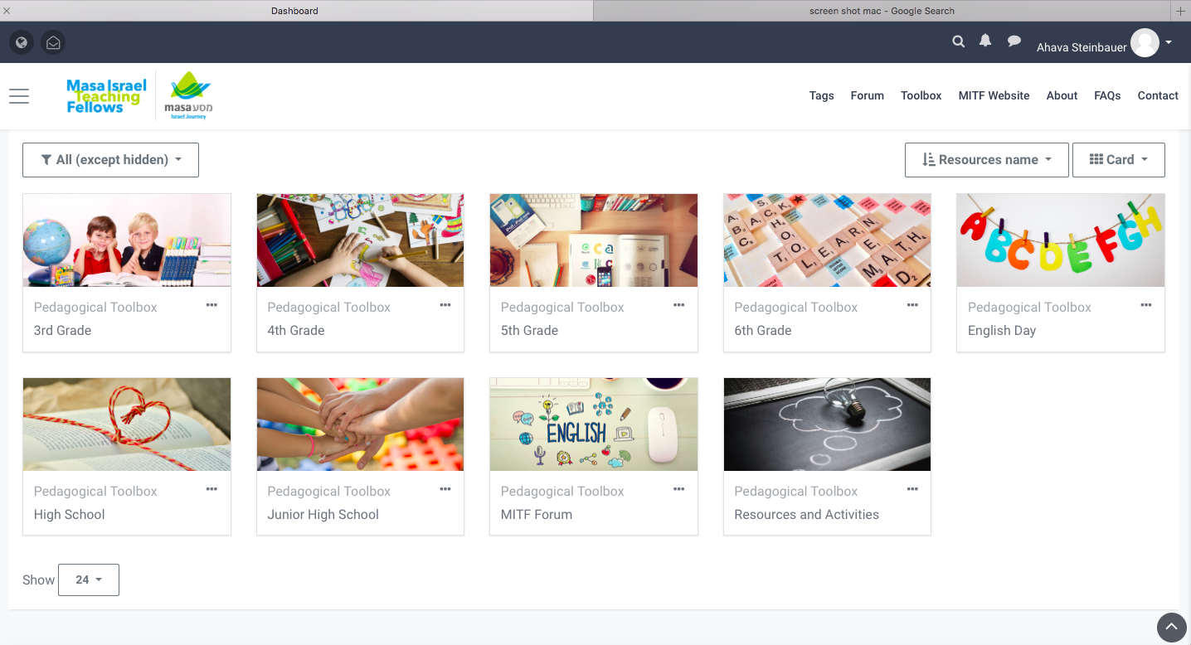
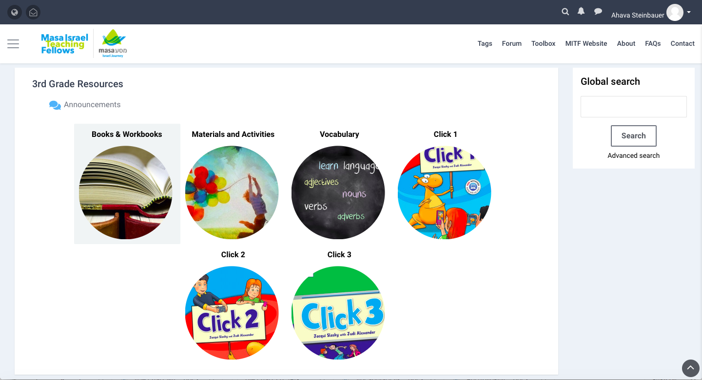
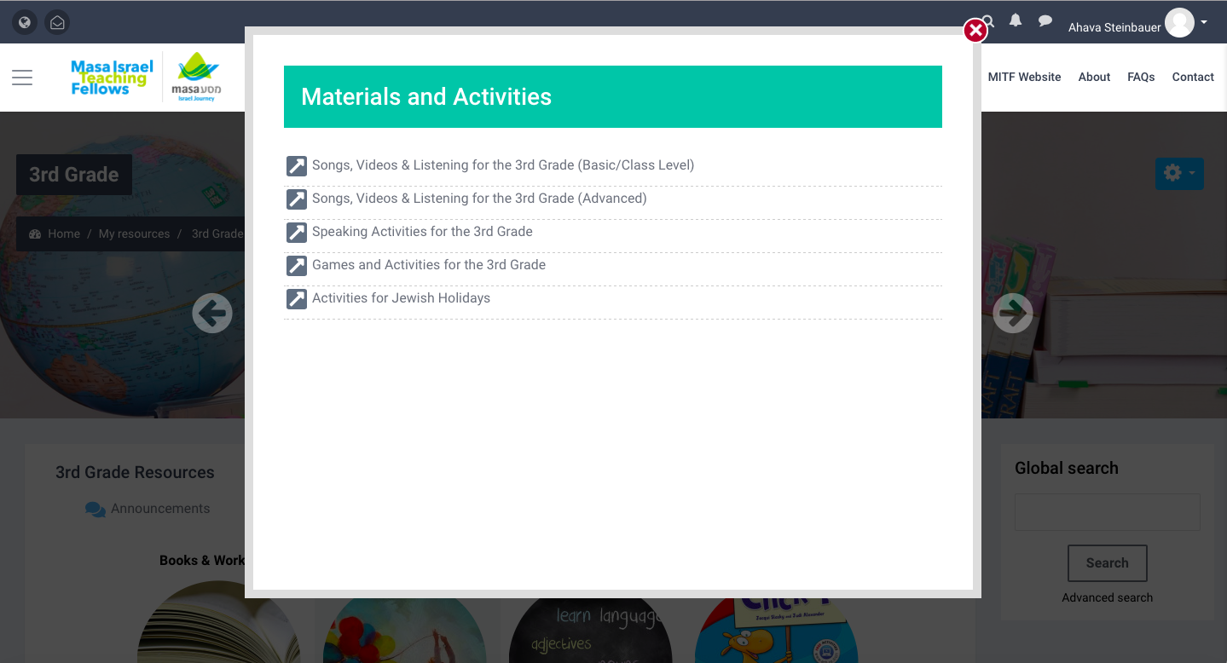
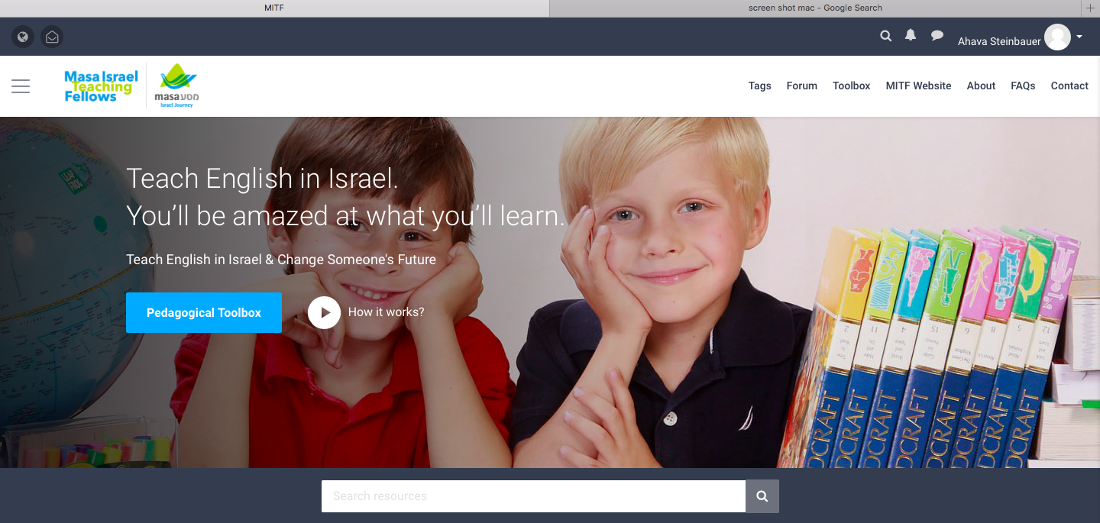
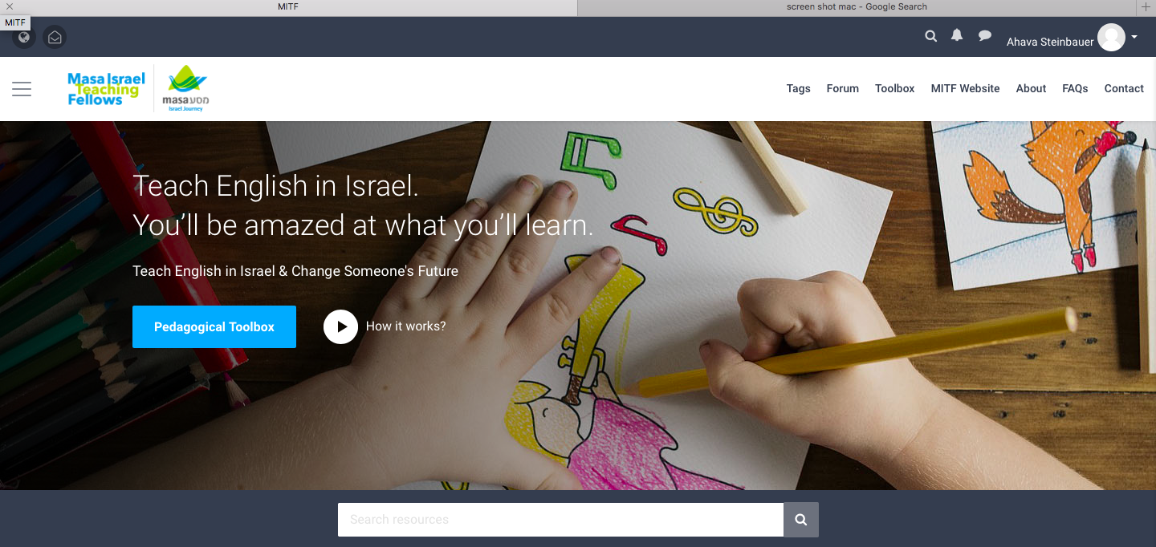
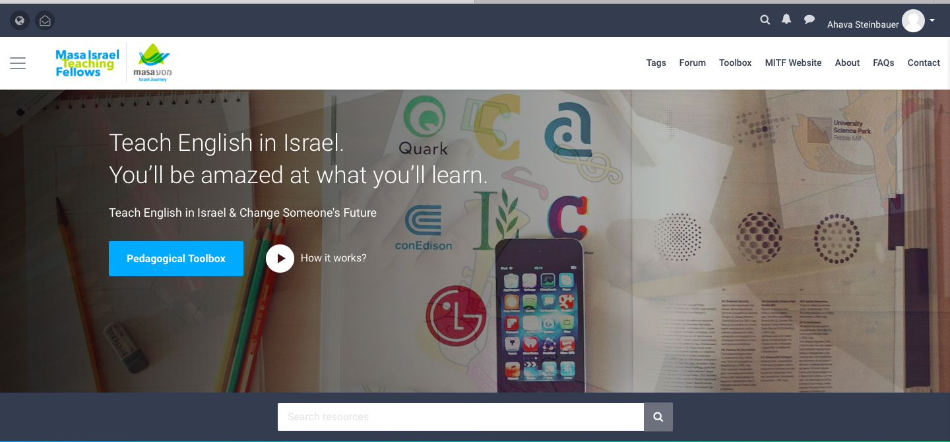
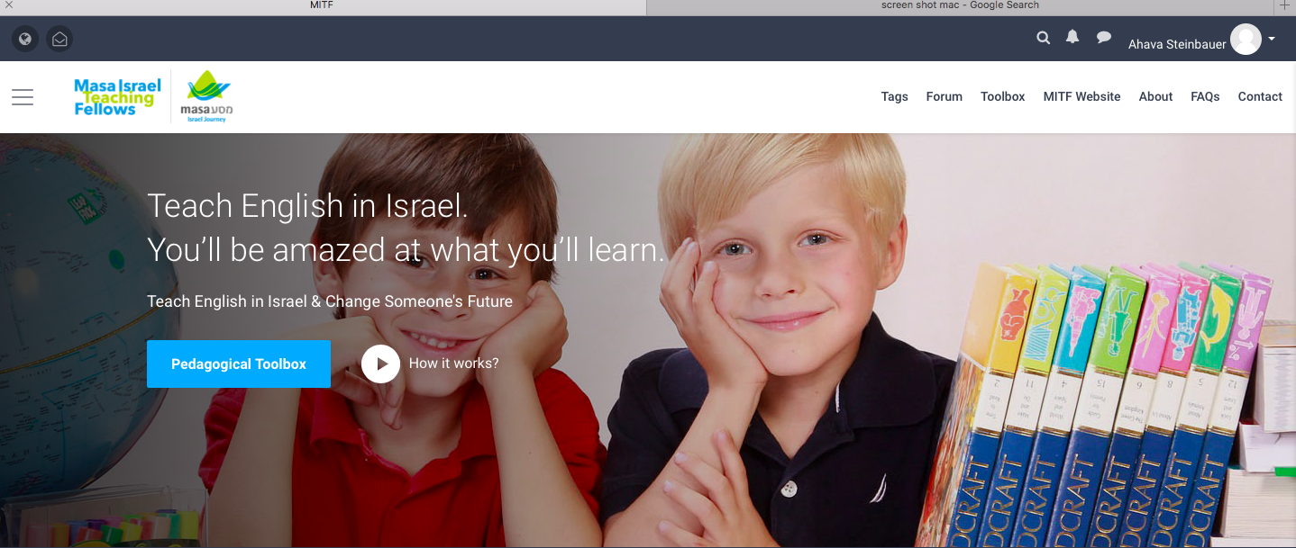

Slide 20


Slide 21
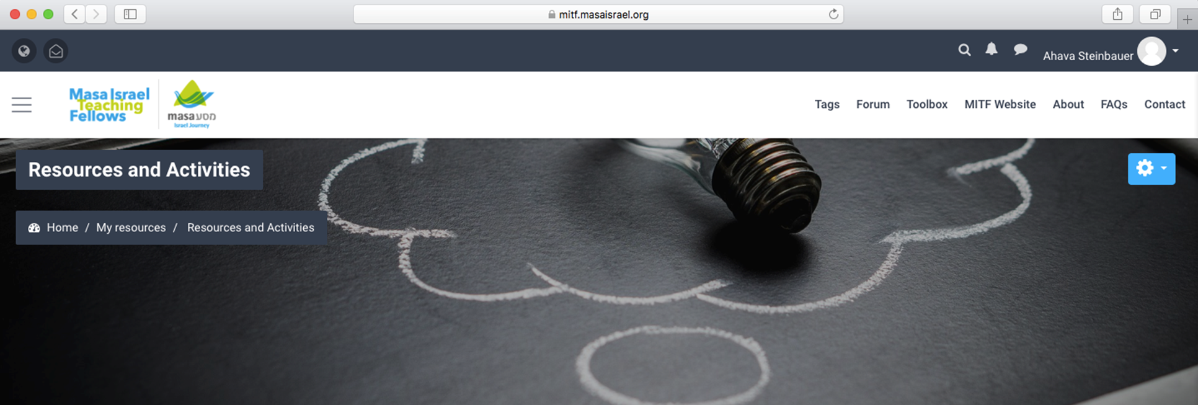
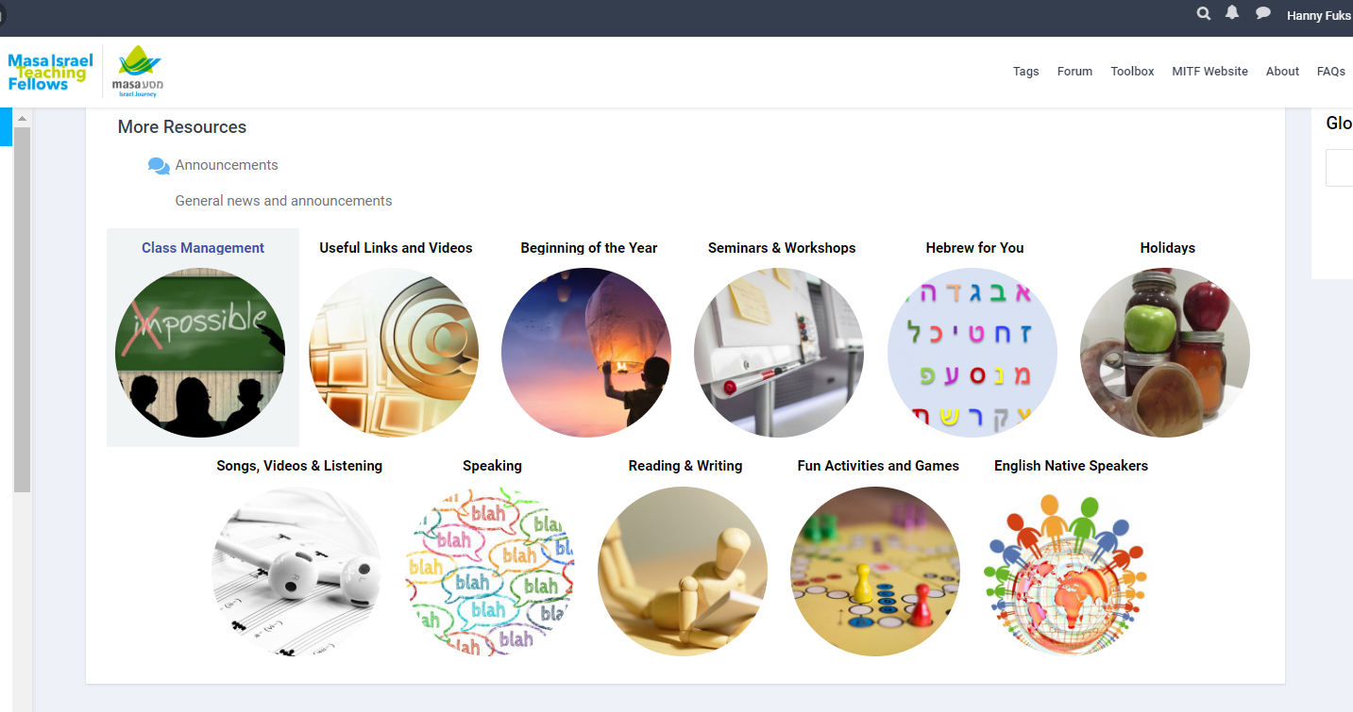
Notes:
11 subsections in Materials and Resources

Slide 22
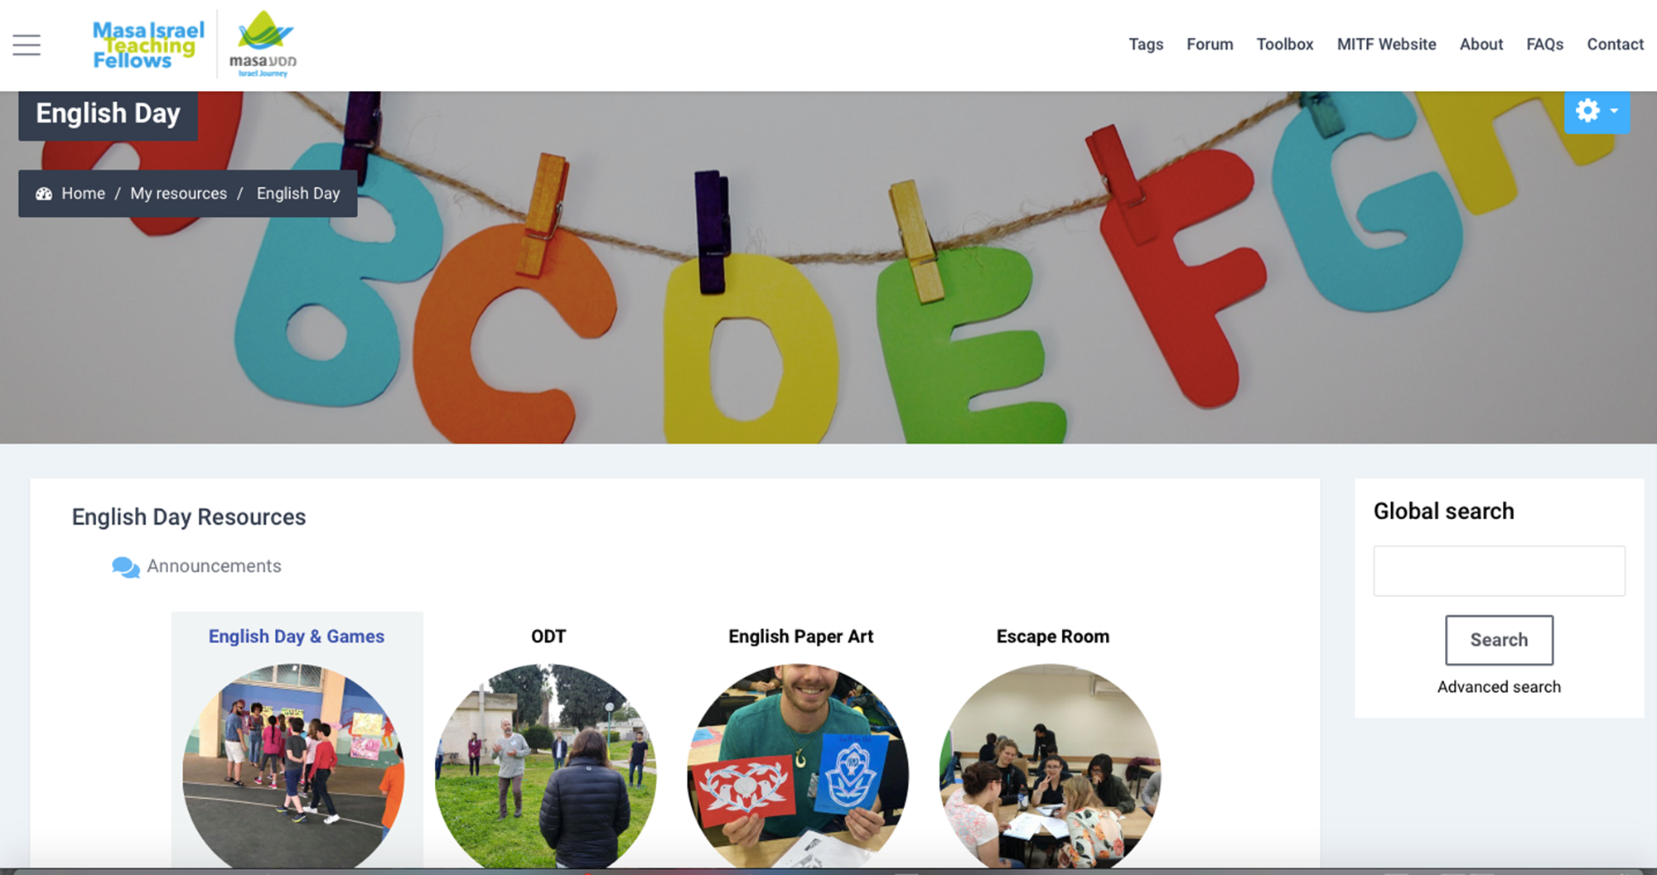
Notes:
English Day

Slide 23
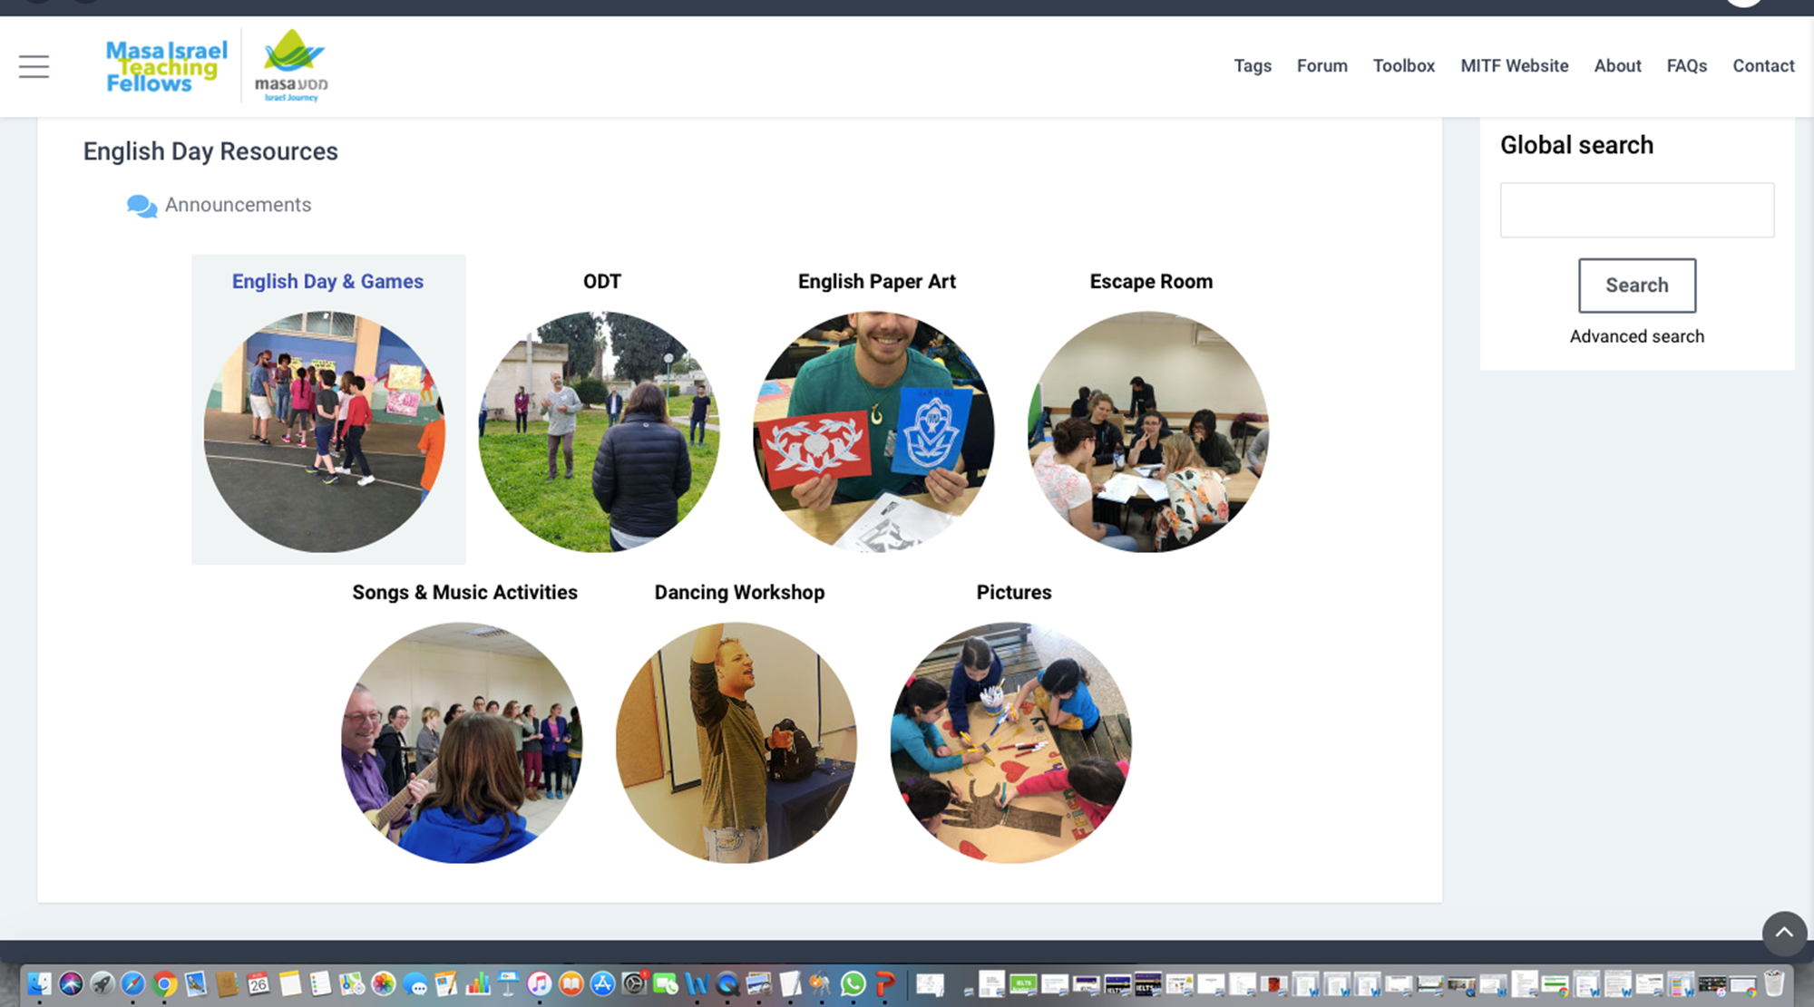
Notes:
English Day

Slide 24
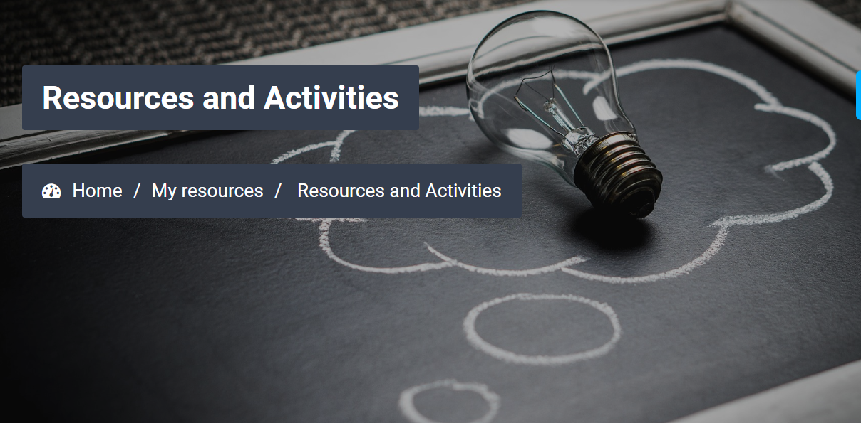
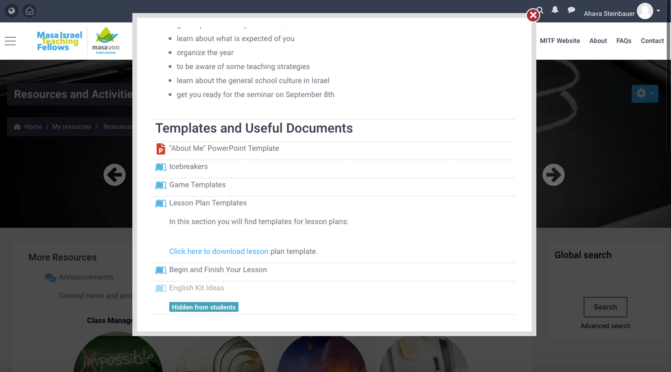
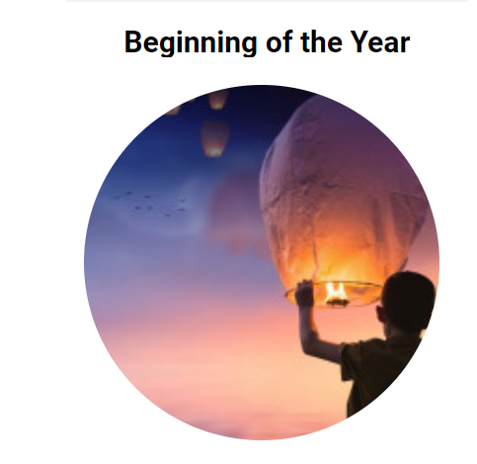
Notes:
Beginning of the Year
I would like to emphasize the last subsection that is called the “Beginning of the Year” because this is the one you should focus on right now.

Slide 25


Notes:
You will also find Icebreakers (since Israel is so hot!!!) in the Beginning of the Year section.

Slide 26
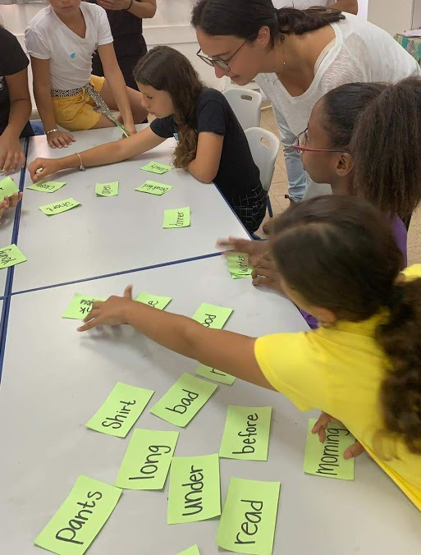
ESL Warmer: Yes, No, Stand up
https://www.youtube.com/watch?v=G0HoUDhRpKA
Fun Activities
ESL Warmer: Class Snap
https://www.youtube.com/watch?v=F-DysLKBS-8
ESL Warmer: What is it?
https://www.youtube.com/watch?v=iLkS4Uy_bFw
ESL Game: Creative Match
https://www.youtube.com/watch?v=L4NzHs_Ymdw
Pass the beat around the room
https://www.youtube.com/watch?v=8u5Jc3D5p3c
"Crazy Claps" Warm Up Activity by Aytek Yıldız
https://www.youtube.com/watch?v=E3m9DKEt2Oc
ESL Games That Are Fun | ESL Basketball | Easy ESL Games
https://www.youtube.com/watch?v=dpwykorTPbo
ESL Game for Large Classes | Relay Race | Easy ESL Games
https://www.youtube.com/watch?v=zxaEJST8-3Y
Notes:
Icebreakers

Slide 27
Notes:
Beginning of the Year - Here you can download the forms you need and focus on creating your “About Me” Presentation using the templates provided. Then you will have your tools ready and use your tricks and pull a rabbit out of your hat when you meet your students!!!

Slide 28
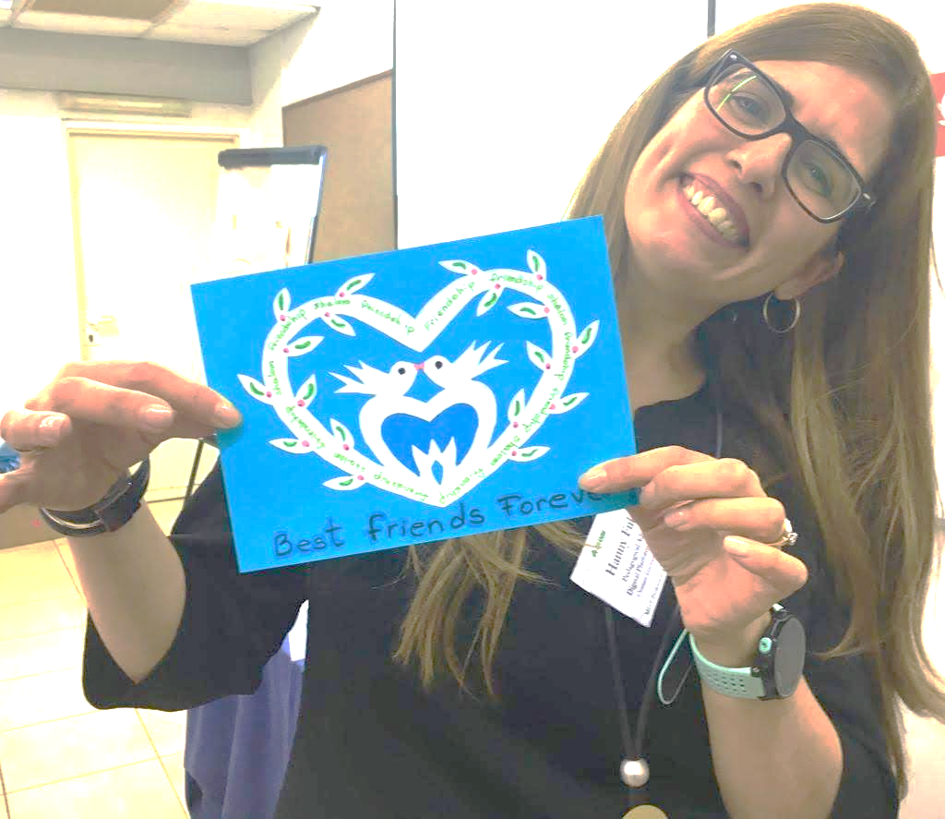
This is me!
Notes:
About Me Template

Slide 29


My name is Hanny.
I grew up in Argentina.
I live in Israel.
Notes:
About Me

Slide 30
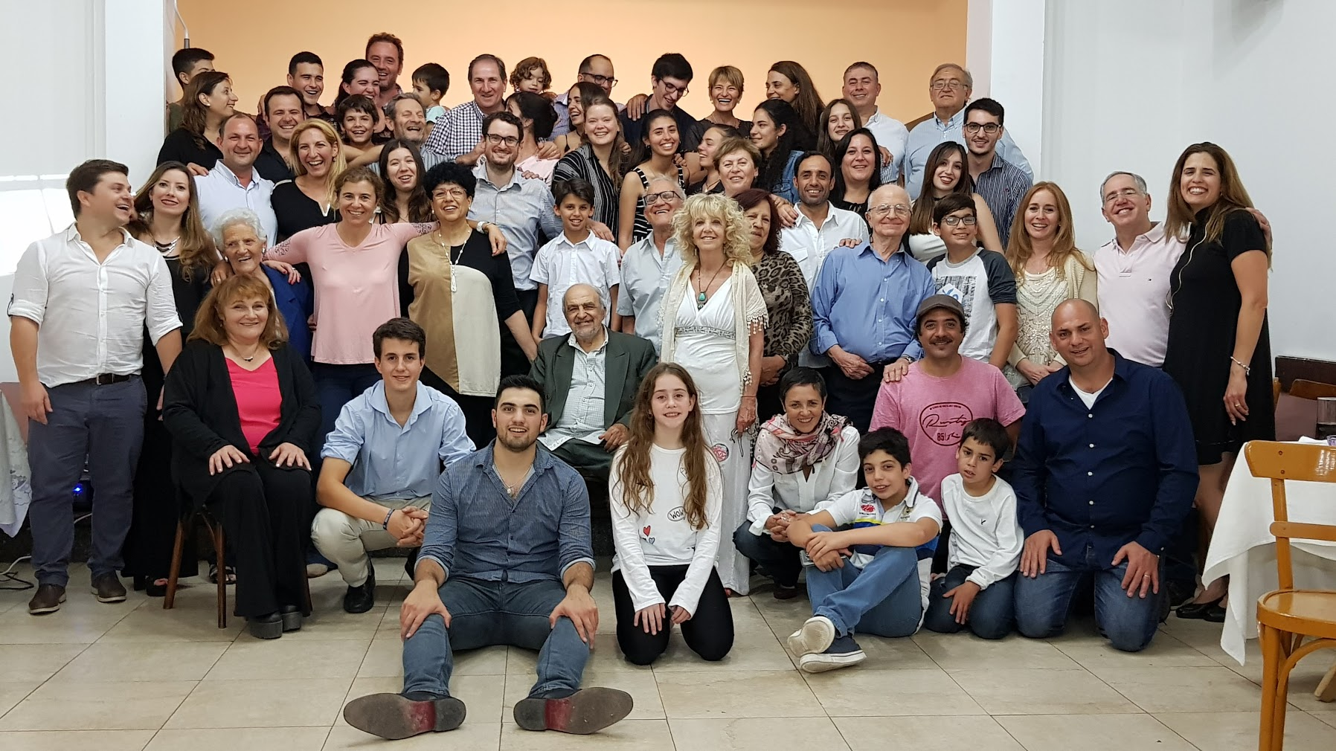
This is my family.
Notes:
About Me

Slide 31
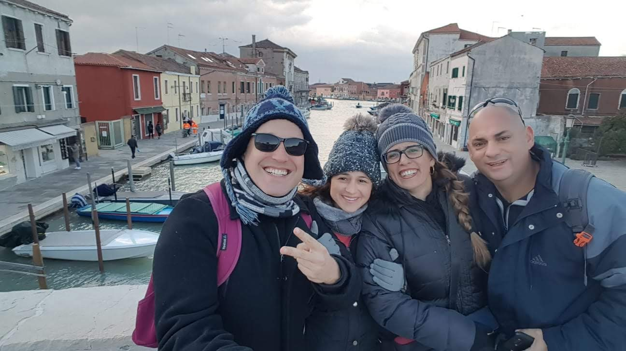

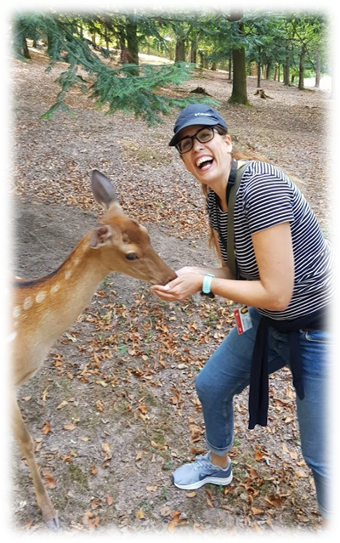
I love...
My Friends
My Family
Animals
Notes:
IAbout Me love...

Slide 32

I like...
Gourmet Food
What do you like?
Notes:
IAbout Me love...

Slide 33
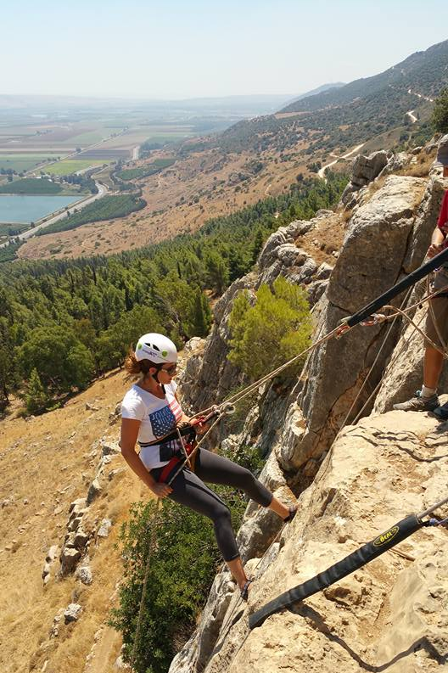
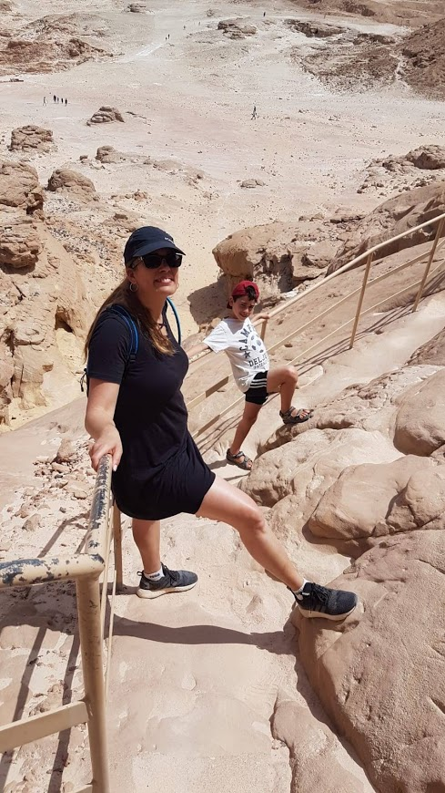

My hobbies are...
Notes:
IAbout Me love...

Slide 34


I want to be…
an artist.
Notes:
About MeI love...

Slide 35
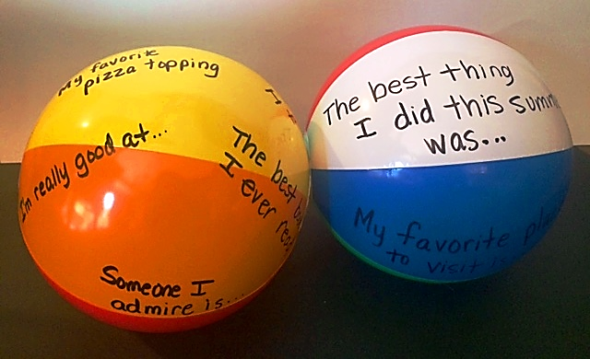
Beach Ball Introductions
https://www.scholastic.com/teachers/blog-posts/genia-connell/10-fun-back-school-activities-and-icebreakers/
Notes:
Beach Ball Activity with Fellowslove...

Slide 36
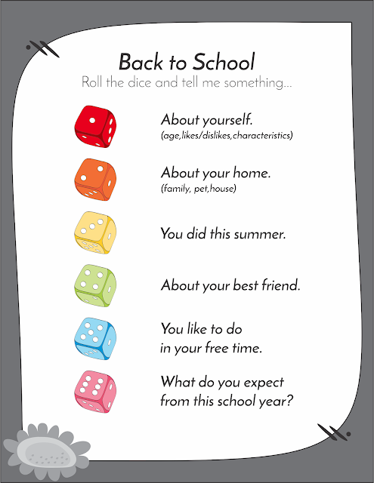
https://wordwall.net/resource/354397/dice
Notes:
I love...

Slide 37
I hope...
We have a great year together!
Notes:
I hope we have a great year together! love...

Slide 38
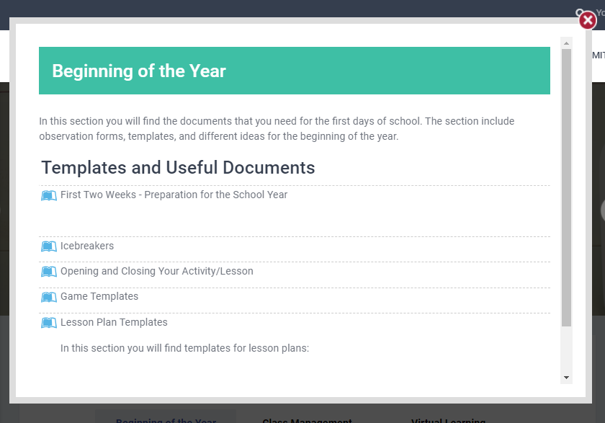
Notes:
School Visit forms you will complete in Google Forms and bring with you to the Seminar on September 8th

Slide 39
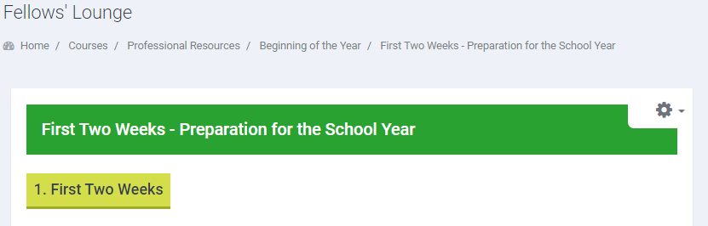

Slide 40

We wish you good luck !
Notes:
Good Luck and see you on September 8th!

