Slide 1

Co-Teaching Experience

Slide 2
What is Co-Teaching?
It is…
  Two professional educators cooperatively working together.
  A professional partnership delivery in a shared space.
  Promoting diverse groups of students.
It is not…
  One professional educator and an assistant.
  Only taking turns teaching a whole class lesson.
  Always separating/grouping the students based on abilities.
Notes:
These are our guidelines about co-teaching.
However, as you’ll see today these guidelines can be adjusted based upon what the students need.
This is what we did...

Slide 3
How Does Co-Teaching Work?
You need to quickly purchase a gift for a friend’s child…
Things to Know:
  Spend under ₪75, as that’s all you have now!
  Child wears glasses.
  The child loves:
    Animals
    Building/making things
Other Notes:
  9 year old girl
  Diabetic, so no sugar!
  Allergic to latex.
  Constantly loses her glasses.
  Afraid of dogs.
  Doesn’t own phone/computer.
How many ideas do you have?
Combine your choices with a partner. Do you have more to select from?

Slide 4
Isn’t there conflict?
Who makes the final decisions?
Notes:
**ASK THEM**
This is often a misunderstanding about co-teaching. Whether there is a conflict of interest or ideas.
Co-teaching is making a joint decision. Equal voice

Slide 5
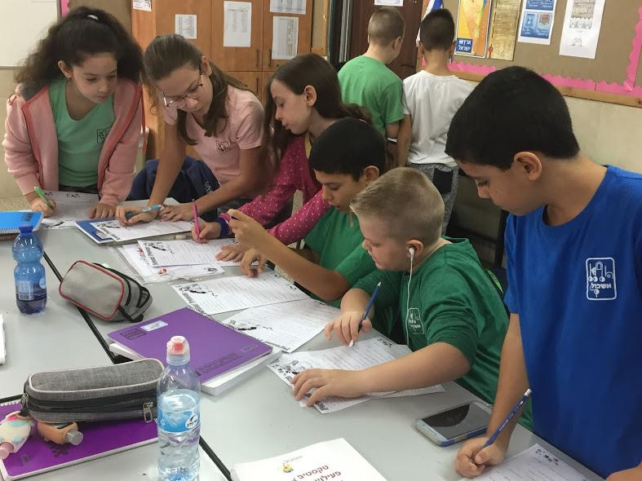
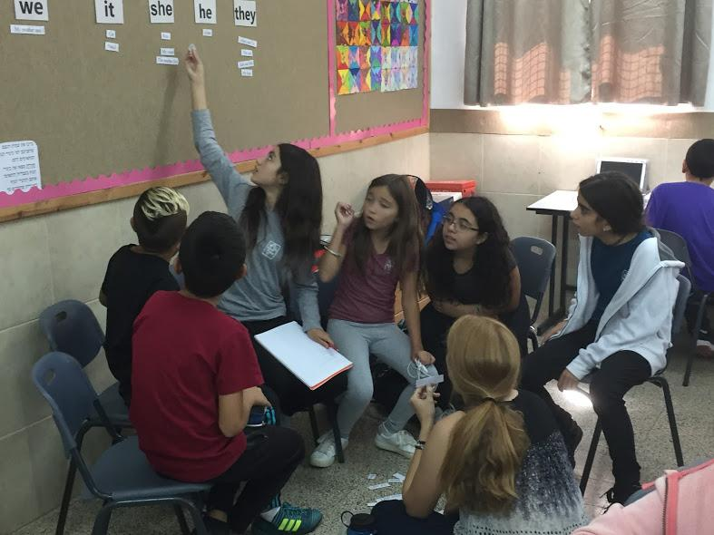
Sharing
Hopes,
Attitudes,
Responsibilities and
Expectations
Bucks County Intermediate Unit: www3.bucksiu.org

Slide 6


Questions When Lesson Planning
What curricular material must be covered?
What are the main goals we want the students to achieve?
How can we use authentic methods of teaching?
  Allowing students to be critical thinkers and engaged?
Which co-teaching model should we use?
  Ensuring we reach all the students’ needs.
  One Teaches, One Drifts; Stations; Parallel; Team; Alternative
Does either teacher have experiences or resources to supplement the lesson?
Notes:
Start with, “As you well know lesson planning is always about…”

Slide 7
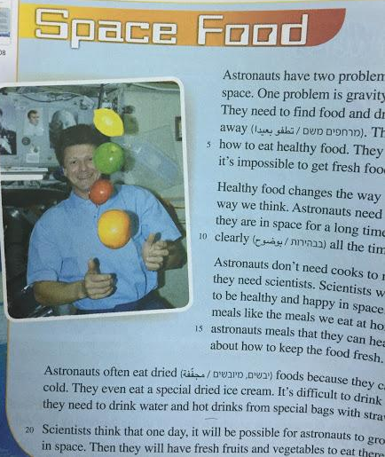
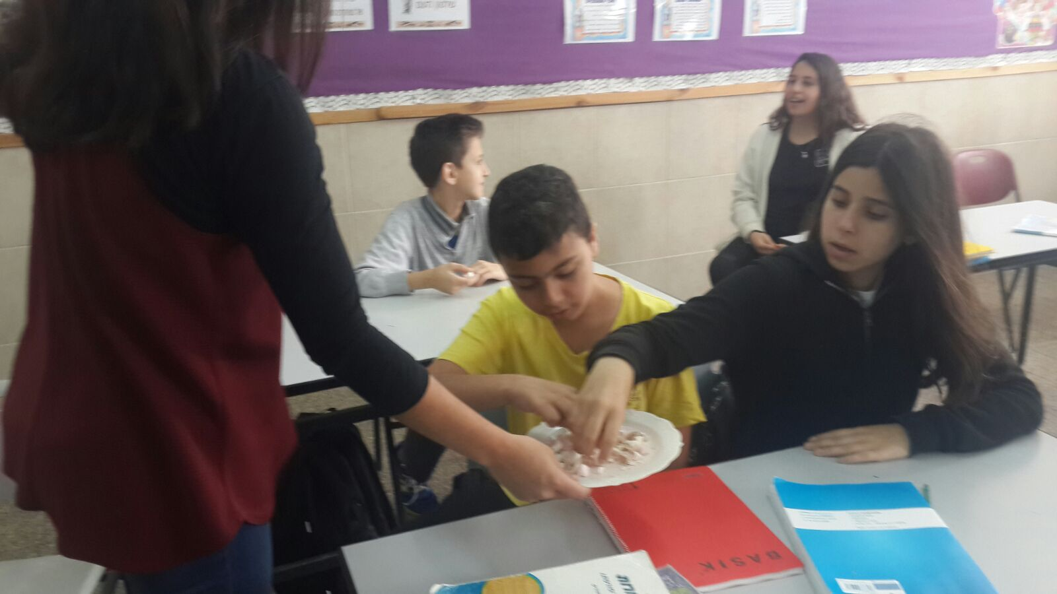
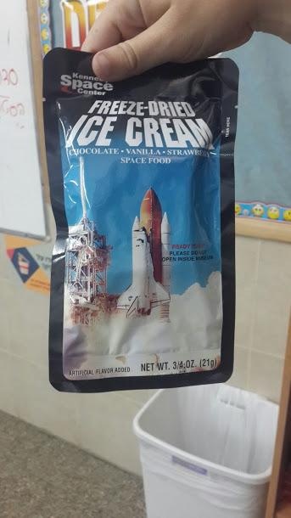
Lesson Planning & Execution
Goal: Students will use new vocabulary knowledge to read the text, ‘Space Food’, and answer comprehension questions.
External Resources: Courtney lived near NASA for 20 years, and previously taught Space Units in the U.S.
Bonus: Has actual space food… freeze-dried ice cream!
Teaching Model:
One lead teacher guiding vocabulary review, discussion and comprehension check, with co-teachers drifting.

Slide 8
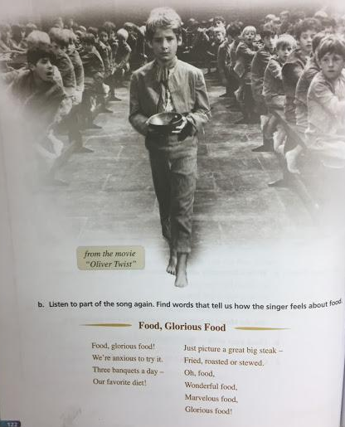
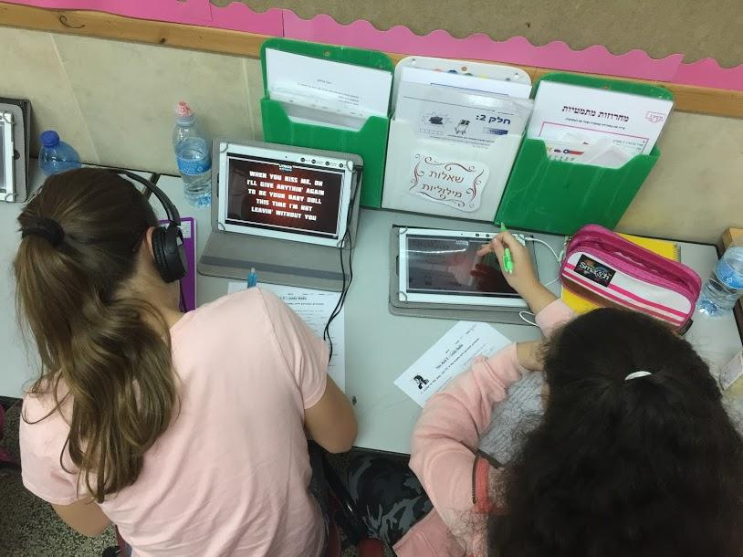
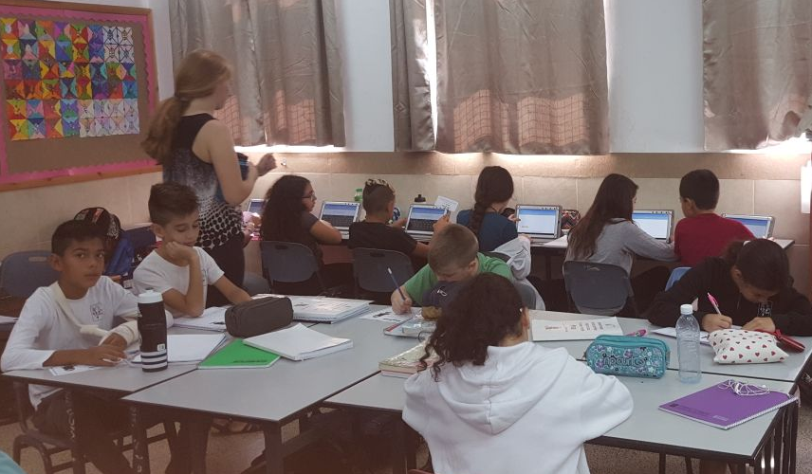
Lesson Planning & Execution
Goal: Students will use new vocabulary knowledge to read ‘Oliver Twist’ and answer comprehension questions.
External Resources: Britney has experience with musicals, including songs from ‘Oliver Twist’.
Teaching Model: Stations, where each co-teacher directs an activity:
Listening and writing song lyrics.
Vocabulary review games.
Comprehension of videos clips.

Slide 9
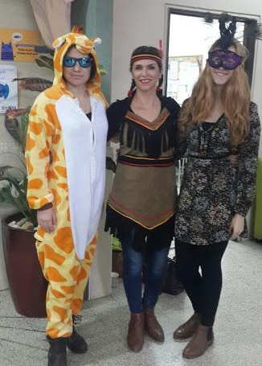
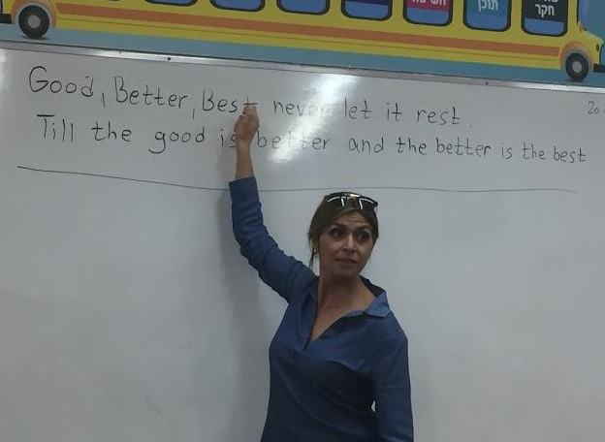
Reflections Of Each Lesson
Were the learning goals met?
What were the struggles with the lesson? The successes?
What can I (personally) do to improve my teaching?
How can I improve interaction and collaboration with my co-teacher?
Must be open to receive constructive feedback from co-teacher - which requires open communication.
Notes:
As

Slide 10
Using 3 Models
Madeleine Lifsey
Ofek Primary School, Ramle
http://prezi.com/dcwskm4dgkpe/?utm_campaign=share&utm_medium=copy&rc=ex0share

Slide 11
Co-Teaching in Middle/High School
Hannah Wilpon
Mada’im School, Rehovot

Slide 12
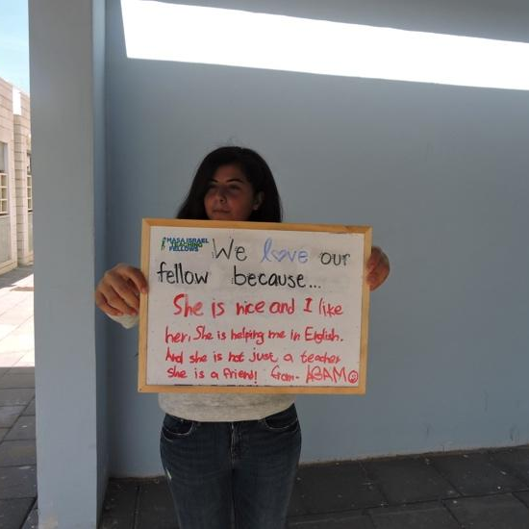

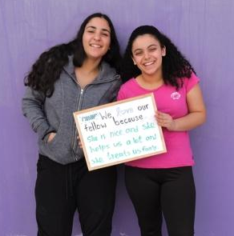
Older students are more aware of the benefits
of working with a native English speaker.
The higher language level of the students allows for more comprehensive projects, combining the skills and knowledge of the host-teacher and U.S.-teacher.

Slide 13
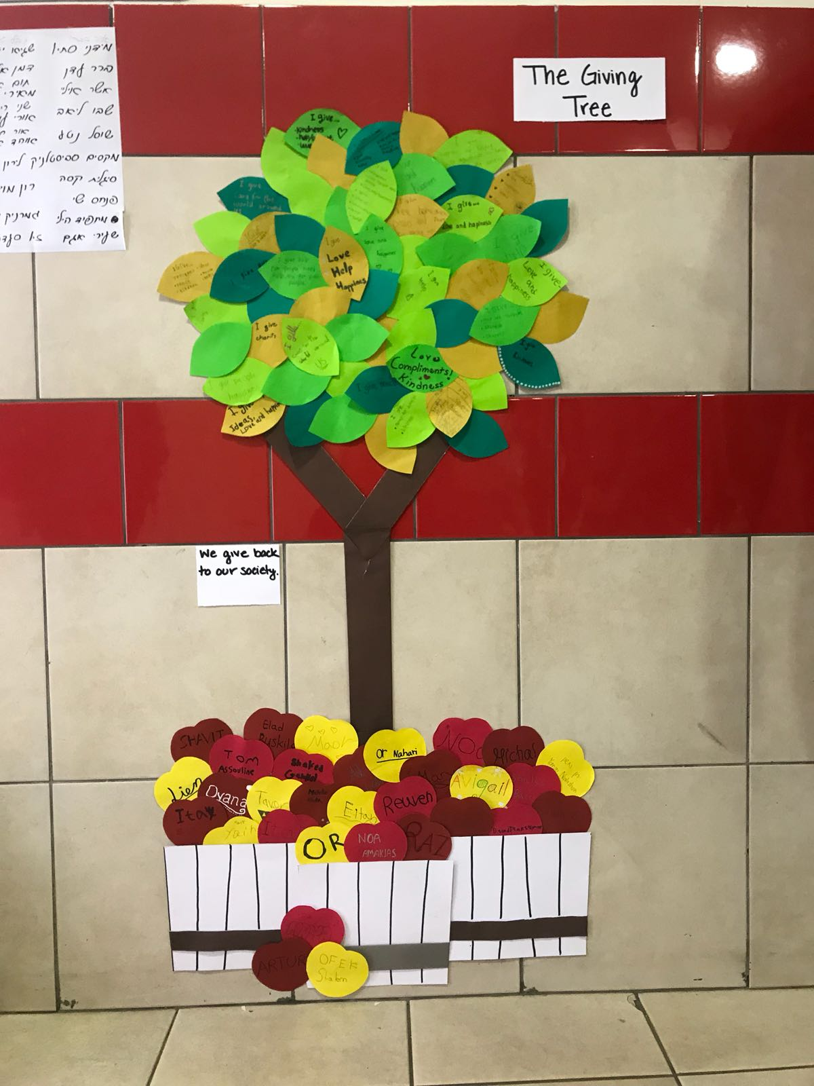
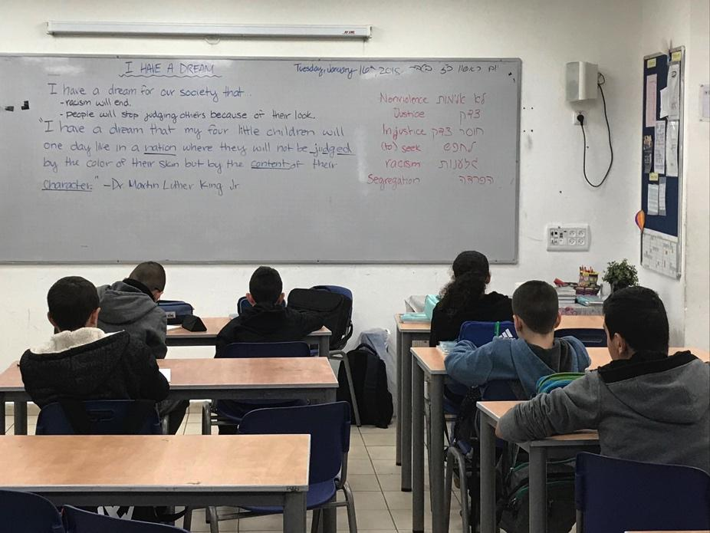
Example Projects

Slide 14
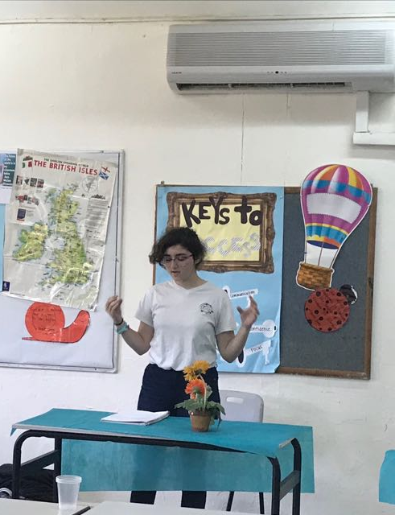
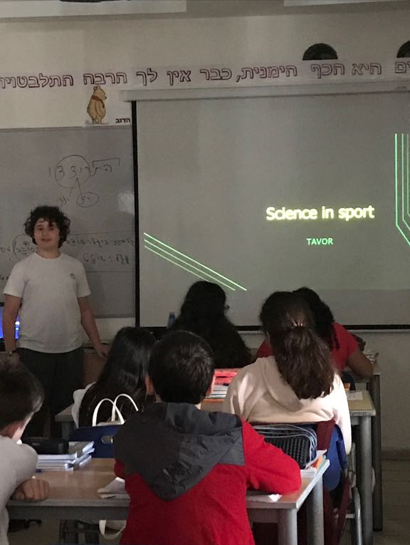
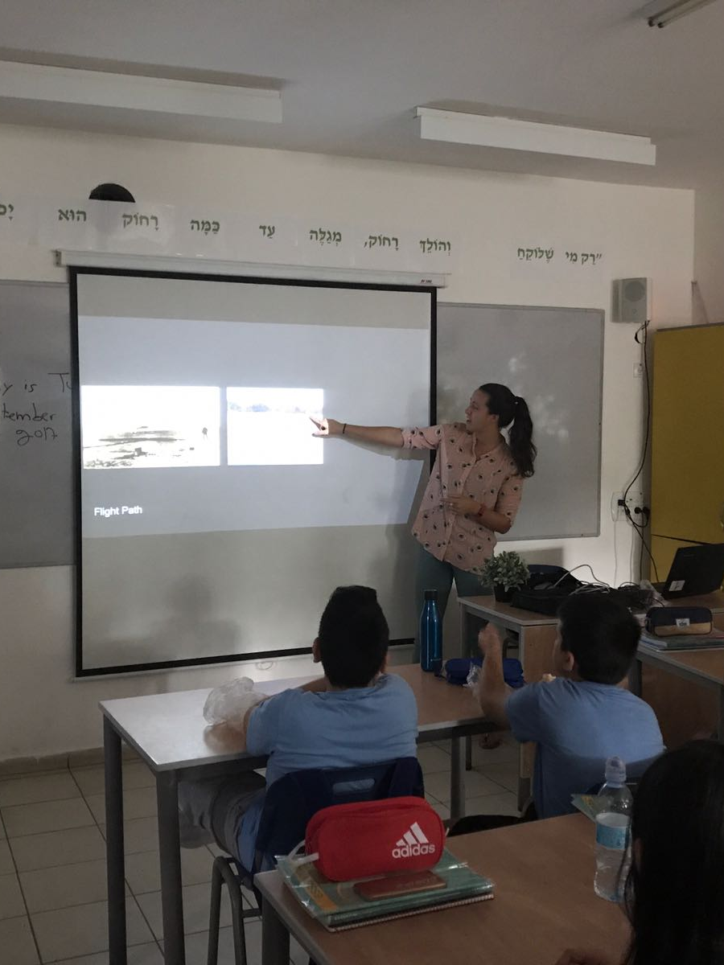
Co-teaching in middle and high school age groups is a unique way for students to express themselves and speak about their interests,
all while utilizing oral language skills.

Slide 15
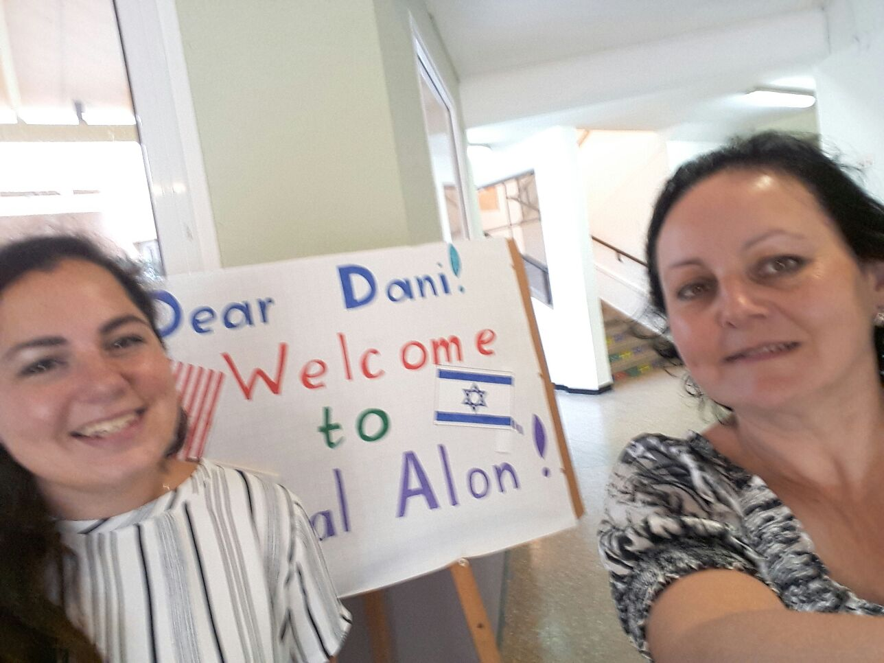
Co-Teaching in a Challenging Environment
Dani Peckman & Natalie Libenson
Yigal Alon Young Academy of Music, Netanya

Slide 16
School Demographics
Southern Netanya - Kirat Nordau
7.55/10 מדד הטיפוח (national scale)
259 Pupils
Lower socio-economic households
Heterogeneous population
High percentage of pupils with single parent
High levels of assistance from social services for low income needs
Low test scores overall

Slide 17
External Struggles and Difficulties
Various learning disabilities
ADHD
Emotional deprivation and disturbance
Neglect
~70 high-risk pupils

Slide 18
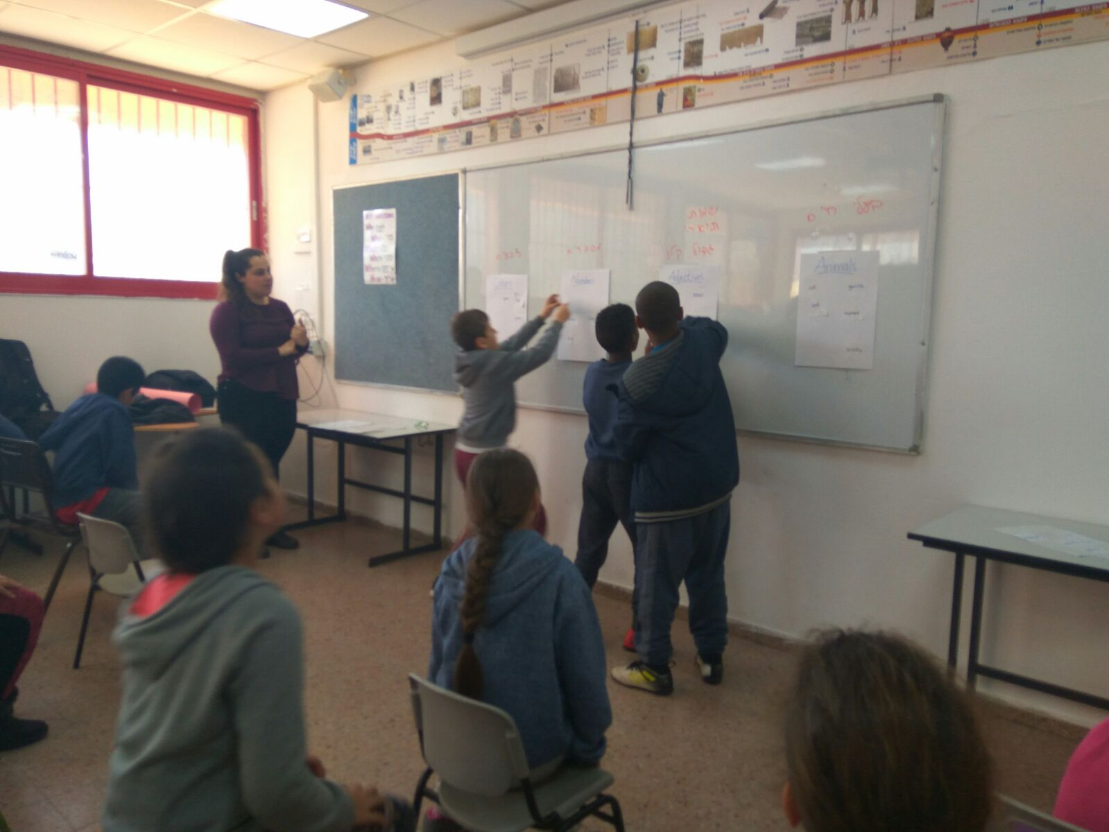
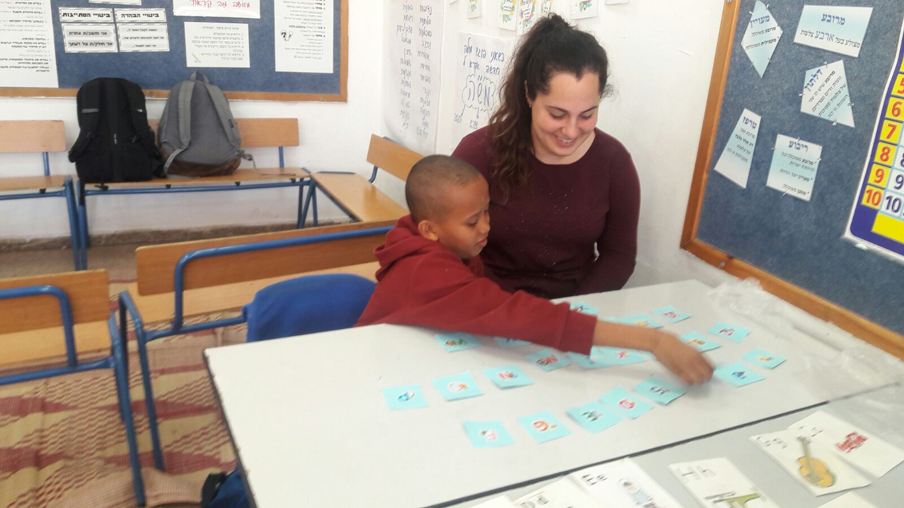
Advantages of Co-Teaching
Combination of strengths
  Experience + New Ideas
  Special Education background and knowledge
  Weekly planning meetings
  Sharing resources and perspectives
  Ability to ‘split’ a teacher in half
More attention given to the individual
  2 Teachers in class
  Tend to emotional needs
  Extra pairs of eyes
  Simultaneous whole class and individual instruction

Slide 19
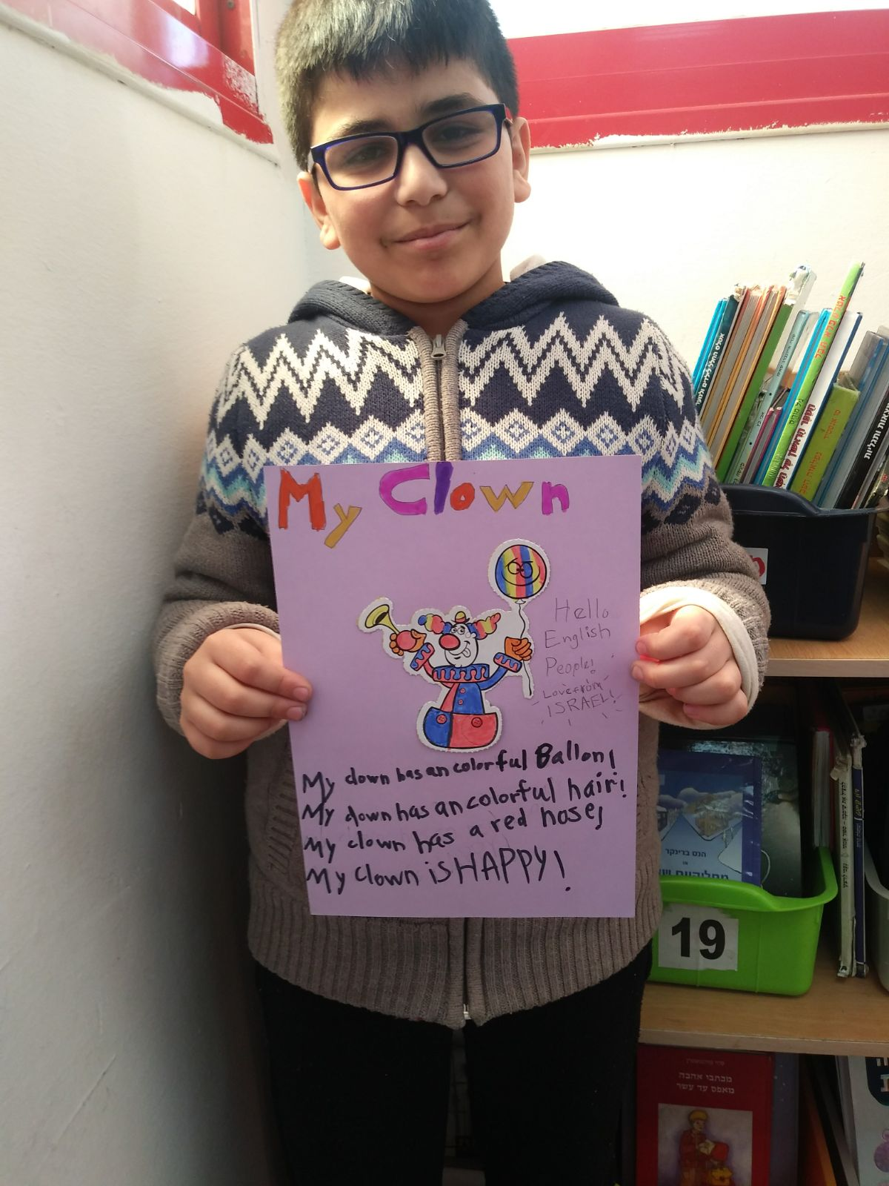
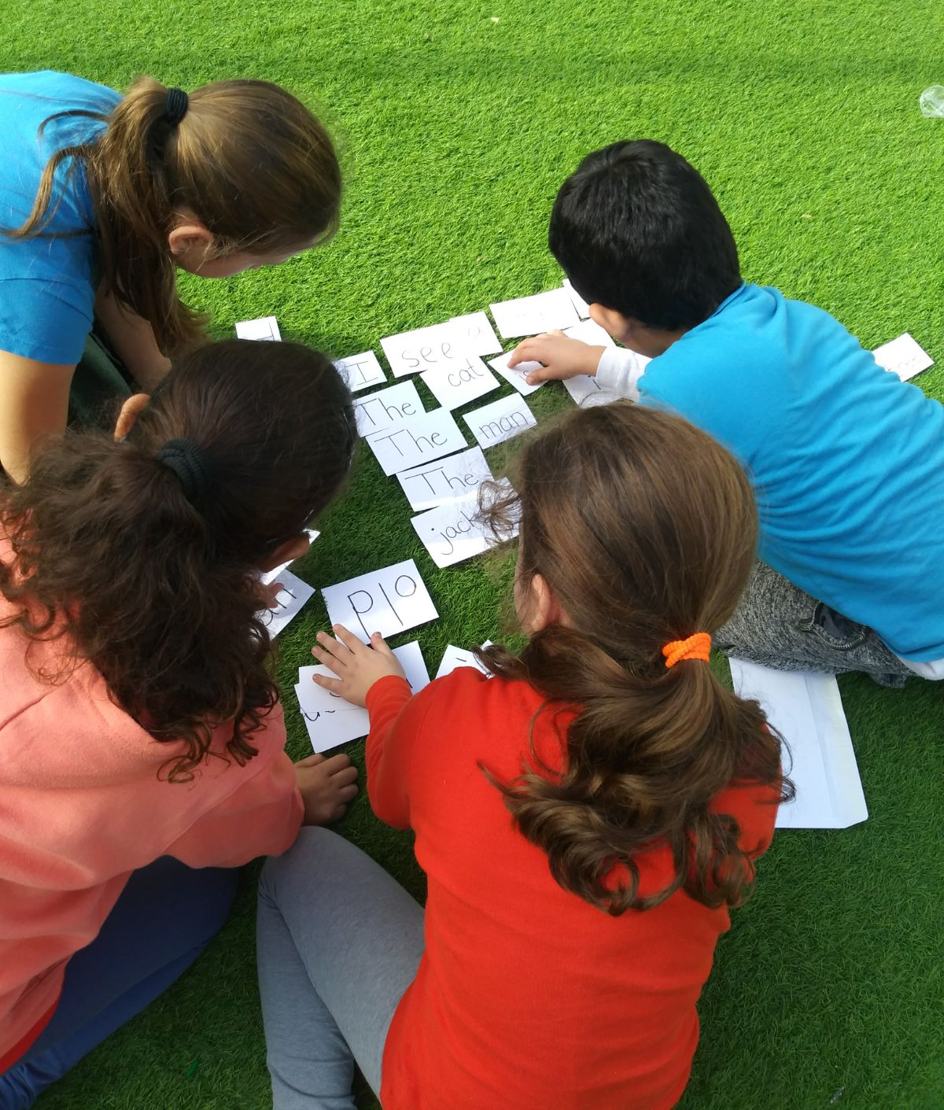
Advantages of Co-Teaching (continued)
Differentiation
  Ability to meet students at their current levels.
  Address different learning styles and intelligences
  Meeting students’ emotional and behavioral needs
Flexibility
  Ability to change plans if needed
  Pull out small groups
  Differentiated tasks
  Save time in transitions

Slide 20
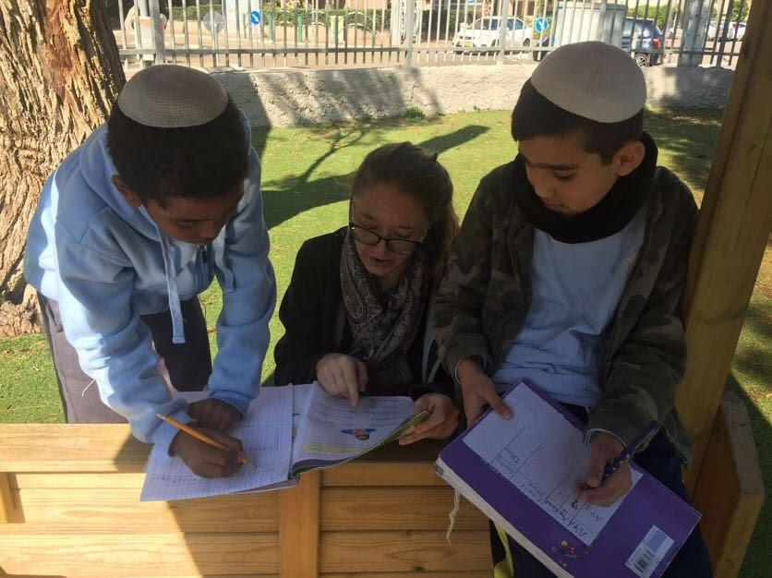
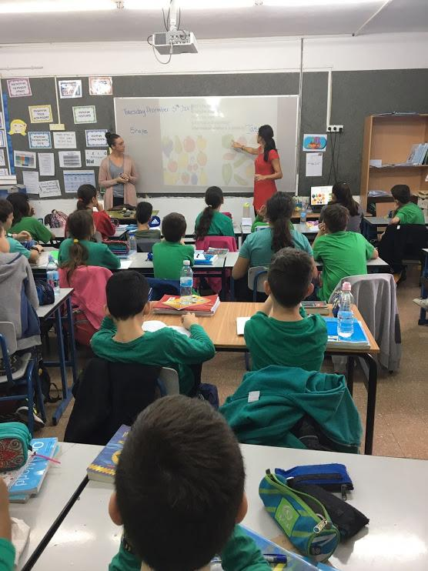
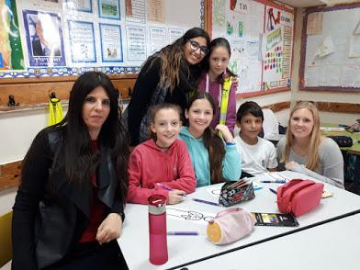
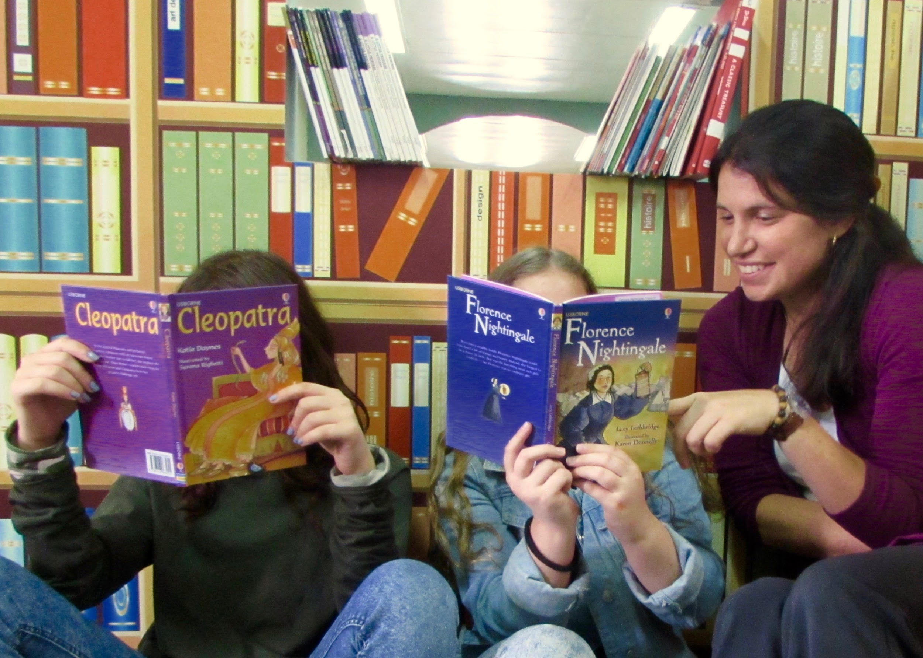
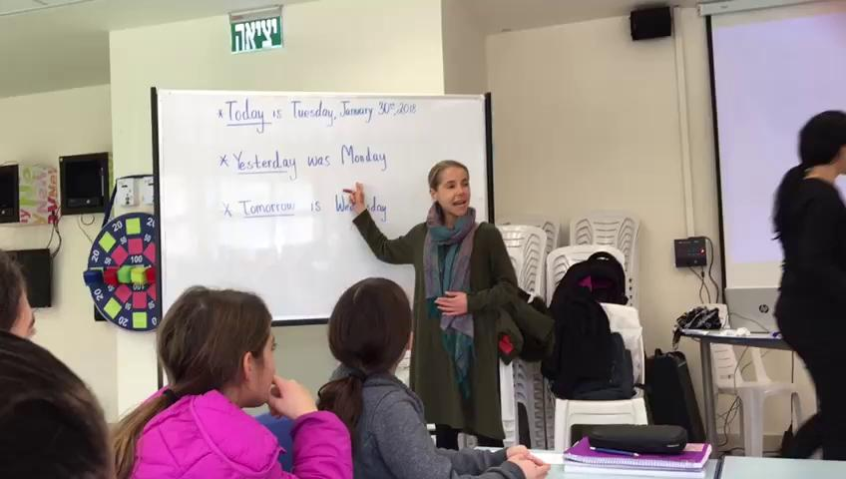
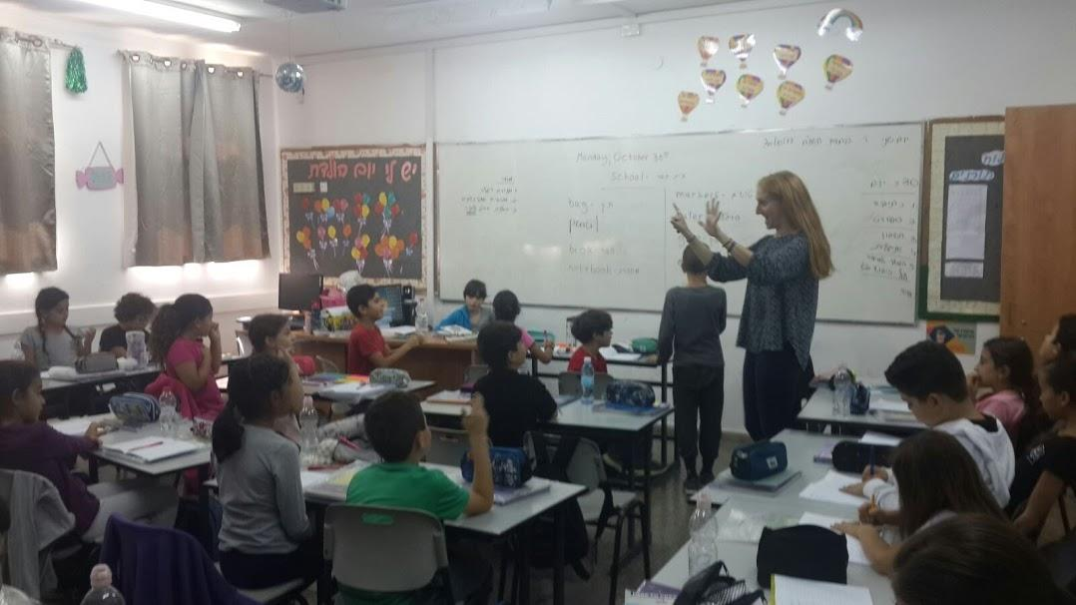
Individualized Instruction
Collaboration & Shared Responsibility
Strong Teacher-Student Rapport
Different Viewpoints
Dependability & Teamwork
Effective Classroom Management
Whole Classroom Engagement

