Slide 1
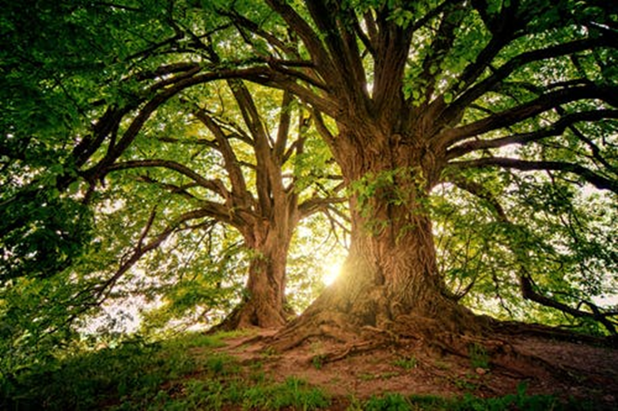
The Holiday of the Trees
Tu B’Shvat

Slide 2
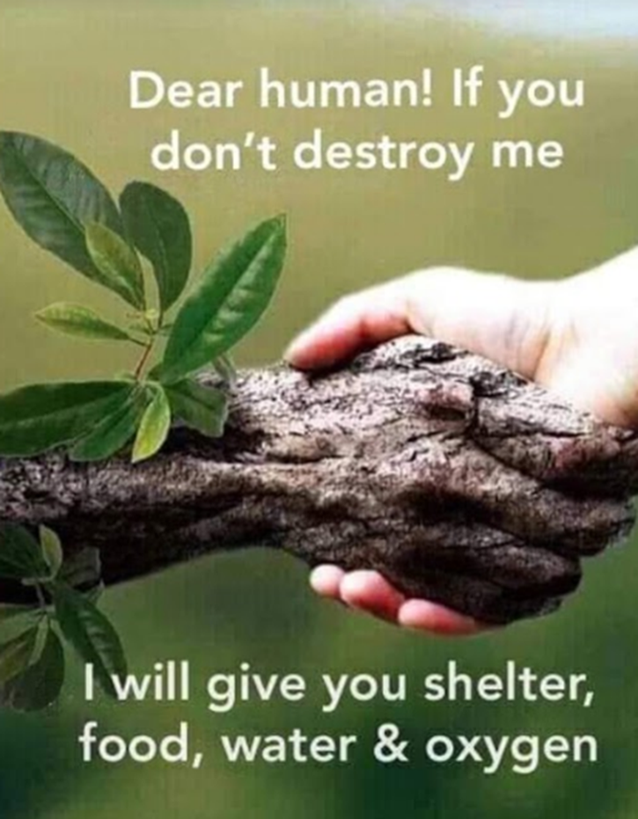
What do you think of this picture?
Notes:
Please
Think of questions that are simple in the beginning and more complex at the end. Do you see a tree? Do you see a man, boy, woman, girl?

Slide 3
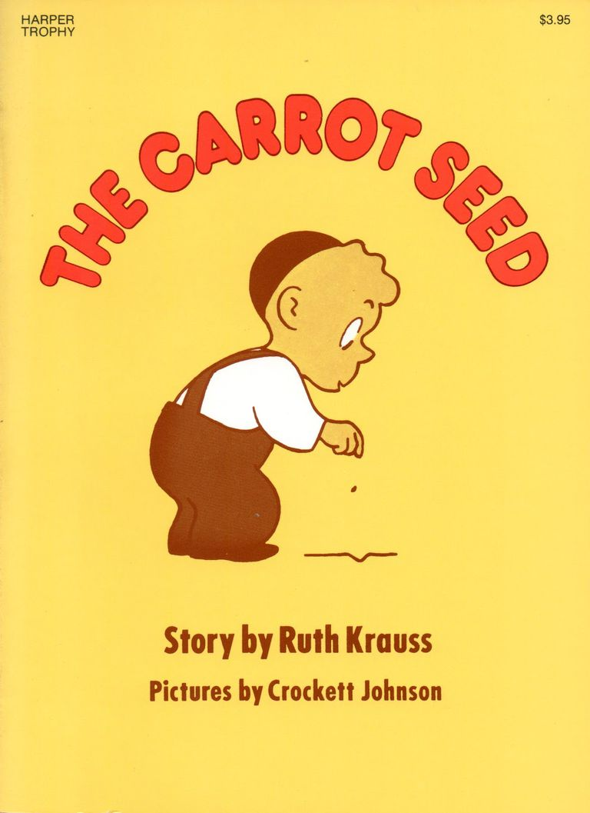
Story
The Carrot Seed
By Ruth Krauss
Play the story read aloud from Mrs. Clark’s Reading Corner on YouTube:
https://www.youtube.com/watch?v=t_bKqYUc-2M

Slide 4
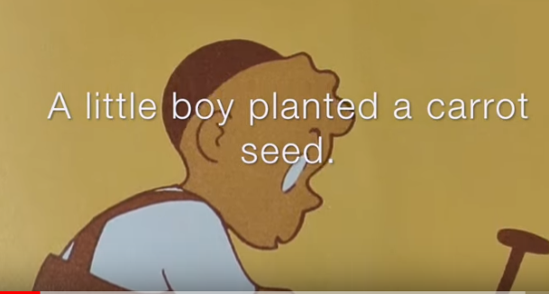
Planted-שתל carrot seed-זרע של גזר

Slide 5
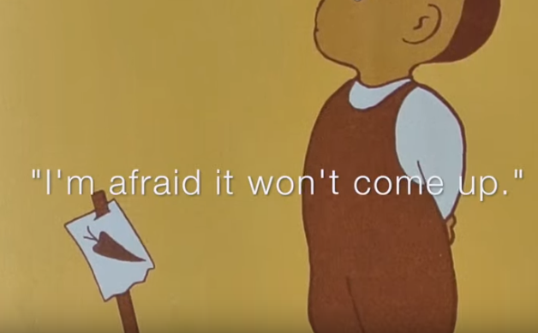
I am afraid-אני חושש/ת come up-יצא

Slide 6
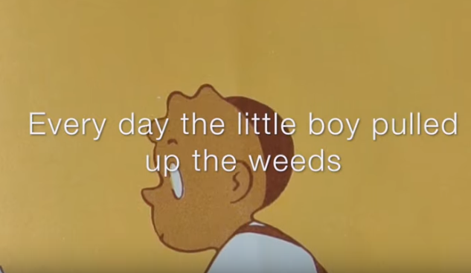
Pulled up-משך weed-עשבים

Slide 7
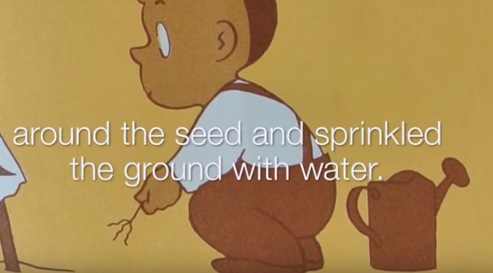
Sprinkle-לזרזף ground-אדמה water-מים

Slide 8
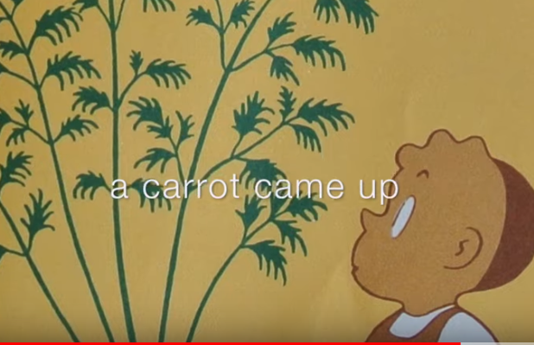
Came up-יצא

Slide 9
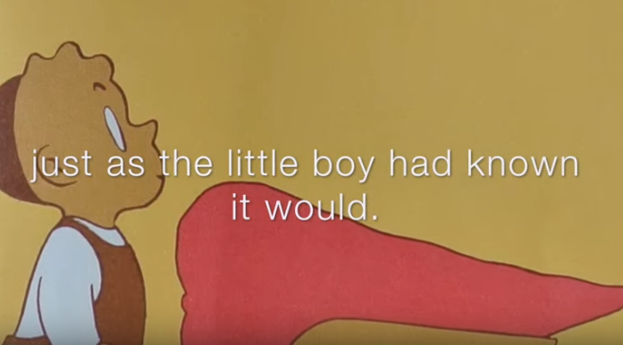
Had known-ידע תמיד it would-שיהיה

Slide 10
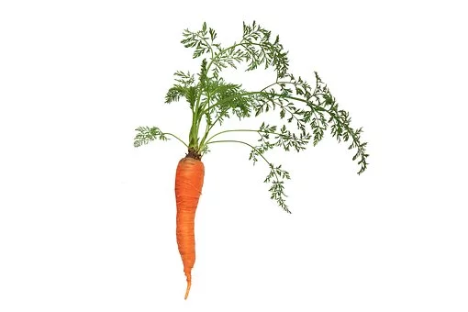
What is the message of the story?
1. Sometimes a little boy knows…
2. Don’t give up hope.
3. Work for what you believe in, even if people tell you otherwise.
4. ? Student answers…

