Slide 1
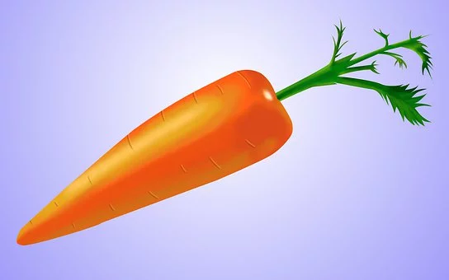
The Carrot Seed
Group Work in Class

Slide 2
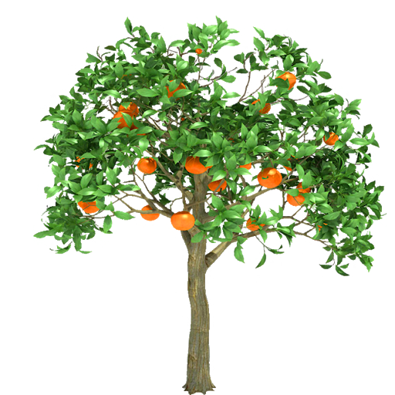
Plant a Tree
Game
https://www.facebook.com/games/orangetree/?fbs=133

Slide 3
Questions:
1) What did the little boy want to do?
2) What did the little boy’s mother tell him?
3) What did his father say?
4) What did the little boy do after he planted the carrot seed?
5) What did the brother say?
6) What did the little boy pull up every day?
7) Does the boy think the seed will grow?
8) How do you know the boy thinks the seed will grow?
9) What happened in the end?
10) What is the message (מסר) of the story?

Slide 4
Questions with Answers:
1) What did the little boy want to do? He wanted to grow a carrot.
2) What did the little boy’s mother tell him? I’m afraid it won’t come up.
3) What did his father say? I’m afraid it won’t come up.
4) What did little boy do after he planted the carrot seed? He watered it and pulled the weeds.
5) What did the brother say? His brother said it won’t come up.
6) What did the little boy pull up every day? He pulled weeds every day.
7) Does the boy think the seed will grow? Yes he thinks it will grow.
8) How do you know the boy thinks the seed will grow? I know because he didn’t give up, because he watered it...
9) What happened in the end? In the end, a carrot came up.
10) What is the message (מסר) of the story? The message is don’t give up, be patient, good things come to those who wait…
Notes:
There should be additional simple questions

Slide 5
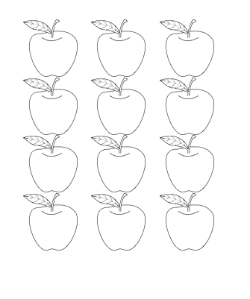
Game
Plant a Tree
Questions – SET 2
1) What is the name of the story?
2) What did the little boy want to do?
3) What did the little boy’s mother tell him?
4) What did his father say?
5) What did the little boy do after he planted the carrot seed?
6) What did the brother say?
Answers - SET 1
He pulled weeds every day.
Yes, he thinks it will grow.
I know because he didn’t give up, because he watered it...
In the end, a carrot came up.
The message is don’t give up, be patient, good things come to those who wait…
Notes:
See worksheet game and copy for each student to play. Each student gets questions and the partner’s answers.
The goal is to fill the tree with apples.

Slide 6


Slide 7
Game
Plant a Tree
Questions – SET 1
What did the little boy pull up every day? He pulled weeds every day.
Does the boy think the seed will grow? Yes he thinks it will grow.
How do you know the boy thinks the seed will grow? I know because he didn’t give up, because he watered it...
What happened in the end? In the end, a carrot came up.
What is the message (מסר) of the story? The message is don’t give up, be patient, good things come to those who wait…
Answers - SET 2
Notes:
See worksheet game and copy for each student to play. Each student gets questions and the partner’s answers.
The goal is to fill the tree with apples.
Please add answers

Slide 9
Answer Key - Write the words in Hebrew:
seed :________________
come up: _____________
water: ________________
plant:________________
know: ________________
6. sprinkle: _________________
7. afraid: ___________________
8. ground: __________________
9. weed: ___________________
10. will not - won’t: _____________
11. pull: _____________________

Slide 10
Words for the memory game:
water pull
seed weed
plant ground
come up afraid
sprinkle know
won’t brother
mother father
carrot mother

Slide 11
Words for the memory game:
water | pull
carrot | seed
weed | mother
plant | ground

Slide 12
Words for the memory game:
come up | afraid
sprinkle | know
brother | will not - won’t
mother | father

