Slide 1

Proactive Teaching Strategies
MITF Webinar October 2020

Slide 2
Teaching Strategies

Slide 3
Think about your most recent teaching challenge
Think about a situation that could occur, one that tends to test your intent to remain calm and effective.
Now, put yourself in that situation as though it were live and happening right in front of you
You’ve just come upon that situation, just walked in the door of your classroom, and here’s a challenge staring you in the face.

Slide 4
Think about your most recent teaching challenge
Think about a situation that could occur, one that tends to test your intent to remain calm and effective.
Now, put yourself in that situation as though it were live and happening right in front of you.
How did you handle it?
Were your actions proactive or reactive?
Did you look at all angles of the situation?
How did you treat the people involved?
What would you do differently next time?

Slide 5
Padlet Write & Share
https://padlet.com/mattgig/grammarsongs

Slide 6
Pedagogical Support Model
Pedagogical Program Support
We are going to be talking about 4 main aspects in field
Notes:
Hanny

Slide 7
Pedagogical Support Model
Students
Fellows
Host Teachers
School
Pedagogical Support/Digital Toolbox
Notes:
Hanny

Slide 8
Pedagogical Support Model
Fellows
Students
Pedagogical Support/
Digital Toolbox
Host
Teacher
School
Notes:
Hanny

Slide 9
Pedagogical Support Model
Host teacher
Tips with host teacher:
Google form (LINK)
WhatsApp
Phone call
Contact your host teachers (in the beginning of the week).
Notes:
Hanny

Slide 10
Pedagogical Support Model
School
Proactive ideas in school:
Project initiate be more involved in school like:
Read-a-thon
Padlet competition -uploading reading parts reading
Spelling bee competition contest
Offer your services to come to school to offer lessons small groups to help in the school (LD students)
Pedagogical support/Digital Toolbox
Notes:
Hanny

Slide 11
Pedagogical Support Model
Fellows
Suggestions to engage students in a lesson with students 1-2 or group:
Use engaging interactive lesson suggest to include:
Youtubes
On-going project over time building something
Songs, most successful = work on vocabulary - can see progress - can measure progress - play, wrote, sing, dance, repeat, then see that they can use the words independently - then feel like you are teaching and students are working - google form to teachers
See Sample: LINK
Notes:
Hanny

Slide 12
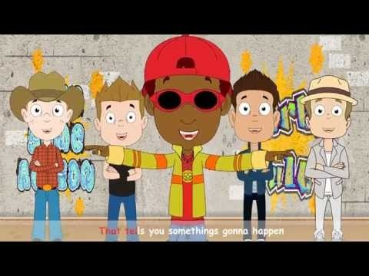
Engage Students with Songs
Vocabulary
Recognition
Repetition
Production
https://youtu.be/GDb5LboBieY

Slide 13

Songs to teach Grammar
https://youtu.be/UrrMEex1_lg

Slide 14
Pedagogical Support Model
Students
Fellows
Host Teachers
School
Pedagogical Support/Digital Toolbox
Notes:
Hanny

