Slide 1


MITF
Pedagogical Development Seminar
Oranim Academic College of Education
Notes:
My name is Hanny Fuks. I am the English Pedagogical Advisor and Digital Toolbox Manager. I would like to take this opportunity to thank the Oranim International School staff and all the Masa staff members who have worked intensively in order to launch this Digital Toolbox for you.
Toolbox
My session will be devoted to the MITF Toolbox.

Slide 2

Greetings and Welcome & Introduction to the Seminar

Slide 3
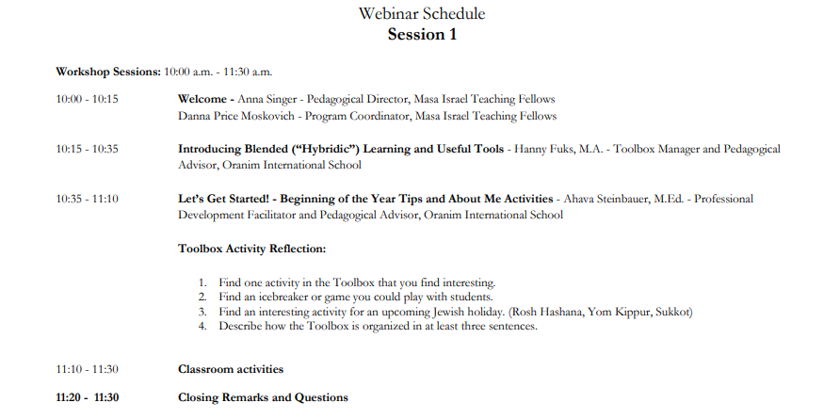
Webinar Schedule

Slide 4
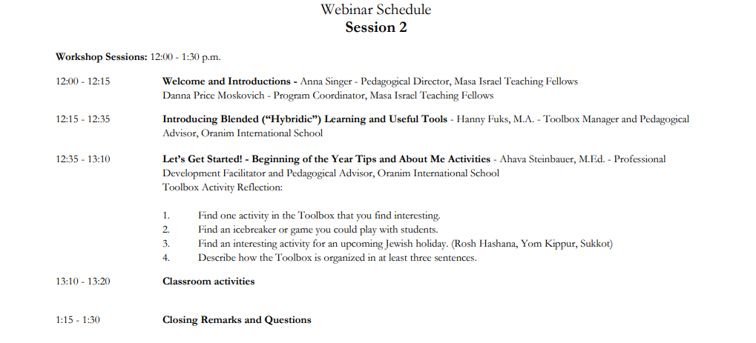
Webinar Schedule

Slide 5

Icebreakers and Engaging Activities
Online Ice Breakers
https://wordwall.net/community?localeId=1036&query=ICE%20BREAKER
Ice Breakers
https://www.teachervision.com/teaching-strategies/icebreakers
Chinese Whisper - Words
Chinese Whispers - Movements
https://www.youtube.com/watch?v=SZMg5JyL0fc
https://www.teachervision.com/teaching-strategies/icebreakers
https://www.snacknation.com/blog/boost-productivity-meetings-icebreakers-games/

Slide 6

Agenda
Welcome
Getting to Know You
Presentation Rationale
Bitmoji Virtual Classroom Tools
Plan and Organize Digital Tools
Virtual Teaching
Synchronous Vs Asynchronous
Blended Model
Sample Blended Reading Lesson
10.Beginning

Slide 7
Covid-19 disrupted face-to-face education in Israel for a few months. This situation is still relevant across the globe and teachers everywhere are still struggling to create meaningful virtual learning experiences for students.
This presentation serves as an overview of technologies and suggestions for those who would like to introduce virtual teaching tools and strategies in their everyday teaching of EFL, especially in the field of reading acquisition.

Slide 8

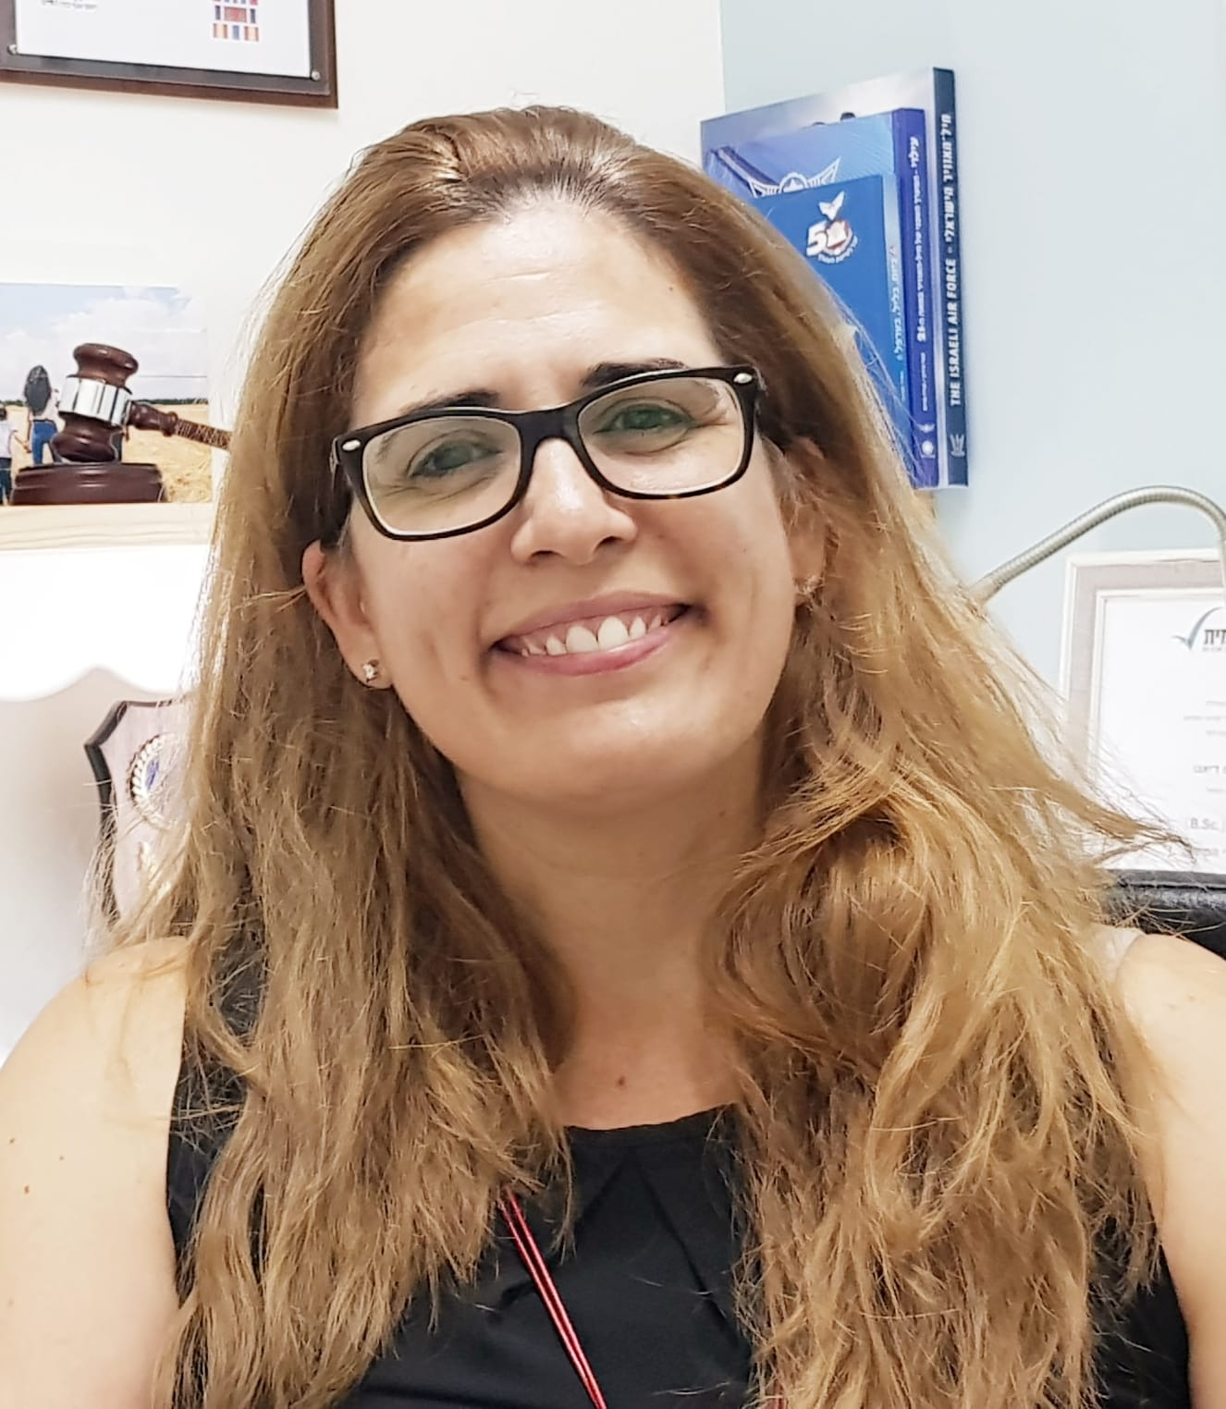















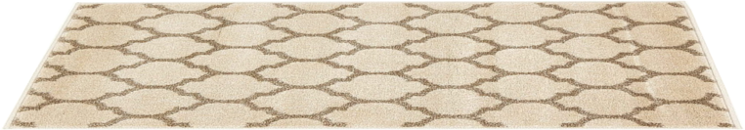


Created by Mandi Still
Notes:
Redesign the room and add your Bitmoji and personal items. The next several slides can be redesigned and then shown to the students with this one as an introduction.

Slide 9
















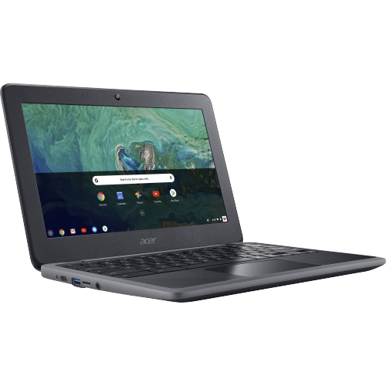




Virtual Classrooms

Slide 10
Can you define virtual teaching?

Slide 11
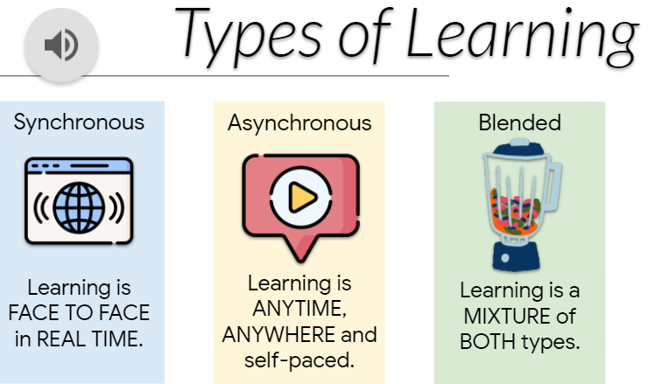

Can you think of different types of online teaching?

Slide 12
Synchronous i.e. ZOOM
Blended Learning
Asynchronous
Synchronous
Asynchronous
Face-to-Face
Conventional Classrooms
Picciano, A. G. (2009). Blending with purpose: The multimodal model. Journal of asynchronous learning networks, 13(1), 7-18.

Slide 13
Synchronous learning
Synchronous learning occurs in real-time.
This type of learning can be virtual or face-to-face.
Tips for Virtual Lessons: https://drive.google.com/file/d/1_136v9xu4wo237bWQX6IMrvpdiABAuAu/view?usp=sharing
Notes:
An example is an online meeting taking place live while you are presenting materials and activities to students. This could involve:
Simple phone calls
Whatsapp calls (you can share links etc…)
watching a live web stream (live webinar) of a class while simultaneously taking part in a discussion.
Instant messaging
Zoom - multi participants online at the same time.
For our students who are learning English, it is important to make sure that the interaction is meaningful and allows for feedback from you and that they produce language.
With synchronous learning, learners can receive immediate feedback from their fellow students or teacher through instant messaging. This would occur using a “web conferencing tool” such as

Slide 14
Asynchronous learning
Asynchronous learning occurs through online channels without real-time interaction.
Can you think of some examples?
Notes:
An example is when you provide a scripted lesson which could be a Sway presentation, a PowerPoint or Google Slides Presentation (could be with audio) that gives access to various activities, games and/or lessons that can be done independently.
In this case, again we have several options.
We can send lessons to students and you can then give them spoken or written feedback.
Students can self-monitor or have their work reviewed by the instructor afterward.

Slide 15
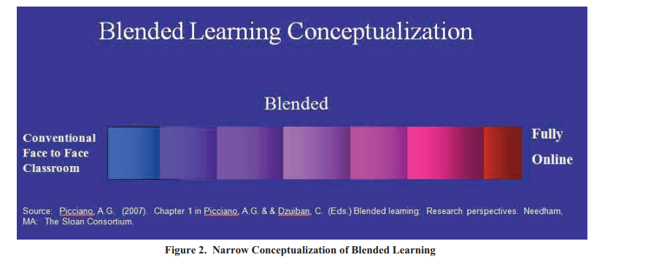
Blended Learning
Picciano, A. G. (2009). Blending with purpose: The multimodal model. Journal of asynchronous learning networks, 13(1), 7-18.
Notes:
Blended Teaching can be lessons/curriculums that integrate online with traditional face-to-face class activities in a planned, pedagogically valuable manner, where a portion (institutionally defined) of face-to-face time is replaced by online activity .
(Picciano, A. G. (2009). Blending with purpose: The multimodal model. Journal of asynchronous learning networks, 13(1), 7-18.)

Slide 16
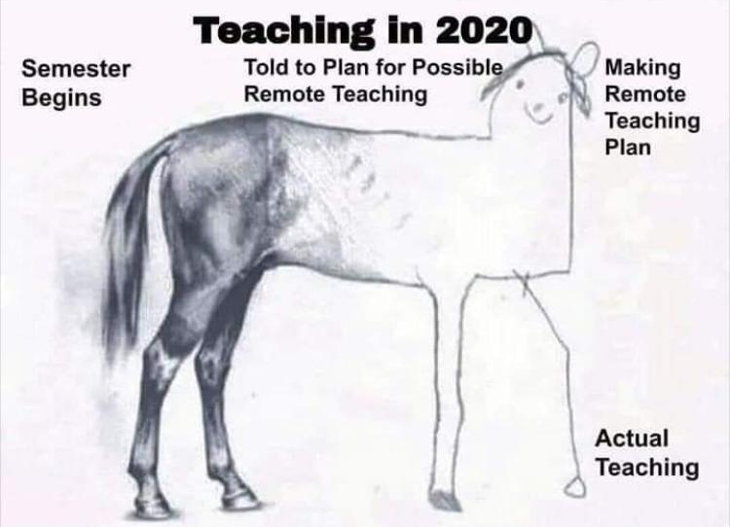
Can you think of advantages and disadvantages of virtual teaching?
Picture retrieved from: https://medium.com/groklearning/5-tips-to-embrace-teaching-digital-technologies-remotely-4dca12646854

Slide 17
Blended Learning and Teaching
ASB Virtual Learning - We are ready. American School of Bombay
https://www.youtube.com/watch?v=mmfznhCZxgI

Slide 18

Blended Teaching Planning
Less is more!
Efficient Planning is one of the key for success.
Find ways to connect with your students giving meaningful feedback.

Slide 19

ASSESSMENT? HOW?
Beginning
During
End

Slide 20
Blended Teaching Planning
Reading Program – Sample Lesson

Slide 21






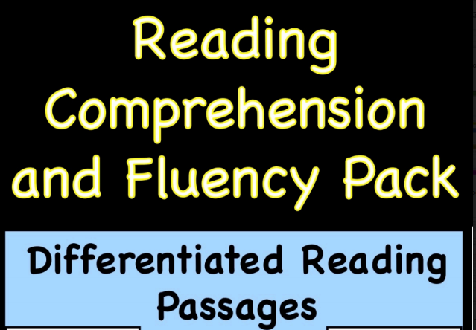






Click on…
One of the letters:
Learn
Practice
Play
One of the books:
Read
Listen
Play
Learn new words and practice
Phonics Reading Approach
Hickey Method

Slide 22


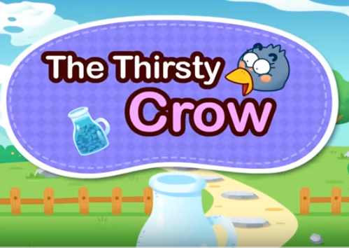







A Rainy Day Activity
The Thirsty Crow Activity
Robin Hood Activities

Slide 23





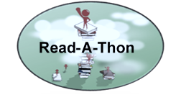








Great reading project!
Elementary , JHS and High School.
Discover Unite Digital World Books
Click on one of the Geodes books on the bookshelf to listen to it read aloud.
Notes:
Unite Books are short, colorful, and easy to understand with picture/text format and narration in home languages. New books and languages are added every month.
Spread the Words
Unite Books have been read more than 15 million times, in every county of the U.S. and most countries of the world. As our readership grows, we are adding ever more diverse content and narrations to help families everywhere “see” themselves in the pages, celebrate their identities, cultures and home languages, and grow a love of reading. Our goal is to partner with schools, communities, and families to create picture book abundance for all.
Please join us!

Slide 24





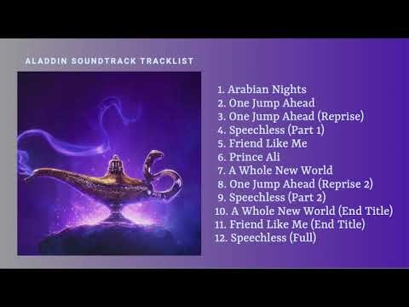
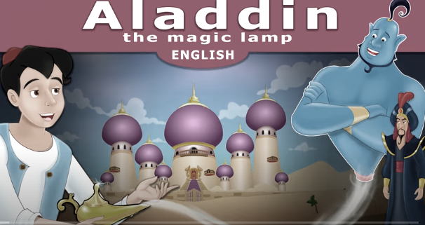





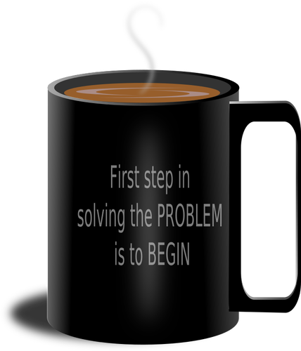

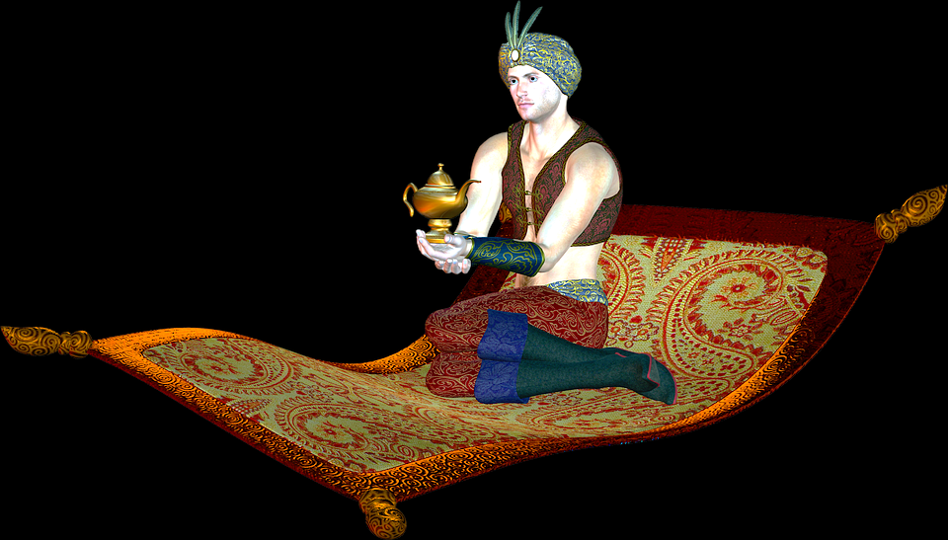


Songs
Video Book
Live Worksheets Click and Share
Aladdin Unit
Downloadable Booklet

Slide 25
Digital Tools & Resources
 | Tool | Aim
1 | Padlet | sharing ideas expressing opinions in a shared way.
2 | mentimeter https://www.mentimeter.com/ | Interactive platform - surveys/word clouds
3 | Google Docs | sharing, collaborating, joint projects / papers joint documents
4 | Crossword puzzle maker https://worksheets.theteacherscorner.net/make-your-own/crossword/ | Make free crossword puzzles to review vocabulary items or any other terms.
5 | vizia https://vizia.co/ Edpuzzle https://edpuzzle.com/ | interactive use of video clips - enables the addition of questions / reactions at specific points in the clip
6 | Quizlet https://quizlet.com/ | Great for recycling vocabulary

Slide 26
Play / Create Online Games
When creating virtual learning activities these are the things to take into consideration:
What is the level? (who are the students?)
What is the aim of the activity? (writing, reading, speaking, listening)
What is the topic?
What is the vocabulary/text?
https://www.youtube.com/watch?v=YKULhMUnG8o
https://www.crazygames.com/t/build
https://larryferlazzo.edublogs.org/2008/04/21/the-best-websites-for-creating-online-learning-games/
https://www.mes-games.com/
https://eslactive.com/interactive/
http://roomescapemaker.com/v1
https://wordwall.net/myactivities
https://games4esl.com/powerpointgames/
https://www.liveworksheets.com/

Slide 27

Games to Supplement Textbook Tasks
Introducing game strategies for vocabulary teaching, grammar, reading comprehension and oral interaction
https://mitf.masaisrael.org/mod/book/view.php?id=566

Slide 28

Promote Speaking in Your Class
Theory and English speaking activities

Slide 29
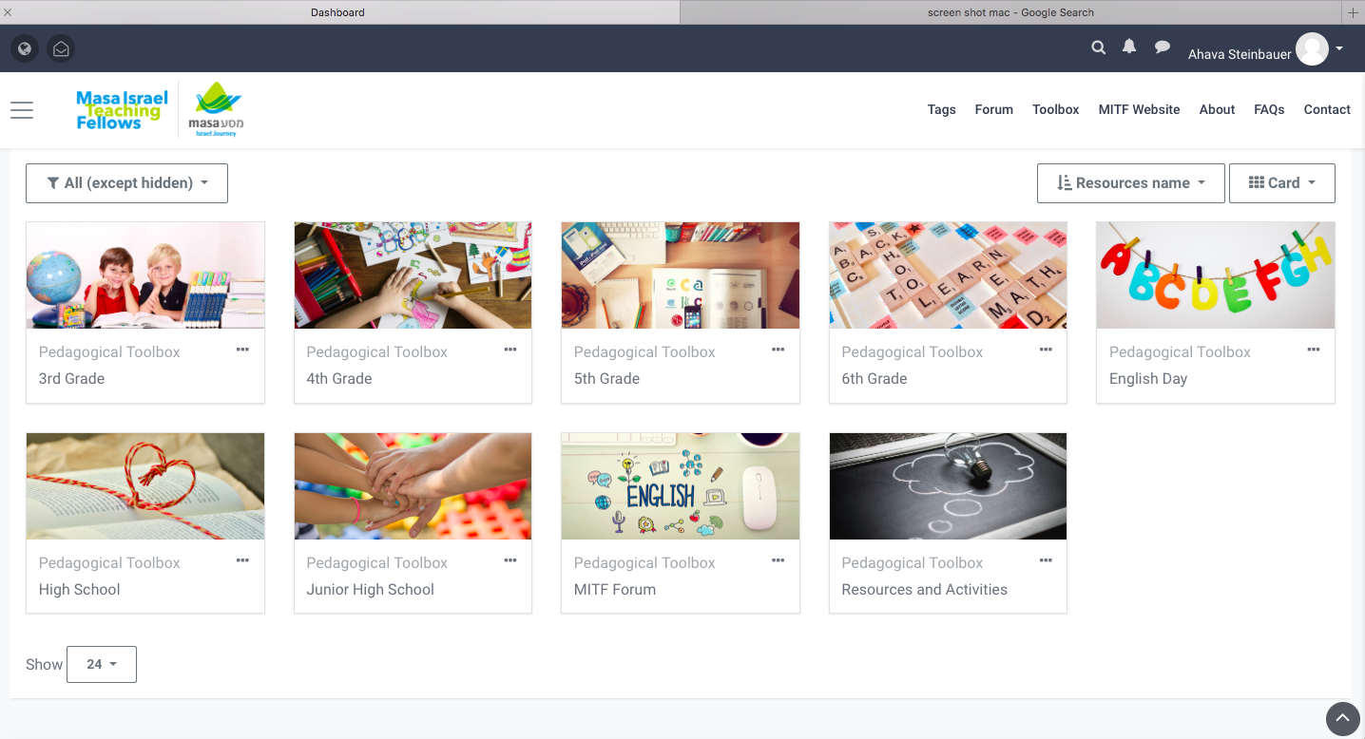
Pedagogical Support andDigital Toolbox
Active Learning - Favorite Fun Activities
Hanny Fuks, M.A.
Ahava Steinbauer, M.Ed.
Tal Alon

Slide 30

ROSH HA’ASHANA
https://mitf.masaisrael.org/mod/book/view.php?id=347&chapterid=329
More Activities

Slide 31

Seminar Summary

Slide 32

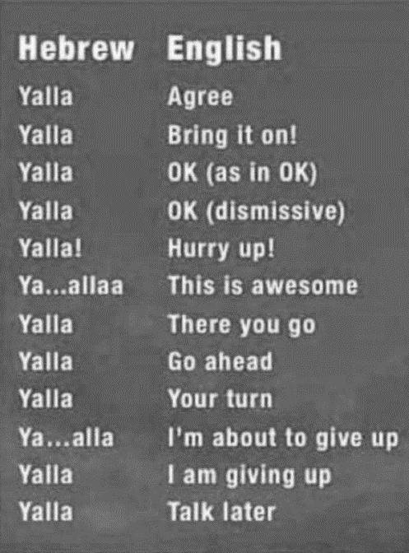
Hebrew Slang Intonation and Meaning

Slide 33



We wish you a great year!

