Slide 1
Tips and Tricks for Engaging Students Online
Ahava Steinbauer
MITF Webinar March, 2020

Slide 2

SET Up Your Space

Slide 3
Presenting an Online Activity
Tip 1: Provide active learning opportunities to increase opportunities for engagement
Use interactive slides, games, and videos...

Slide 4
Presenting an Online Activity
Tip 2: Make learning social and provide timely and useful feedback
Verbally - Say “yes, that’s right, good effort…, Let’s try that again together…”
Nonverbally - look at camera, nod your head

Slide 5
Presenting an Online Activity
Tip 3: Pause often to check for understanding
Say, “Do you have any questions?”
“Can you repeat back to me what you’re supposed to do?” Can you tell me one thing you just learned?”
Give sentence starters for younger students: What did you learn today. “Today, I learned about… ___________”

Slide 6
Presenting an Online Activity
Tip 4: Break up content into smaller chunks.
Provide 3-4 five-minute mini-lessons.
Create movement breaks: Movement Break
Assign activities students can do on their own after the session.
Tell them what they should practice at home.

Slide 7

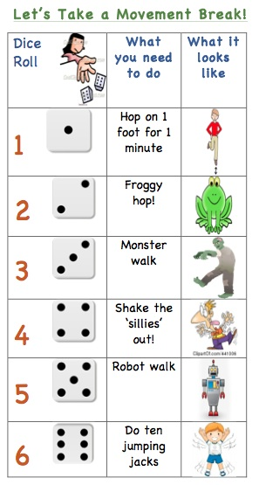
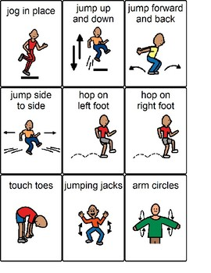
Place your screenshot here
Movement breaks:

Slide 8
Interactive Online Lesson Example
Interactive Activities for 4th - 6th grade:
Link: What do you do in your free time?

Slide 9
Hyperdoc
What’s a HyperDoc?
Interactive Google Doc replacing worksheet method of delivering instruction
Puts a digital lesson into your student’s hands
Link: Hyperdoc - Hopes and Dreams
Link to 500 Free HyperDocs

Slide 10
Record and Read a book aloud to your students:
Goldilocks and the Three Bears
Read by Ahava Steinbauer
📖

Slide 11
This is a link to many books to record and read aloud.
Level A PDF books
📖

Slide 12
Free Video Recording Tool
“Screencastify” (Tutorial)
FREE UPGRADE Visit this page and click "Redeem coupon" (under the Next Billing Date) -- Enter code CAST_COVID -- Click "Activate License" (no credit card required).
Ignore the Next Billing Date (and the bill) - that will be incorrect
  Download Video as MP4 (How-To)
  Master the Screencast Lessons

Slide 13

Helen Gottstein “Loud and Clear”
Video: Five Things to Avoid When Communicating Online

Slide 14
questions?

