Slide 1
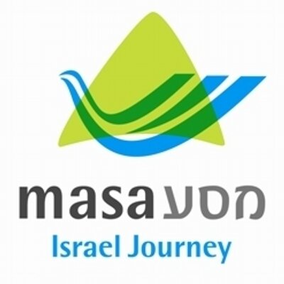
Introduction to
MITF Teachers’ Track
Your Role in the Israeli Classroom

Slide 2
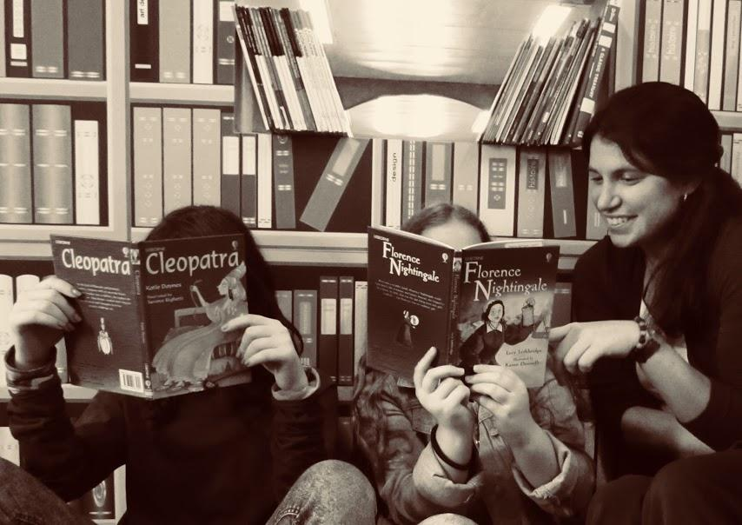
Courtney Roy
MITF Teacher’s Track & Community Coordinator
Background:
  Originally from Canada; Moved to Florida with parents.
  Hon. B.S. in Exceptional Education & Psychology (UCF)
  MPhil in Research of Second Language Education (Cambridge)
  Certifications in TEFL, ESL, Reading & Special Ed.
  Published studies on language acquisition in U.S. and Africa
Taught K-12th Grade; all primary subjects, learning strategies, career development, remedial mathematics, reading, and ESL.
Pilot Teacher’s Track (2017-2018) in Be’er Sheva.

Slide 3
My Responsibilities to You
Supervising your journey and experiences in host school.
  Your “go-to” for all professional-related questions.
  Responsibilities; Days-Off; In-School Projects; etc.
Organizing professional development workshops.
Coordinating educational events and activities for all Fellows
Surveying all Fellows needs and finding solutions.
Collecting great stories -- I want to know the exciting things you’re doing!
Phone: 058.603.9535 Email: courtneyr@masa.israel.com

Slide 4
Major Differences I Saw In Israeli Schools
Students are given more freedom to “release” their energy.
Lining up? Mah zeh?
  Only use them when entering a library/computer room or for productions.
Children will often self-advocate vocally or with gestures.

Slide 5
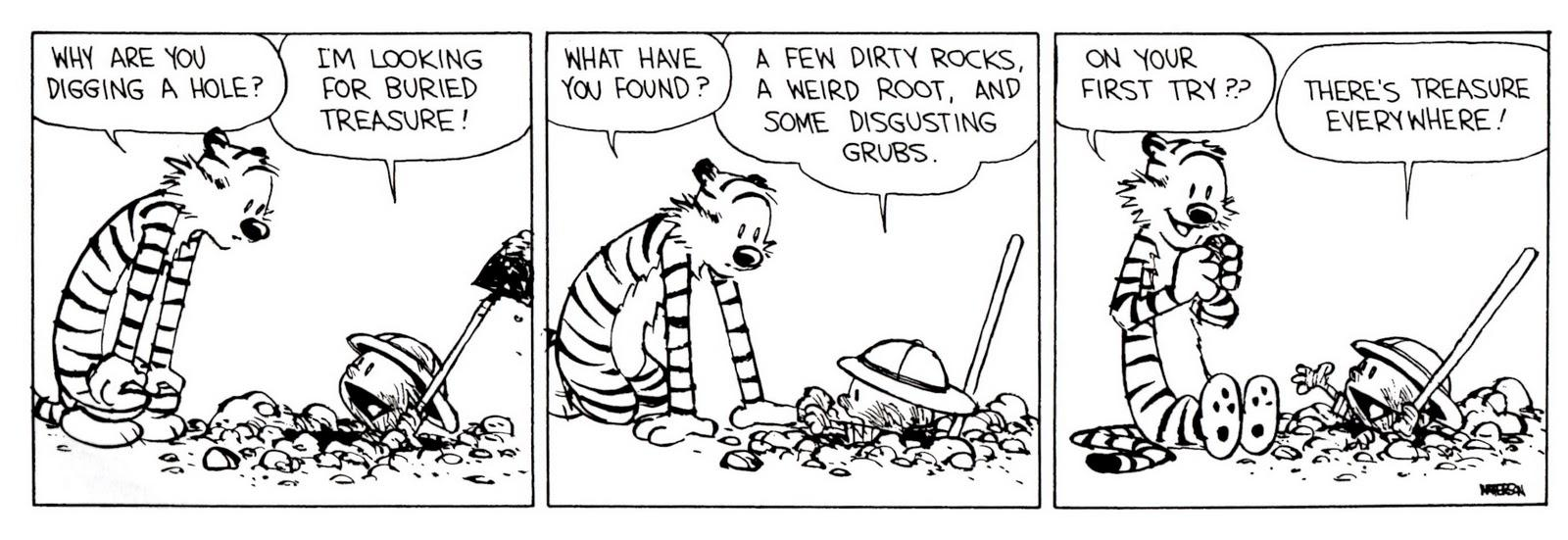
Expect the Unexpected!

